Slide 1
Social Security: With You Through Life’s Journey
Produced at U.S. taxpayer expense

Slide 2
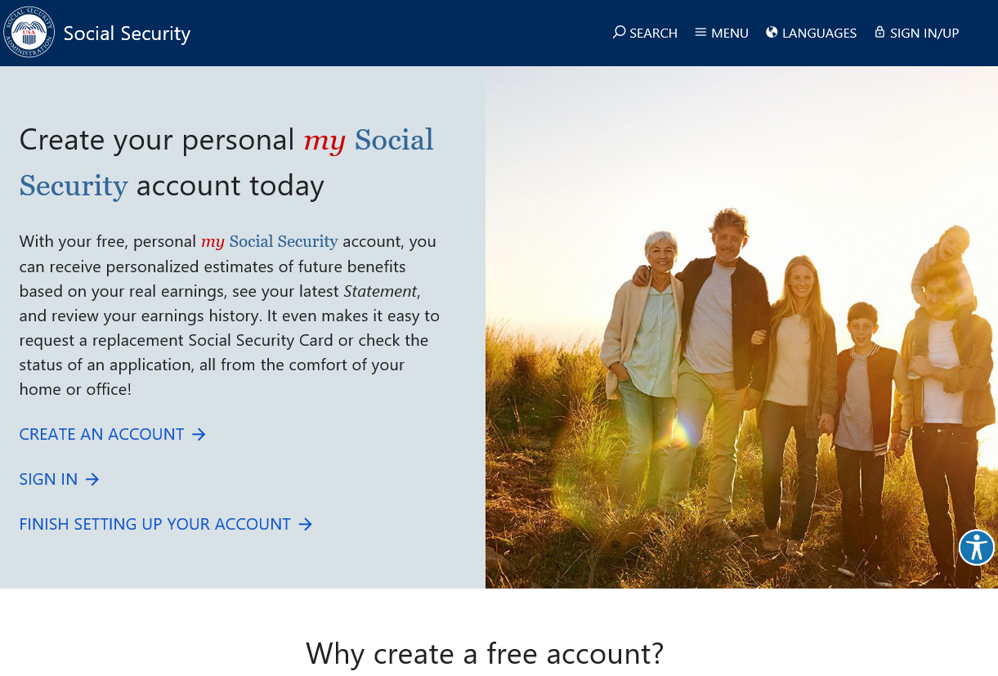
my Social Security
socialsecurity.gov/myaccount

Slide 3
my Social Security Services
Review your Social Security Statement annually
In some states, request a replacement Social Security (SSN) card
Check the status of your application or appeal
Get a benefit verification letter for proof of income
Change your address, phone #, or direct deposit info
Get a replacement SSA-1099 for taxes
Get a replacement Medicare Card

Slide 4
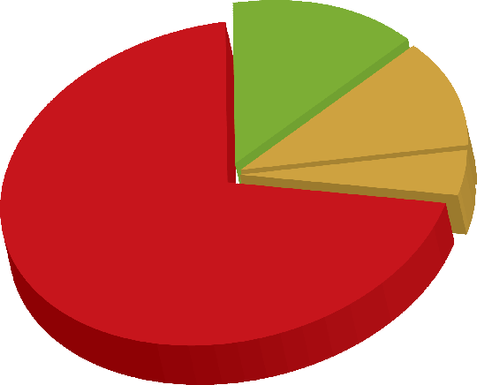
Over 63 Million Receiving Benefits
(Over $940 Billion Per Year)
8.7 M Disabled
1.7 M Dependents
6 M Survivor Spouses
2 M Survivor Children
42.5 M Retired Workers
3 M Dependents

Slide 5
Social Security in the Future
Social Security Trust Funds Will Be Able To Pay About 80 Cents for Each Dollar of Scheduled Benefits after 2035

Slide 6
How Do You Qualify?
By earning “credits” when you work and pay Social Security taxes
You need 40 credits (10 years of work) and you must be 62 or older
Each $1,360 in earnings gives you one credit
You can earn a maximum of 4 credits per year
Note: To earn 4 credits in 2019, you must earn at least $5,440.00.

Slide 7
How Social Security Determines Your Benefit
Benefits are based on earnings
Step 1 – Your wages are adjusted for changes in wage levels over time
Step 2 – Find the monthly average of your 35 highest earnings years
Step 3 – Result is “average indexed monthly earnings”
Consult your my Social Security account or the online Estimator

Slide 8
2019 Retirement Benefit Formula
If your lifetime average monthly earnings = $5,700
Then your monthly benefit = $2,340
90% of first $926 in earnings…………………….$926 = $ 833
32% of earnings ($5,583 - $926)..…………... .$4,657 = $1,490
15% of earnings over $5,583............................. $117 = $ 17
$ 5,700 $2,340
*Payments rounded to whole dollar amounts

Slide 9
Year of Birth | Full Retirement Age (FRA)
1943-1954 | 66
1955 | 66 and 2 months
1956 | 66 and 4 months
1957 | 66 and 6 months
1958 | 66 and 8 months
1959 | 66 and 10 months
1960 + | 67

Slide 10
What Is the Best Age to Retire?
Age You Choose to Start Receiving Benefits
Note: This example assumes a benefit of $1,000 at a full retirement age of 66
Notes:
gov/pubs.

Slide 11
Social Security Spouse’s Benefits
Born after 1/1/1954? Must apply for your own benefit first
Earliest Age: 62 (reduced payment)
Spouse payment rate: up to 50% of worker’s full benefit amount (does not reduce payments to worker)
Divorced Spouse: 10-year marriage and single (former spouse not required to apply for own benefit, at least 62)
Calculation: If own full benefit is less than 50% of the worker’s full benefit, then benefits are combined

Slide 12
Spouse Benefit Computation
Kelly’s own Full Retirement Age (FRA) benefit = $800
Kelly’s spouse/Ex-spouse FRA amount = $2,000
$1,000 Kelly’s max spouse benefit (50% of $2,000)
- $800 Kelly’s own FRA benefit
$200 Kelly’s spousal payment
Kelly's spousal benefit ($200) is added to Kelly’s own FRA benefit ($800) for a total benefit of $1,000

Slide 13
Survivor Benefits
Full survivor benefit at Full Retirement Age – (payments reduced if deceased worker received early retirement); or
At age 60, receive 71.5% of deceased’s Full Retirement Age benefit; waiting increases payment amount; or
If disabled, receive as early as age 50; or
Caring for minor child of the deceased who is under age 16
Surviving Divorced Spouse: 10-year marriage required
Must be unmarried unless remarriage after age 60 (50 if disabled)

Slide 14
Medicare
Eligibility
Age 65
ALS
Kidney failure
After 24 months of SSDI

Slide 15
Applying for Benefits
3 options available:
Online at SocialSecurity.gov
By phone 1-800-772-1213
At our office (call for appointment)
You choose the most convenient option for you.

Slide 16
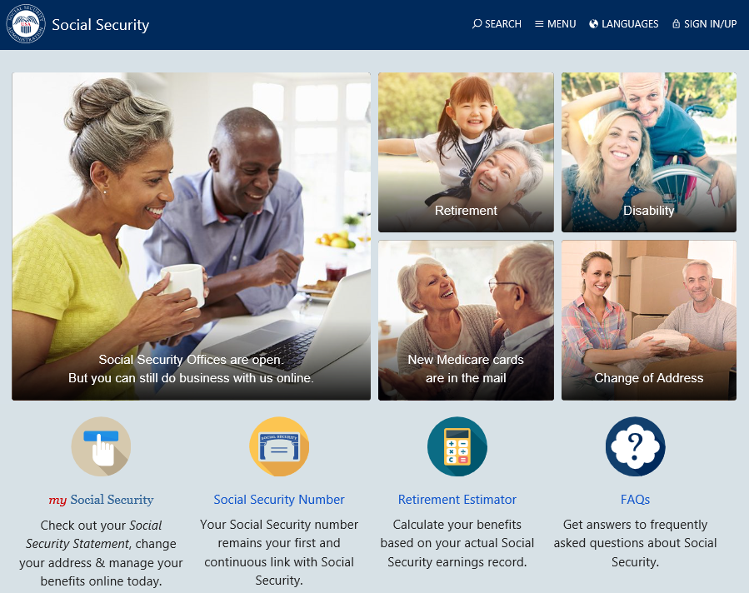

Slide 17
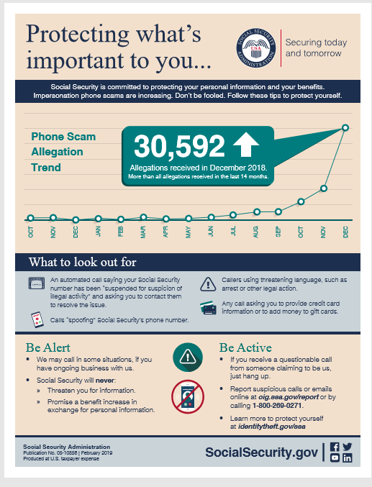
Fraud Hotline:
Call 1-800-269-0271
Need Help:
IdentityTheft.gov
Notes:
The Social Security Administration’s Office of the Inspector General continues to receive reports from across the country about fraudulent phone calls from people claiming to be from SSA.
Scam artists go to great lengths to trick you out of your personal information or money.
Here are 3 Tips to Protect Yourself:
Understand The Threats. Fraudsters use several different approaches to try to trick you. They might contact you and claim to be from SSA, the IRS, or another government agency and request your information. They might claim that you have won the lottery or become eligible for an investment if you will pay them a fee first. They might design emails or text messages that look legitimate and request your immediate response. The most recent scam is an automated recording stating that your Social Security number has been suspended for suspicion of illegal activity, and that you must call the number provided or your assets will be frozen. If you call the number and provide personal information, the scammer then uses it to commit identity theft or some other type of fraud. Be aware of these types of schemes, so you understand when you should question the situation to guard against scams.
Exercise Caution. Generally, no government agency or reputable company will call or email you unexpectedly and request your personal information, or request advance fees for services in the form of wire transfers or gift cards. Make it your habit to verify the identity of anyone who asks for your personal information over the phone. Tell them you will respond through the entity's customer service channel. When anyone pressures you to provide information or money over the phone, it’s probably a scam and you should just hang up. Social Security does contact citizens by telephone - generally those who have ongoing business with Social Security. Social Security employees will never threaten you. If that happens, the call is fraudulent, and you should hang up immediately.
Secure Your Information. Store your Social Security card in a secure location. Don’t routinely carry it with you. Shred documents that list personal information such as your Social Security number and banking information. Avoid opening emails from unknown sources or clicking on suspicious hyperlinks. Equip your computing devices with strong anti-virus software and maintain strong passwords. Regularly check your credit reports for suspicious activity.
To report allegations of fraud, waste, and abuse concerning SSA programs and operations, go to:
www.ssa.gov/fraudreport/oig/public_fraud_reporting/form.htm or call 1-800-269-0271 from 10 a.m. to 4 p.m. E.S.T.
REFERENCE: Related fact sheet: SSA/OIG Protecting Personal Information oig.ssa.gov/sites/default/files/audit/full/pdf/PII.pdf
Source: oig.ssa.gov/newsroom/scam-awareness

Slide 18
AABD Medicaid
(Aid for the Aged, Blind and Disabled)
Presented by Laela Wilmot, Benefits Program Manager Regions 5 and 6

Slide 19
3 Types of Medicaid
Full coverage Medicaid
Covers basic medical needs
Long Term Care Medicaid
More extensive Medical needs
Medicare Savings Plans
Helps with monthly Medicare premiums

Slide 20
Basic Eligibility Criteria
Resident of Idaho
Meet citizenship or legal non-resident criteria
Meet Age or Disability Criteria
Meet income and resource guidelines

Slide 21
Residence
Voluntarily living in Idaho and have no immediate intention of leaving.
No minimum amount of time required to establish residency.

Slide 22
Citizenship
Must be a US Citizen or a Qualified Non-Citizen.
Documentation required to support Citizenship and Identity
Qualified Non-Citizens are required to provide proof in the US legally a minimum of 5 years with few exceptions.
**If receiving SSI, SSD, or Medicare = exempt from verifying citizenship.

Slide 23
Aged or Disabled
65 years of age or older
Under age 65 meeting the definition of blindness or disability
Same definition used by Social Security Administration (SSA) to determine disability
Does not require an application for SSA benefits

Slide 24
Income and Resource Guidelines
Current income limit for 2019 (updates annually):
Guidelines vary depending on type of Medicaid program applied for
$824 - $2,333 for an individual per month
$1177 - $4,646 for a couple per month
Current Resource limit:
Limit for an individual is $2000
Limit for a couple averages $3000-$2000 each (dependent on Medicaid program)

Slide 25
Potential Income
Before Medicaid can be approved, the customer must access all other income potentially available to them
Social Security (exception of Supplemental Security Income - SSI)
Other retirement payments

Slide 26
Social Security and Medicaid
SSI recipients are eligible for Medicaid no matter the amount of the SSI payment.
Recipients of other SSA payments have to have eligibility for Medicaid determined based on eligibility factors
Social Security Disability Insurance (SSDI)
Retirement, Survivors, Disability Insurance (RSDI)
Note: There are separate applications for Medicaid and Social Security Payments.

Slide 27
Long Term Care Medicaid
Home and Community Based Services
Cost less than Nursing Home
Own Home
Assisted Living
Residential Care
Nursing Home Assistance
Nursing Facility
Eligibility based on ability to care for self determined by a nurse reviewer from the Division of Medicaid.
Notes:
Income limit $2,219 ($2,199)

Slide 28
Over Income/Resource for Long-term Care Medicaid
Can set up an Income Trust also known as a “Miller Trust”
Contact Idaho Legal Aid
Contact Information: www.idaholegalaid.org
or
Request assistance from an elder law attorney
Resource Assessment for Couples
Determine Spousal Share (1/2 of countable resources verified on 1st day of continuous care)

Slide 29
Resource Spend-down
Pay for care privately
Settle personal debt
Prepay burial, for self and spouse
Other options as discussed with eligibility specialist

Slide 30
Asset Transfers
Look-back up to 5 years
Assets transferred without fair consideration
Penalty for Long-Term Care eligibility: value vs. average cost = months of ineligibility
Notes:
$5813

Slide 31
Estate Recovery
If full Medicaid is received at the age of 55 or older, any resources in an estate at time of death may be subject to recovery of medical expenses.
Lien is put on property by the State of Idaho
Never recover more than medical costs paid by Medicaid.

Slide 32
Medicare Savings Programs
Assistance to help pay the costs of Medicare
Must be eligible for Medicare
Medicare Savings Programs are not subject to Estate Recovery.
Meet income and resource guidelines
Resource Limit is $7,560 for an individual and $11,340 for a couple.

Slide 33
QMB
Qualified Medicare Beneficiary (QMB) – Income at or below 100% Federal Poverty Guidelines (FPG) = currently $1057 for individual and $1425 for couple (updates annually)
QMB benefits begin the month after approval
Pays for Medicare:
Part B premiums
Part A in some circumstances
Deductibles
Co-Pays

Slide 34
SLMB & QI
Qualified Medicare Beneficiary (QMB) – Income at or below 100% Federal Poverty Guidelines (FPG) = currently $1057 for individual and $1425 for couple (updates annually)
QMB benefits begin the month after approval
Pays for Medicare:
Part B premiums
Part A in some circumstances
Deductibles
Co-Pays

Slide 35
Expanded Medicaid
Begins January 2020
Applications accepted November 2019
Eligibility criteria
Citizen or legal non resident in the US
Resident of the State of Idaho
Between 0-138% Federal Poverty Guidelines (Household of 4 = $2961/month gross)
Between ages 19-64
Not receiving Medicare
Not eligible for other Medicaid programs

Slide 36
To Apply
Visit the local office and meet with an Eligibility Specialist
Paper application is not required
Obtain and complete an application
Pick up in the local office
Have one emailed or mailed
Download from the Department of Health and Welfare Website
Return it
Take into local office
Mail
Email
Fax
Visit idalink.idaho.gov

Slide 37
Eligibility Information
Refer to www.livebetteridaho.org to easily find information regarding eligibility for all welfare programs as well as many other resources available in the community.

Slide 38
Learn more about Medicaid and other assistance offered by the Department of Health and Welfare at:
http://www.healthandwelfare.idaho.gov
or call:
The Idaho Care Line by dialing 211

Slide 39
AN OUNCE OF PREVENTION,
WHAT IS IT WORTH?
Keeping Yourself Injury Free in Life
Tyler Billings PT, DPT, Cert. MDT

Slide 40
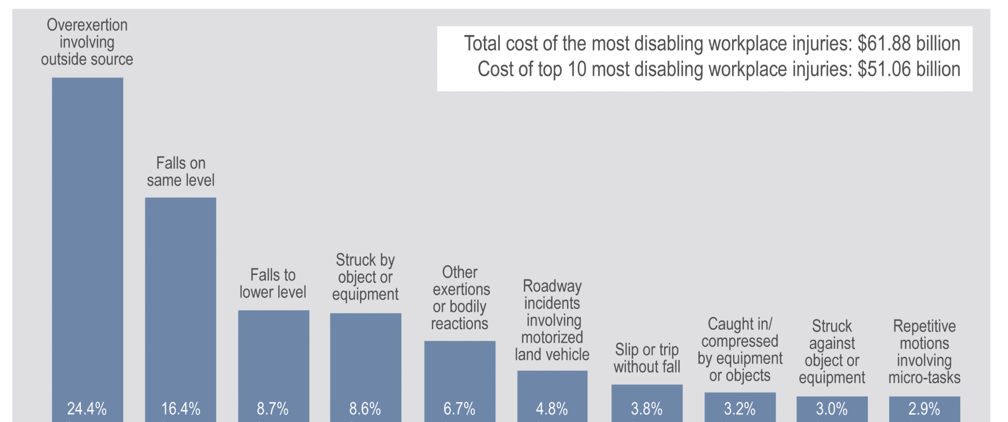
INJURY RISK
Notes:
2-24 - MVA
25-64 - Drug Overdose
65 + - Falls

Slide 41
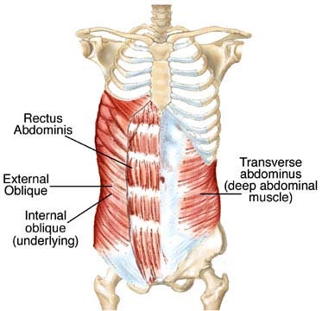
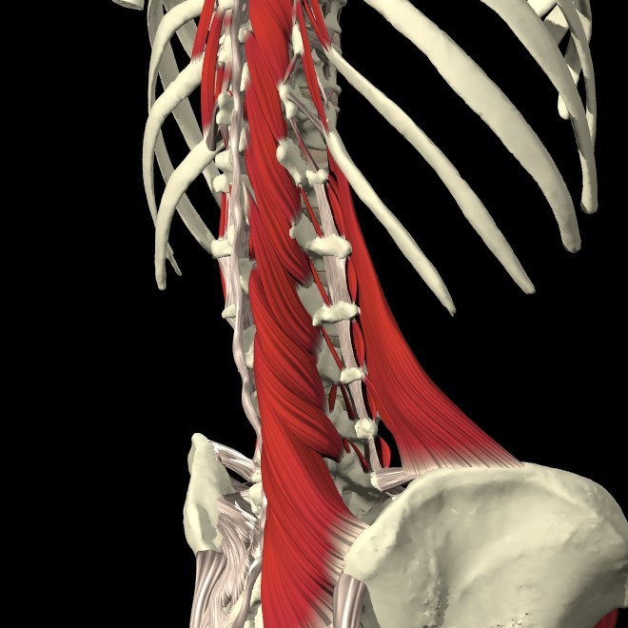
PREVENTION IS BEST
Motion is Lotion
Nerve Movement
Deep layer Strength
Habits of daily living

Slide 42
OPTIMAL LOAD

Slide 43
RISK FACTORS
Repetitive Motion
Prolonged Position
Awkward Body Position
High Loads or Forces
Poor Rest
Low Fitness

Slide 44
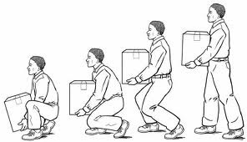
BODY MECHANICS
Plan ahead
Keep curve
Avoid twisting the back
Break it up
Avoid prolonged positions
Keep Load Close to Body

Slide 45
TOP 10 HAZARDS
Weather Conditions: Ice and Snow
Contaminants on the Floor
Indoor Walking Surface Irregularities
Outdoor Walking Surface Irregularities
Inadequate Lighting
Stairs and Handrails
Stepstools and Ladders
Tripping Hazards: Clutter, Loose Cords, etc.
Improper Use of Floor Mats and Runners
Poor Drainage: Pipes and Drains

Slide 46
TAKE HOME TIPS
4. Secure Bathrooms
5. Corral Toys / Other
6. Install Supports
Rule of 2s
Stabilize Staircases
Clear Steps
Notes:
- Make sure all staircases have solid handrails, securely affixed flooring, adequate lighting, and safety gates if there are small children in the home.
- Secure rugs to avoid slipping and water pooling on slick surfaces. Non-slip stickers are another good way to keep everyone in your home from slipping in the shower.
- Provide an easy space for kids to stow toys and make sure every playdate ends without injury. Secure skateboards, bikes, and other mobile toys in a safe area where family members and visitors won’t trip on them.
- Install safety rails to help family members old and young safely get in and out of the shower. Or use these Balance Assist Bars, which are small enough to fit in any shower, and more than one can be added to provide extra support to older family members and others who need additional help.

