Slide 1
Welcome
Medicare
Choosing a Plan
Scott Standley
Scott.standley@hubinterntional.com
208-737-6875

Slide 2
The material appearing in this presentation is for informational purposes only and should not be construed as advice of any kind, including, without limitation, legal, accounting, or investment advice. This information is not intended to create, and receipt does not constitute, a legal relationship, including, but not limited to, an accountant-client relationship.
Although this information may have been prepared by professionals, it should not be used as a substitute for professional services. If legal, accounting, investment, or other professional advice is required, the services of a professional should be sought.
Disclaimer

Slide 3
Coverage Decision
Mandatory
Option 1 Option 2
Original
Medicare
Supplements
& Part D
Med Advantage
Part C
Must have
Part A & B
Most have Rx
Can not buy a separate Rx
Part A
Supplement purchased to fill the gaps
Part B
Rx policy purchased separately

Slide 4
Coverage Decision
Risk – Reward
65 yr. old – Plan F Supplement – Average Rx Card $30/month
Supplement & Rx Drug policy |  | Med Advantage includes Rx policy
Risk | Reward | Risk | Reward
Cost Est. $170/mo. Increasing Premiums with age | Best Coverage available. No Co-Pays No Out of Pocket | Limiting Network, Co-pays and Co-insurance Higher Maximum out of pocket | Cost Est. $35/mo.
Total annual cost including Part B ($144.60) $3,775 |  | Total annual cost inc.l Part B ($1144.60) $2,155
Total savings est. $1620/yr. See an Agent to show you all the options and help you enroll.

Slide 5
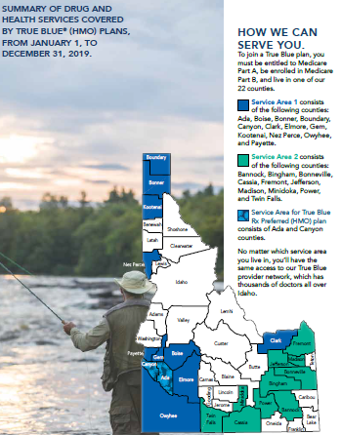
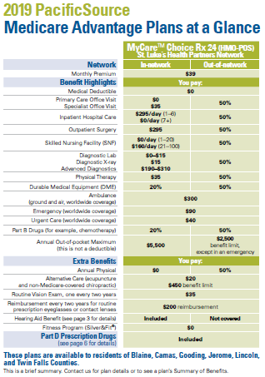

Slide 6
Information you will need to get started
Your Medicare card with effective dates for both Part A and Part B. The initial letter has the information also. The effective date of you chosen plan will be the same as Part B or the first of the month following your sign up date if later than Part B effective date.
List of the current Prescriptions. Your agents will run the prescription to show the cost on each company’s formulary.
Your current Health Providers, Primary Care & Specialist. Your agent will make sure they except Medicare and/or they are in the network.
Write down all the questions you might have. Your agent can help you understand and answer this complicated procedure.

Slide 7
Medicare.gov
The official web site provided by the Center of Medicare and Medicaid Service, CMS.
Has all the detail information provided in the presentation
Direct you to Social Security site to enroll in Medicare on line.
Compares all the Medicare Advantage and Prescription Drug plans available in your area.
Look up all physicians that will except Medicare reimbursement.
Look up all drugs and get the price per pharmacy, generic alternatives and formulary info per insurance company.

Slide 8


Slide 9
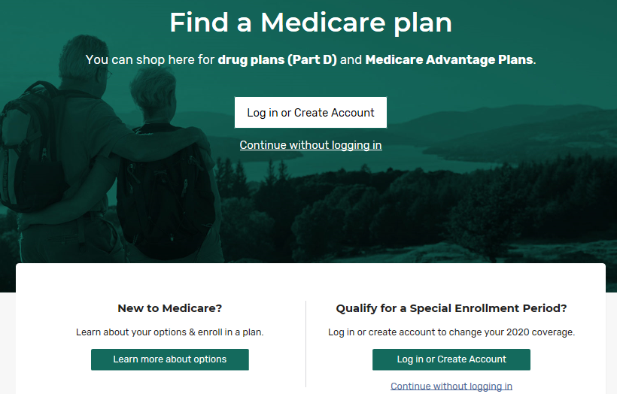

Slide 10
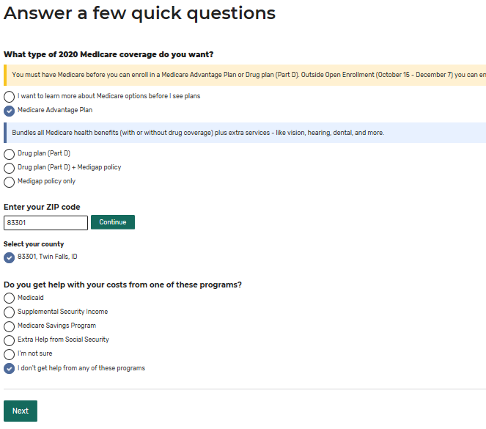

Slide 11
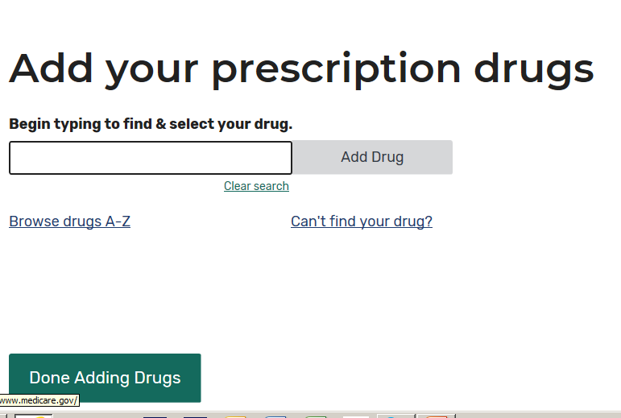

Slide 12
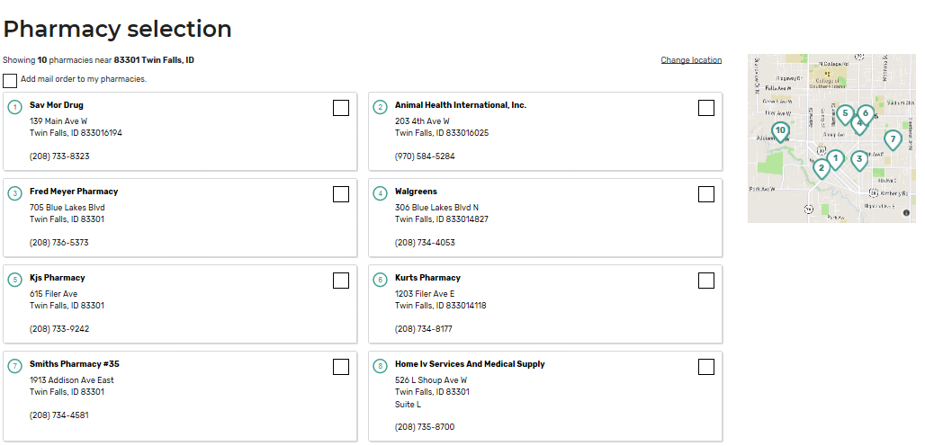

Slide 13
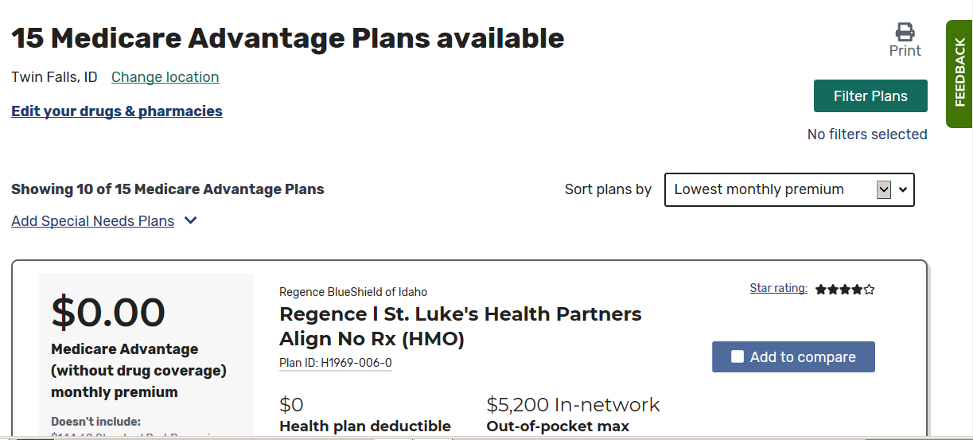

Slide 14
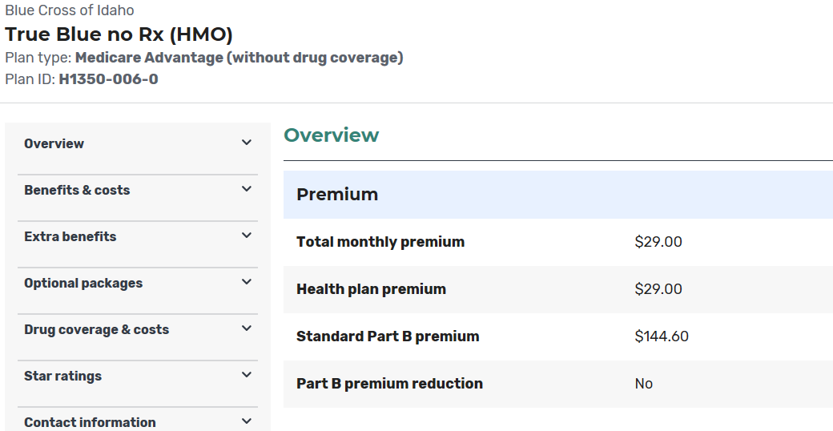

Slide 15
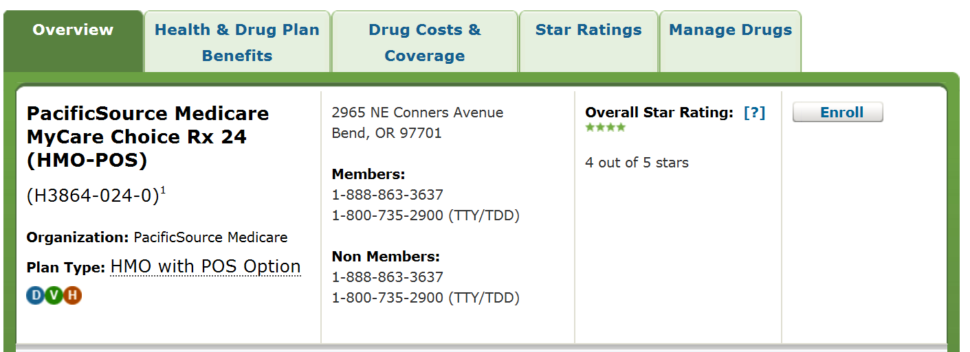

Slide 16
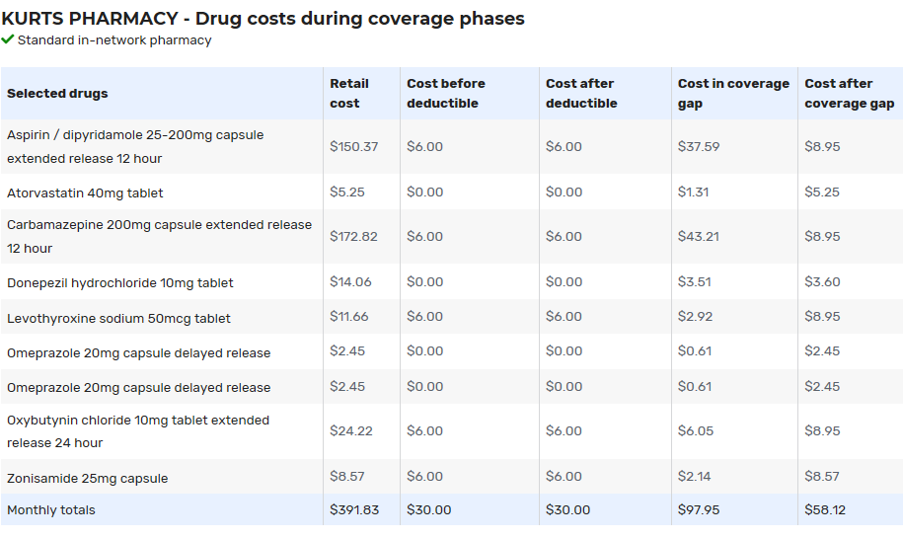

Slide 17
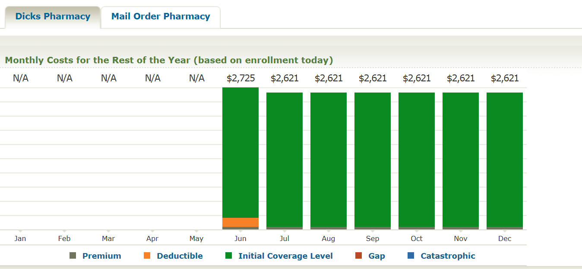

Slide 18
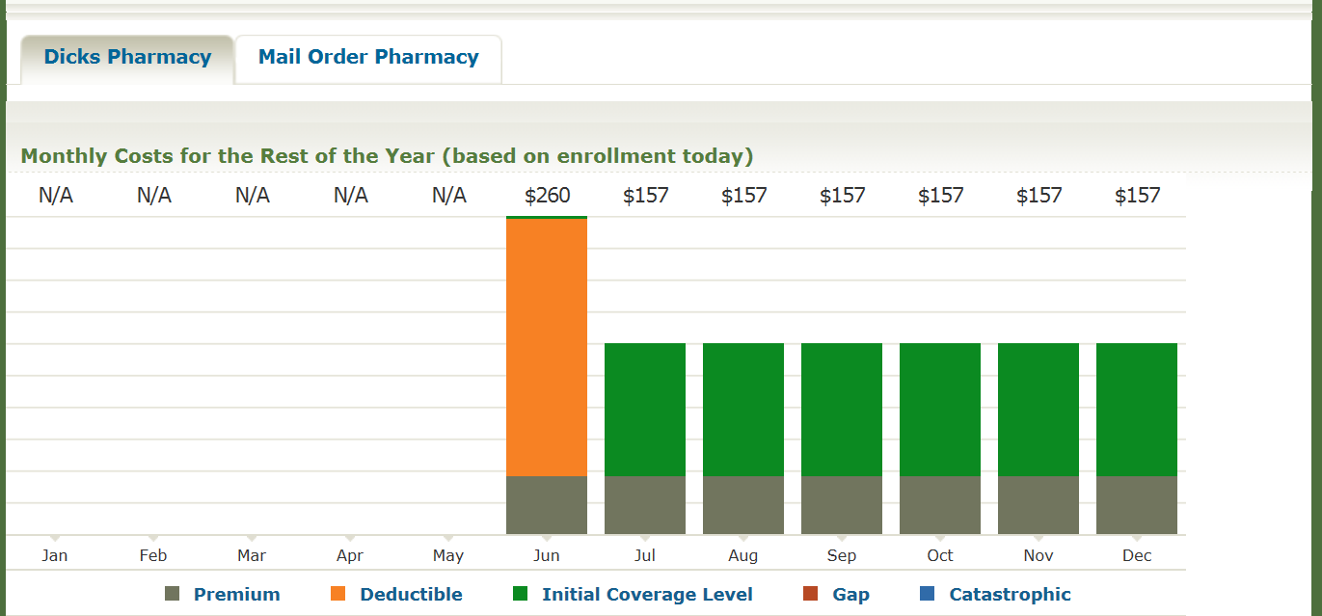

Slide 19
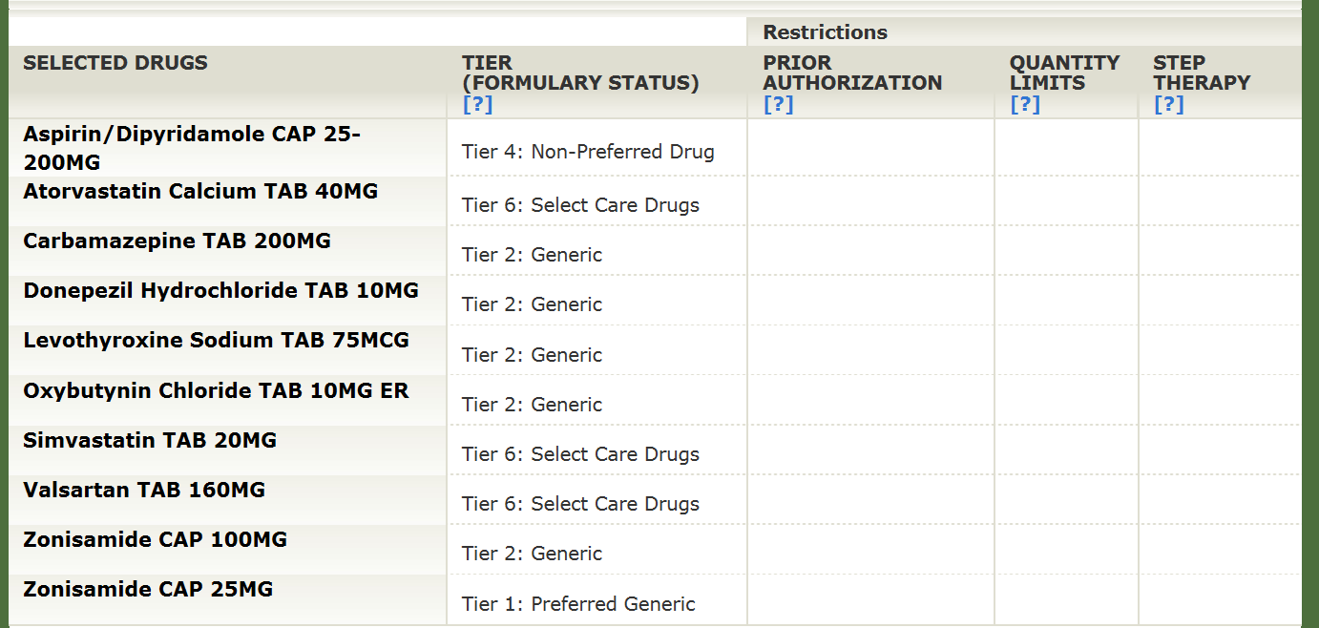

Slide 20
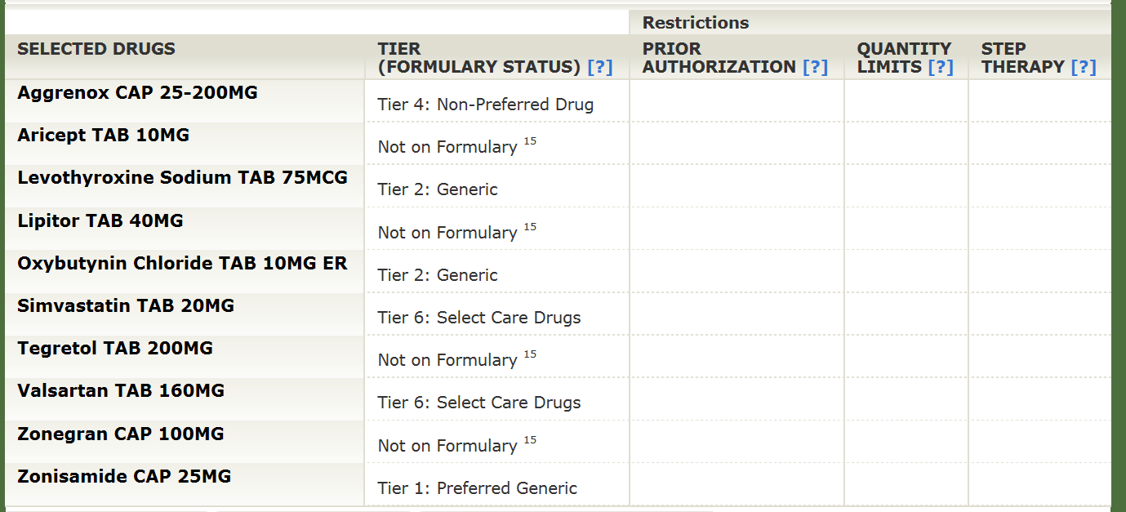

Slide 21
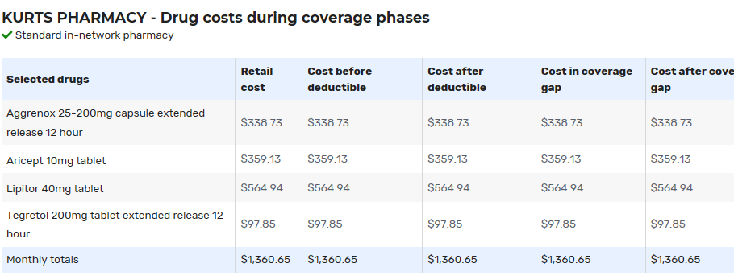

Slide 22
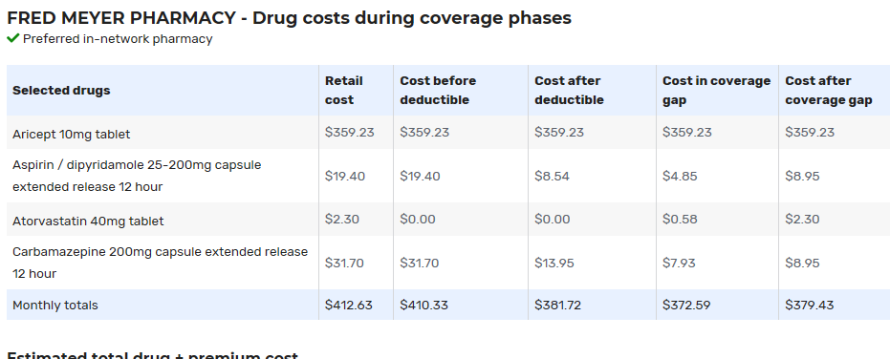

Slide 23
Thanks for your Time
Scott Standley
Scott.standley@hubinternational.com
208-737-6875

Slide 24
Let’s Take a Fun Break
Join your faculty in the lobby for additional resources
10-00 – 10:25 am
WE WILL START ON TIME – Fun drawing

Slide 25
Social Security:
With You Through Life’s Journey
Produced at U.S. taxpayer expense

Slide 26
my Social Security Services
    Review your Social Security Statement annually
  In some states, request a replacement Social Security (SSN) card
  Check the status of your application or appeal
  Get a benefit verification letter for proof of income
  Change your address, phone #, or direct deposit info
  Get a replacement SSA-1099 for taxes
  Get a replacement Medicare Card

Slide 27

Over 63 Million Receiving Benefits
(Over $940 Billion Per Year)
8.7 M Disabled
1.7 M Dependents
6 M Survivor Spouses
2 M Survivor Children
42.5 M Retired Workers
3 M Dependents

Slide 28
Social Security in the Future
Social Security Trust Funds Will Be Able To Pay About 80 Cents for Each Dollar of Scheduled Benefits after 2035

Slide 29
How Do You Qualify?
By earning “credits” when you work and pay Social Security taxes
You need 40 credits (10 years of work) and you must be 62 or older
Each $1,410 in earnings gives you one credit
You can earn a maximum of 4 credits per year
Note: To earn 4 credits in 2020, you must earn at least $5,640.00.

Slide 30
2020 Retirement Benefit Formula
If your lifetime average monthly earnings = $5,900
Then your monthly benefit = $2,425
90% of first $960 in earnings…………………….$960 = $ 864
32% of earnings ($5,785 - $960)..…………... .$4,825 = $1,544
15% of earnings over $5,785............................. $115 = $ 17
$ 5,900 $2,425
*Payments rounded to whole dollar amounts

Slide 31
Year of Birth | Full Retirement Age (FRA)
1943-1954 | 66
1955 | 66 and 2 months
1956 | 66 and 4 months
1957 | 66 and 6 months
1958 | 66 and 8 months
1959 | 66 and 10 months
1960 + | 67

Slide 32
Working While Receiving Benefits
If you are | You can make up to | If you earn more, some benefits will be withheld
Under Full Retirement Age | $18,240/yr. | $1 for every $2
The Year Full Retirement Age is Reached | $48,600/yr. before month of full retirement age | $1 for every $3
Month of Full Retirement Age and Above | No Limit | No Limit
Note: If some of your retirement benefits are withheld because of your earnings, your benefits will be increased starting at your full retirement age to take into account those months in which benefits were withheld.

Slide 33
Disability Definition
Must have a physical or mental impairment (or combination of conditions)
Inability to perform substantial work activity (SGA, 2020): Disability ($1,260/month) Blind ($2,110/month)
Disability must be expected to last 12 consecutive months or result in death
We consider age, education and past work activity

Slide 34
Social Security Spouse’s Benefits
Born after 1/1/1954? Must apply for your own benefit first
Earliest Age: 62 (reduced payment)
Spouse payment rate: up to 50% of worker’s full benefit amount (does not reduce payments to worker)
Divorced Spouse: 10-year marriage and single (former spouse not required to apply for own benefit, at least 62)
Calculation: If own full benefit is less than 50% of the worker’s full benefit, then benefits are combined

Slide 35
Spouse Benefit Computation
Kelly’s own Full Retirement Age (FRA) benefit = $800
Kelly’s spouse/Ex-spouse FRA amount = $2,000
  $1,000 Kelly’s max spouse benefit (50% of $2,000)
  - $800 Kelly’s own FRA benefit
    $200 Kelly’s spousal payment
Kelly's spousal benefit ($200) is added to Kelly’s own FRA benefit ($800) for a total benefit of $1,000

Slide 36

Survivor Benefits
  Full survivor benefit at Full Retirement Age – (payments reduced if deceased worker received early retirement); or
  At age 60, receive 71.5% of deceased’s Full Retirement Age benefit; waiting increases payment amount; or
  If disabled, receive as early as age 50; or
  Caring for minor child of the deceased who is under age 16
  Surviving Divorced Spouse: 10-year marriage required
  Must be unmarried unless remarriage after age 60 (50 if disabled)

Slide 37
Survivors Benefits Tips
If Worker is deceased before surviving spouse reaches retirement age, spouse can draw reduced survivors benefits and then switch to own retirement later
Earnings limits apply to both survivors and spouses benefits

Slide 38
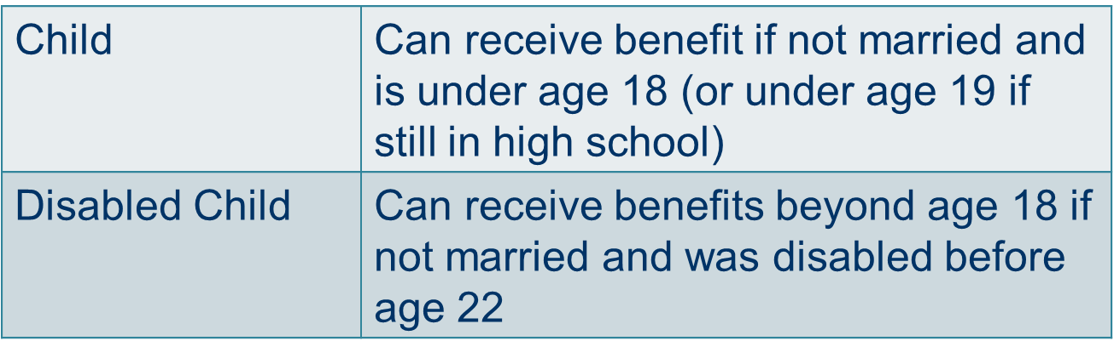
Benefits for Children

Slide 39
Medicare
Eligibility
Age 65
ALS
Kidney failure
After 24 months of SSDI

Slide 40



Applying for Benefits
3 options available:
Online at SocialSecurity.gov
By phone 1-800-772-1213
At our office (call for appointment)
You choose the most convenient option for you.

Slide 41
AABD Medicaid
(Aid to the Aged, Blind, and Disabled)
2/29/20
Laela Wilmot, Program Manager

Slide 42
3 Types of Medicaid
Full coverage Medicaid
  Covers basic medical needs
Long Term Care Medicaid
  More extensive Medical needs
Medicare Savings Plans
  Helps with monthly Medicare premiums

Slide 43

Basic Eligibility Criteria
Resident of Idaho
Meet citizenship or legal non-resident criteria
Meet Age or Disability Criteria
Meet income and resource guidelines

Slide 44

Residence
Voluntarily living in Idaho and have no immediate intention of leaving.
  No minimum amount of time required to establish residency.

Slide 45
Citizenship
Must be a US Citizen or a Qualified Non-Citizen.
  Documentation required to support Citizenship and Identity
  Qualified Non-Citizens are required to provide proof they have been in the US legally a minimum of 5 years with few exceptions.
    Some entry status’ are exempt from the 5 year bar, i.e. Refugees, Asylees, etc.
  **If receiving SSI, SSD, or Medicare = exempt from verifying citizenship.

Slide 46

Aged or Disabled
65 years of age or older
Under age 65 meeting the definition of blindness or disability
  Same definition used by Social Security Administration (SSA) to determine disability
  Does not require an application for SSA benefits
    The Department has another process through contract to determine disability without needing to qualify through SSA.

Slide 47
Income and Resource Guidelines
Current income limit for 2020 (updates annually):
Guidelines vary depending on type of Medicaid program applied for
  $836 - $2,369 for an individual per month
  $1195 - $4,718 for a couple per month
Current Resource limit:
Limit for an individual is $2000
Limit for a couple averages $3000-$2000 each (dependent on Medicaid program)

Slide 48

Potential Income
Before Medicaid can be approved, the customer must access all other income potentially available to them
  Social Security (exception of Supplemental Security Income - SSI)
  Other retirement payments

Slide 49
Social Security and Medicaid
SSI recipients are eligible for Medicaid no matter the amount of the SSI payment.
Recipients of other SSA payments have to have eligibility for Medicaid determined based on eligibility factors
  Social Security Disability Insurance (SSDI)
  Retirement, Survivors, Disability Insurance (RSDI)
Note: There are separate applications for Medicaid and Social Security Payments.

Slide 50

Long Term Care (LTC) Medicaid
Home and Community Based Services
  Cost less than Nursing Home
    Own Home
    Assisted Living
    Residential Care
Nursing Home Assistance
  Nursing Facility
    Eligibility based on ability to care for self determined by a nurse reviewer from the Division of Medicaid.

Slide 51
Over Income/Resource for LTC Medicaid
Can set up an Income Trust also known as a “Miller Trust”
  Contact Idaho Legal Aid
    Contact Information: www.idaholegalaid.org
    or
  Request assistance from an elder law attorney
Resource Assessment for Couples
  Determine Spousal Share (1/2 of countable resources verified on 1st day of continuous care)

Slide 52
Resource Spend Down
Pay for care privately
Settle personal debt
Prepay burial, for self and spouse
Other options as discussed with eligibility specialist

Slide 53

Asset Transfers
Look-back up to 5 years
Assets transferred without fair consideration
  Penalty for Long-Term Care eligibility: value vs. average cost = months of ineligibility

Slide 54
Estate Recovery
If full Medicaid is received at the age of 55 or older, any resources in an estate at time of death may be subject to recovery of medical expenses.
  Lien is put on property by the State of Idaho
  Never recover more than medical costs paid by Medicaid.

Slide 55

Medicare Savings Programs
Assistance to help pay the costs of Medicare
Must be eligible for Medicare
Medicare Savings Programs are not subject to Estate Recovery.
Meet income and resource guidelines
  Resource Limit is $7,860 for an individual and $11,800 for a couple.

Slide 56
Qualified Medicare Beneficiary (QMB)
Income at or below 100% Federal Poverty Guidelines (FPG) = currently $1084 for individual and $1457 for couple (updates annually)
QMB benefits begin the month after approval
Pays for Medicare:
  Part B premiums
  Part A in some circumstances
  Deductibles
  Co-Pays

Slide 57
SLMB & QI
Specified Low Income Medicare Beneficiary (SLMB) - Income at or below 1% Federal Poverty Guidelines (FPG) = currently $1296 estimated for individual and $1744 for couple (updates annually)
Qualified Individual Medicare Beneficiary (QI) ) - Income at or below 135% Federal Poverty Guidelines (FPG) = currently $1456 estimated for individual and $1960 for couple (updates annually)
Pays for:
  Medicare Part B premiums
Coverage can begin up to 3 months prior to the application month
QI has limited funding

Slide 58
Medicaid for Adults (Medicaid Expansion)
Began January 1, 2020
Eligibility criteria
  Citizen or legal non resident in the US
  Resident of the State of Idaho
  Between 0-138% Federal Poverty Guidelines – updates annually
    Example: Household of 4 = $2961/month gross
  Not receiving/eligible for Medicare
  Not eligible for other Medicaid programs

Slide 59

To Apply
Visit the local office and meet with an Eligibility Specialist
  Paper application is not required
Obtain and complete an application
    Pick up in the local office
    Have one emailed or mailed
    Download from the Department of Health and Welfare Website
  Return it
    Take into local office
    Mail
    Email
    Fax
Visit idalink.idaho.gov

Slide 60

Eligibility Information
Refer to www.livebetteridaho.org to easily find information regarding eligibility for all welfare programs as well as many other resources available in the community.

Slide 61


Learn more about Medicaid and other assistance offered by the Department of Health and Welfare at:
http://www.healthandwelfare.idaho.gov
or call:
The Idaho Care Line by dialing 211

Slide 62
Over 60 & Getting Fit
Monday, Wednesday, Friday
9-9:50
CSI Gymnasium
FREE!

Slide 63
Active Aging Classes (60)
Zumba Gold
Zumba Gold Toning
Weight Training
Yoga
Pilates
Water Fitness
Fit Fun and Over 40
CSI Gymnasium
$/semester/class

Slide 64


