Slide 1
Office on Aging
Located on the csi twin falls campus
PO Box 1238
Twin Falls, Idaho 83303
208.736.2122

Slide 2
Office on Aging
Shawna Wasko, M.OLP
Public Information/Contracts Manager/Group Facilitator
Widowed Wellness Programs of Idaho, Inc. Caregiver Support Group Grandparents as Parents support group

Slide 3
Office on Aging
Our Goal:
Is to enable people to live in their own homes:
As long as they can
As comfortably as they can
As safely as they can.

Slide 4
Office on Aging
The csi office on aging provides
a wide range of services to
seniors aged 60 and older
and to family members of a senior citizen.

Slide 5
Office on Aging
The csi office on aging serves the eight
Counties of the magic valley:
Blaine, camas, cassia, gooding, Jerome,
Lincoln, minidoka, and twin falls

Slide 6
Office on Aging
Aging & Disability Resource Center
Helps people with questions about long term care. It helps identify needs; educate as to options & resources; empower them to make informed choices; & assist them to access desired resources

Slide 7
Office on Aging
Adult Protection Services
Are mandated by Law to investigate allegations of abuse, neglect, or exploitation of a vulnerable adult (18 or older, who is unable to make, implement, or communicate decisions due to mental/physical impairment).

Slide 8
Office on Aging
Adult Protection Services
What to report to adult protection (can be anonymous):
Physical/Mental Abuse: unexplained bruises, falls, scratches, lacerations, contusions, etc.
Neglect: Malnourishment, no food, no clothing, failure to obtain needed medical care, no heat, no running water.

Slide 9
Office on Aging
Adult Protection Services
What to report to adult protection:
Self-Neglect: Social isolation, no food, no heat, no running water, malnourishment, failure to obtain needed medical care
Exploitation: Unusual account activity, unpaid bills, inappropriate legal documents

Slide 10
Office on Aging
Information & Assistance
Is the gateway to senior services in the Magic Valley. They can help identify needs, & make referrals to resources and services to meet those needs.

Slide 11
Office on Aging
Ombudsman Program
Works to assist residents of long-term care facilities to protect their health, rights, safety, and welfare.

Slide 12
Office on Aging
Ombudsman Program
They investigate complaints for seniors that involve accessing care, resident rights, facility or home-based care issues, Medicaid, Medicare, social security and other agencies

Slide 13
Office on Aging
Ombudsman Program
They investigate complaints, in 57+ facilities, for seniors that involve accessing care, resident rights, facility or home-based care issues, Medicaid, Medicare, social security and other agencies.

Slide 14
Office on Aging
Support Groups
Meet regularly for education, discussion & peer support.
Caregiver support group Grandparents as parents support groups widowed wellness programs of Idaho, Inc.

Slide 15
Office on Aging
3 things you need to know about hits to your finances
Grandparents as parents new law
Widowed: poorest people in all nations
Caregiving is exceedingly expensive

Slide 16
Office on Aging
Contracted services
Homemaker: assist with light housekeeping & general chores
Respite Care: offers caregivers a break with companionship, supervision, & assistance, with such tasks as bathing, dressing, & other care receiver needs.

Slide 17
Office on Aging
Contracted services
Transportation: services provide rides for seniors to senior centers, medical appointments, shopping and other locations.

Slide 18
Office on Aging
Contracted services
Senior Dining & Activities: are offered at 16 senior centers and 2 meal sites throughout the Magic Valley.

Slide 19
Office on Aging
Senior Centers
1 in 6 seniors in idaho struggle with Hunger
Congregate Meals: On track to serve 98,280 Meals in 2017
Home Delivered Meals: on track to serve 73,692 Meals in 2017
Live longer with less dementia

Slide 20
Office on Aging
Biggest Risk to Seniors:
Loneliness

Slide 21
Office on Aging
Don’t Forget!
Stop by our booth and get your
Red file!

Slide 22
Scams and Schemes
Fraud Prevention education
By
Taenia Hudson
Senior Medicare Patrol coordinator
CSI Office on Aging

Slide 23
What is the Senior Medicare Patrol?
SMPs...
Help preserve the integrity of the Medicare program
Rely on volunteers to help perform SMP work
Help Medicare beneficiaries prevent, detect, and report health care fraud
Notes:
The Senior Medicare Patrol is here to help you avoid these problems.
Senior Medicare Patrol programs, or SMPs, help Medicare and Medicaid beneficiaries prevent, detect, and report health care fraud. By doing so, we help preserve the integrity of the Medicare and Medicaid programs. Because this work often requires face-to-face contact to be most effective, SMPs nationwide rely on approximately 5,000 volunteers who are active each year to help in this effort.
Suggested Handout: SMP Brochure (available in multiple languages)
www.smpresource.org > Resources for SMPs > SMP Resource Library

Slide 25
3 Tips to protect yourself information from the OIG.ssa.gov
Understand the threats. Fraudsters use several forms of impersonation, advance fee, and phishing schemes.
Exercise caution. In general, no government agency or reputable company will call or email you unexpectedly and request your personal information, or request advance fees for services in the form of wire transfers or gift cards.
Secure your information. Store your Social Security card in a secure location; avoid carrying it with you
IT’S SHREWD TO BY RUDE – HANG UP OR BETTER YET DO NOT ANSWER

Slide 26
Thank you

Slide 27
Medicare
Presented by the Idaho SHIBA Program

Slide 28
What is SHIBA?
SHIBA stands for “Senior Health Insurance Benefits Advisors”.
SHIBA is part of the Consumer Affairs Bureau of the Idaho Department of Insurance (DOI).
SHIBA is funded by the Idaho Department of Insurance and federally by the Administration for Community Living (ACL).

Slide 29
What is SHIBA?
SHIBA is part of a nationwide program known as
SHIPs - “State Health Insurance Assistance Programs”.
There is a SHIP program in every State. In Idaho we are called SHIBA. In other states it may be known as SHINE, HICAP, SHIIP.
SHIPs are usually housed under various state agencies such as Department of Insurance, Agencies on Aging, or the Governor’s office.

Slide 30
What SHIBA Staff & Volunteers do
Conduct Community Education about Medicare
Provide one-on-one Medicare counseling
Assist with complex Medicare issues
Conduct Outreach and Advocacy
Educate on Fraud and Abuse

Slide 31
Getting started with Medicare
This Training can help you make important Medicare decisions like
Choosing health and prescription drug coverage
Timing your decisions
To ensure coverage
To avoid penalties

Slide 32
How Medicare is Administered
It is administered by
The Centers for Medicare and Medicaid Services (CMS)
But enrollment is done by either
Social Security Administration (SSA)
Railroad Retirement Board (RRB) - railroad retirees

Slide 33
Medicare & the Affordable Care Act (ACA)
Generally, it’s against the law for someone who knows that you have Medicare to sell you an ACA plan except for these exceptions:
If you are eligible for Medicare, but haven’t enrolled in it because you would have to pay a premium for Part A or because you are not collecting Social Security benefits
If you are paying a premium for Part A, you can drop your Part A and Part B coverage and get an ACA plan
If you are employed and your employer offers employer-based coverage through Your Health Idaho, you may be eligible for that type of coverage

Slide 34
When to Enroll in Medicare
You don’t have to be retired
If you aren’t getting SSA or RRB retirement benefits – you need to contact Social Security if you want Medicare
Your Initial Enrollment Period lasts 7 months
Begins 3 months before your month of eligibility
Includes the month of eligibility
Ends 3 months after your month of eligibility
There are other times you may enroll
But you may pay a penalty if you delay

Slide 35
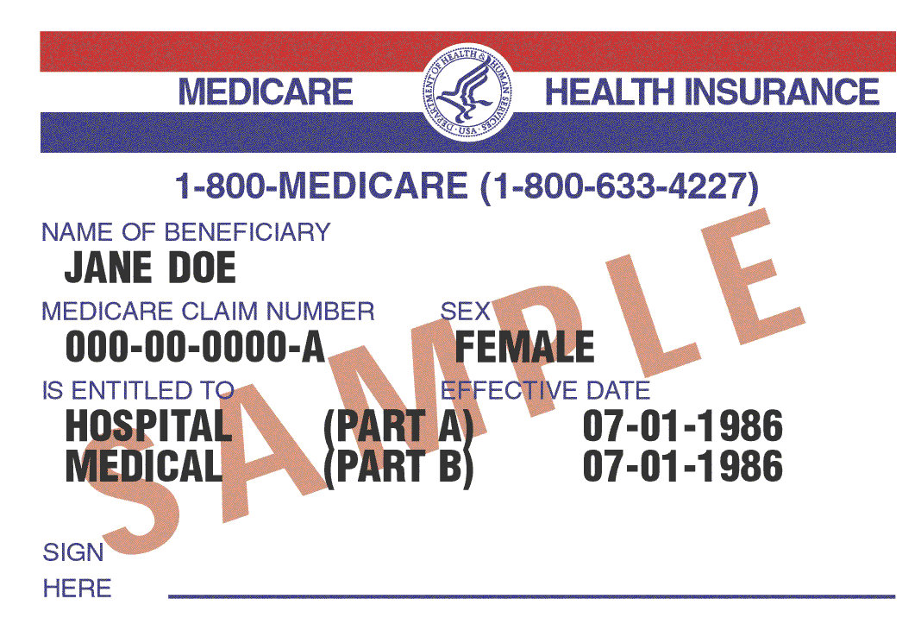
Enrolling in Medicare
Automatic for those receiving
Social Security Benefits
Railroad Retirement Board Benefits
Initial Enrollment Period Package
Mailed 3 months before
25th month of disability benefits
Age 65
Welcome to Medicare

Slide 36
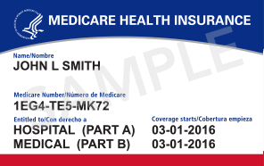
New Medicare Card
Social Security Numbers will be removed from Medicare Cards by April 2019. New cards will be mailed to those who already have a card. This is being done to fight identity theft. Cards will be mailed between April 2018 and April 2019. The new card is pictured below.

Slide 37
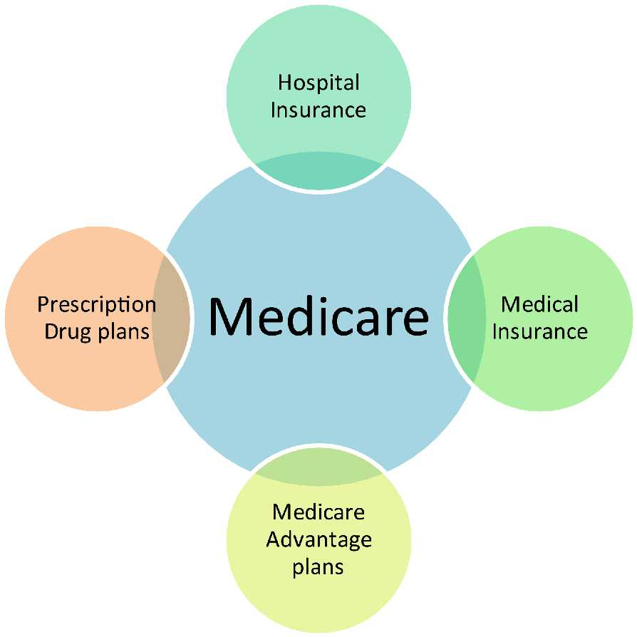
The Four Parts of Medicare
Part A
Part B
Part D
Part C

Slide 38
Original Medicare
Part A – Hospital Insurance
Hospital
Skilled nursing facility
Home health care
Hospice care
Part B – Medical Insurance
Doctor’s visits
Outpatient hospital services
Clinical lab tests
Durable medical equipment
Preventive services
Other services

Slide 39
Medicare Part A (Hospital Insurance)
What does Part A cost?
Most people get Part A premium free – If you paid Medicare taxes at least 10 years
If you paid Medicare < 10 years
You may pay a premium to get Part A
You may have a penalty if not enrolled when first eligible. If you pay a penalty you may have other options.

Slide 40
What you pay for
Inpatient Hospital costs in 2019
For each benefit period in 2019 | You pay
Days 1 – 60 | $1,364 deductible
Days 61 – 90 | $341 per day
Days 91 – 150 | $682 per day (60 lifetime reserve days)
All days after 150 | All Costs

Slide 41
What you pay for
Skilled Nursing Facility costs in 2019
For each benefit period in 2019 | You pay
Days 1 – 20 | $0
Days 21 - 100 | $170.50 per day
All days after 100 | All Costs

Slide 42
Monthly Part B Premium
If your Yearly Income in 2017 was |  | You Pay in 2019
File Individual Tax Return | File Joint Tax Return
$85,000 or below | $170,000 or below | $135.50
$85,001 - $107,000 | $170,001 - $214,000 | $189.60
$107,001 - $133,500 | $214,001 - $267,000 | $270.90
$133,501 - $160,000 | $267,000 – 320,000 | $352.20
$160,000 - $500,000 | $320,000 - $750,000 | $433.40
Note: Premiums are usually deducted
from your Social Security benefit payment

Slide 43
Medicare Part B Medical Insurance
Helps Cover
Services from doctors and other health care providers
Outpatient care
Home Health Care
Durable medical equipment
Many preventive services - see Medicare & You 2019, pages 30-49 for a complete list

Slide 44
What you pay for Medicare Part B in 2019
In Original Medicare Part B you pay:
Yearly deductible - $185.00 in 2019
20% coinsurance for most services

Slide 45
Decision:
Should I take Medicare Part B?
If you don’t have coverage from active employment (you or your spouse)
Probably
Delaying Part B may mean
Higher premiums
Paying for health care out-of-pocket
If you do have coverage through active employment (you or your spouse)
Maybe Not
You may want to delay Part B
No penalty if you enroll while you have coverage or within 8 months of losing coverage

Slide 46
Decide how you want to get your Medicare coverage
Original Medicare
Part A & Part B
Medicare Advantage
Part C
Most include
Part D
Part D Prescription Drug Coverage
Medigap
If eligible for Veterans Administration (VA), retiree or other health coverage your options may be different
If you join Medicare Advantage you can’t use and can’t be sold a Medicare Supplement (Medigap)
You cannot choose a stand-alone Part D to go along with Medicare Advantage

Slide 47
What is Medigap Insurance?
Medicare Supplement Insurance is sold by private companies
Fills the “gaps” in Original Medicare (deductibles, coinsurance, co-payments)
Standardized plans A thru N in all but 3 states (MA, MN, WI)
All plans with the same letter sold from different companies
Have the same coverage
Premiums are different
Does not include prescription coverage
which must be purchased separately

Slide 48
2019 Medigap Plan Types
 | Medicare Supplement Insurance (Medigap) Plans
Benefits | A | B | C | D | F* | G | K | L | M | N
Medicare Part A coinsurance and hospital costs (up to an additional 365 days after Medicare benefits are used) | 100% | 100% | 100% | 100% | 100% | 100% | 100% | 100% | 100% | 100%
Medicare Part B coinsurance or copayment | 100% | 100% | 100% | 100% | 100% | 100% | 50% | 75% | 100% | 100%***
Blood (first 3 pints) | 100% | 100% | 100% | 100% | 100% | 100% | 50% | 75% | 100% | 100%
Part A hospice care coinsurance or copayment | 100% | 100% | 100% | 100% | 100% | 100% | 50% | 75% | 100% | 100%
Skilled nursing facility care coinsurance |  |  | 100% | 100% | 100% | 100% | 50% | 75% | 50% | 100%
Part A deductible |  | 100% | 100% | 100% | 100% | 100% | 50% | 75% | 100% | 100%
Part B deductible |  |  | 100% |  | 100%
Part B excess charges |  |  |  |  | 100% | 100%
Foreign travel emergency (up to plan limits) |  |  | 80% | 80% | 80% | 80% |  |  | 80% | 80%
Out-of-Pocket Limit in 2018 |  |  |  |  |  |  | $5,240 | $2,620
*Plan F may be offered as a high deductible plan of $2,240 in 2019
Notes:
All Medigap policies cover a basic set of benefits, including the following:
All plans cover 100% of Medicare Part A coinsurance and hospital costs up to an additional 365 days after Medicare benefits are used up*.
Medicare Part B coinsurance or copayment, with Plans A, B, C, D, F, G, M, and N covering 100%. Plan N pays 100% of the Part B coinsurance, except for a copayment of up to $20 for some office visits and up to a $50 copayment for emergency room visits that don’t result in an inpatient admission. Plan K pays 50% of Medicare Part B coinsurance or copayment, with Plan L paying 75%.
Blood (first 3 pints) with Plans A, B, C, D, F, G, M, and N covering 100%;Plan K 50%; and Plan L 75%.
Part A hospice care coinsurance or copayment with Plans A, B, C, D, F, G, M, N covering 100%; Plan K 50%; and Plan L 75%.
In addition, each Medigap plan covers different benefits:
The skilled nursing facility care coinsurance is covered 100% by Plans C, D, F, G, M, and N covering 100%; Plan K 50%; and Plan L 75%.
The Medicare Part A deductible is covered 100% by Plans B, C, D, F, G, and N; Plans K and M 50%; and Plan L 75%.
The Medicare Part B deductible is 100% covered by Medigap Plans C and F.
The Medicare Part B excess charges are covered 100% by Medigap Plans F and G.
Foreign travel emergency costs up to the plans’ limits are covered at 80% by Medigap Plans C, D, F, G, M, and N.
In 2015, Plans K and L have out-of-pocket limits of $4,940 and $2,470,respectively.
*Plan F also offers a high-deductible plan in some states.

Slide 49
Do I want Medigap insurance?
MAYBE?
Consider
It only works with Original Medicare
Do you have other coverage that coordinates with Medicare? If so, you may not need a Medigap
Can you afford Original Medicare’s deductibles, copays and no out of pocket limit?
What does the Medigap premium cost?
You can go to any health care provider in the U.S. that accepts Medicare

Slide 50
Decision:
When is the best time to buy Medigap?
Usually during your
Medigap Open Enrollment Period
Consider:
Your Medigap Open Enrollment Period begins when you are 65 or older and enrolled in both Medicare Part A and Part B. Beginning January 1, 2018 there is no age requirement in Idaho, but you may be charged up to 150% more (varies by state)
Lasts 6 months (may vary by state)
You have Guaranteed Issue – Companies MUST sell you a plan
After that you can buy a Medigap whenever a company agrees to sell you one or in a guaranteed issue situation

Slide 51
Enrolling in a Part D Plan
You can enroll
During your 7 month Initial Enrollment Period
During the Annual Enrollment Period
October 15 – December 7
Coverage starts January 1
During other special times
Special Enrollment Period

Slide 52
How Medicare Part D works
Optional, but you may pay a penalty if you don’t enroll when first eligible
Plans have formularies
Lists of covered drugs - must include range of drugs in each category
You pay the monthly premium, deductibles, and copayments –higher income beneficiaries pay a higher premium similar to Part B
Plans have network pharmacies
Non-network pharmacies likely not to provide coverage
Preferred pharmacies may offer lowest co-pays
May get lower cost if use mail order pharmacy

Slide 53
Choosing and enrolling in a
Stand Alone Part D plan
1-800-MEDICARE
Medicare Plan Finder at www.medicare.gov/find-a-plan
SHIBA for help comparing plans
To Join a Part D Plan
Enroll online at www.Medicare.gov
Complete a paper enrollment form – from company
Call the plan
Enroll on the plan’s website
Call 1-800-MEDICARE (1-800-633-4227)
Contact an agent

Slide 54
Part C – Medicare Advantage
Medicare pays the plan for each member’s care
Insured usually pays a premium and must continue to pay Medicare Part B premium
Usually have to use network providers
May include other benefits like dental, vision, health club membership
Benefits, cost sharing and provider networks differ among plans
Usually have to take prescription coverage included in
Medicare Advantage Plan
Part D late enrollment penalty may apply
May include travel benefits in addition to emergency/
urgently needed care
Administered by private insurance companies

Slide 55
When can I enroll in an MA plan?
During Your 7 month Initial Enrollment Period
During the Annual Enrollment Period
October 15 – December 7 each year
Coverage begins January 1 of following year
MAPD Open Enrollment January 1 – March 31
May be able to join at other times – Special Enrollment Period
Contact the plan to join
Call the non-member phone number
Visit plan’s website
Enroll online at www.Medicare.gov
Notes:
If you wait till your birth month, or later to enroll, there will be a delay before your coverage takes affect.
If your birthday is on the first of the month, your IEP begins a month earlier, and your coverage will begin on the first of the month prior to your birth month, if you enroll in the first three months of your IEP.

Slide 56
How to Decide
Medications covered on plan formulary?
Cost of premium/co-pays/co-insurance
What is the Out of Pocket Limit?
Extra benefits
What other insurance am I eligible for?
Are my doctors/hospitals in network?
Do I want to be able to choose providers anywhere in the country
Travel/International Travel

Slide 57
Help for People
with Limited Income and Resources
Extra Help
Medicare Savings Programs
Medicaid
Save Money on your Medicare Expenses SHIBA tri-fold which is available today outlines the income/asset limits and other information about
Extra Help & Medicare Savings Programs

Slide 58
What is Extra Help?
Help paying prescription drug costs
Social Security or state makes determination
Some people automatically qualify
People with Medicare AND Medicaid
People with Supplemental Security Income (SSI) only
People who qualify for the Medicare Savings Programs
You, or someone on your behalf, can apply

Slide 59
What are Medicare Savings Programs?
Help from state Medicaid paying Medicare costs
Pays Medicare premiums
May pay Medicare deductibles and coinsurance
Generally, lower income than Extra Help
Income/Assets amounts change each year
Some states offer their own programs
No estate recovery

Slide 60
What is Medicaid?
Federal – state health insurance program
For people with limited income and resources
For certain people with disabilities
Covers most health care costs for people with Medicare and Medicaid (dually eligible)
Eligibility determined by state
Application process and benefits vary
Agency names vary by state – Idaho: Dept. of Health & Welfare

Slide 61
Key Points to Remember
Medicare is health insurance
Medicare doesn’t cover all health care costs
There are different ways to get coverage
There are programs for people with limited income and resources
Important
Make the right decisions
Make them at the right times
Get help if you need it

Slide 62
For More Information
By Phone
MEDICARE 800-MEDICARE
Social Security 800-772-1213
Medicaid 877-456-1233
SHIBA counselor 800-247-4422
Online:
Medicare.gov
SSA.gov
healthandwelfare.idaho.gov
SHIBA.Idaho.gov
Medicare & You 2019 & other Medicare/SHIBA publications

Slide 63
Helpful Resources
MyMedicare.gov
Register at MyMedicare.gov on Medicare.gov
Complete Initial Enrollment Questionnaire
Read your Medicare Summary Notices
Manage your personal health records
Manage your personal drug list and pharmacy information
Senior Medicare Patrol SMP
SMP helps Medicare & Medicaid beneficiaries avoid, detect and prevent health care fraud, errors and abuse.
Report suspected fraud/abuse to 1-800-247-4422

Slide 64
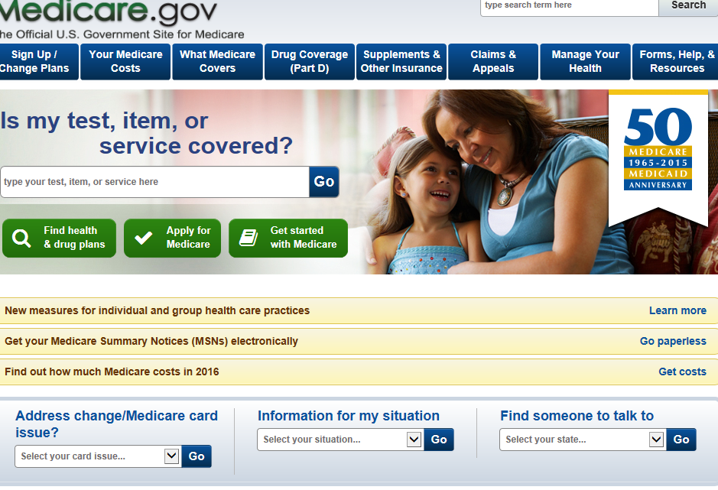
Medicare.gov Homepage

Slide 65
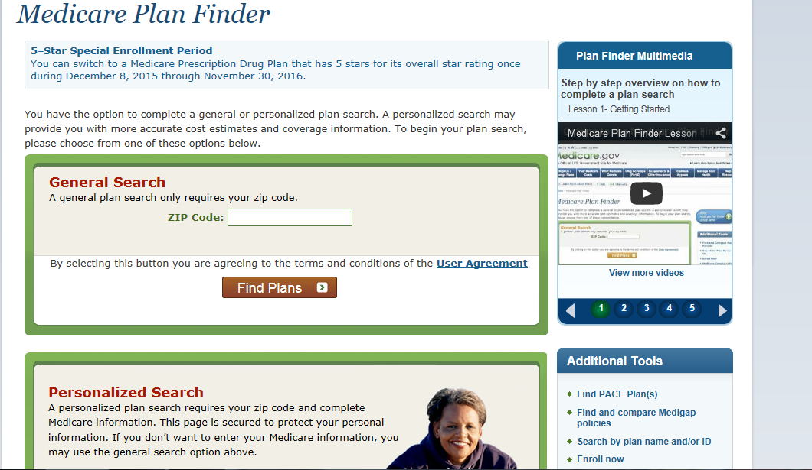
Find Health and Drug Plans

Slide 66
Social Security Homepage: SSA.gov

Slide 67
SSA.gov
What you can do Online

Slide 68
1-800-247-4422

