Slide 1
Social Security: With You Through Life’s Journey…
1
Produced at U.S. taxpayer expense
Notes:
For more than 80 years, Social Security has helped secure today and tomorrow by providing benefits and financial protection for millions of people throughout their life’s journey.
Social Security touches the lives of every American, both directly and indirectly. As you consider the information that you are about to receive , I encourage you to think about all the ways Social Security has been linked to your life – and the lives of your loved ones.

Slide 2
66 Million Social Security Beneficiaries
November 2016
Notes:
This image illustrates the number of beneficiaries we pay. Currently, more than one in every six people in America is receiving a Social Security benefit. The majority of our beneficiaries are retired.
But Social Security is more than retirement...it is a family protection plan (almost 1/3 of the beneficiaries are disabled, dependents of disabled, or survivors).
Source: https://www.ssa.gov/policy/docs/quickfacts/stat_snapshot/

Slide 3
Who Pays for Social Security?
Notes:
Social Security is an intergenerational transfer system: today’s workers help pay for current retirees’ and other beneficiaries’ benefits, not their own future benefits.
There’s no account set aside with your name and contributions on it.

Slide 4
About 173 million workers will pay Social Security taxes in 2017.
About 94 percent of all workers are covered or eligible under Social Security.
Notes:
About 173 million workers will pay Social Security taxes in 2017. About 94 percent of all workers are covered under Social Security.

Slide 5
What’s FICA?
A U.S. federal payroll tax deducted from each paycheck
Stands for the Federal Insurance Contributions Act
Total deducted from your paycheck is 7.65% (6.2% to Social Security, 1.45% to Medicare)
Your employer matches this for a total of 15.3%
Helps fund both Social Security and Medicare programs, which provide benefits for:
Retirees
The Disabled
Children
Notes:
Employers collect a U.S. federal payroll tax known as Federal Insurance Contributions Act withholdings or FICA and report your earnings electronically.
This is how Social Security tracks your earnings throughout your lifetime, and how you earn Social Security retirement, disability, and survivors coverage for you and your family.
This tax is collected from both employees and employers to fund Social Security and Medicare — federal programs that provide benefits for retirees, the disabled, spouses, widows, and children.
The total FICA tax is 15.3 percent of your gross wages. You and your employer both pay 7.65 percent. For Social Security tax, you pay 6.2 percent of your gross wages; for Medicare tax, you pay 1.45 percent of your gross wages.
The current Social Security system works like this: when you work, you pay taxes into Social Security. The amount of taxes is based on your earnings, up to a certain amount. In 2017, that amount is $127,200.
https://www.ssa.gov/pubs/EN-05-10003.pdf.
The money you pay in taxes is not held in a personal account for you to use when you get benefits. We use your taxes to pay people who are getting benefits right now.
Any unused money goes to the Social Security trust funds.

Slide 6
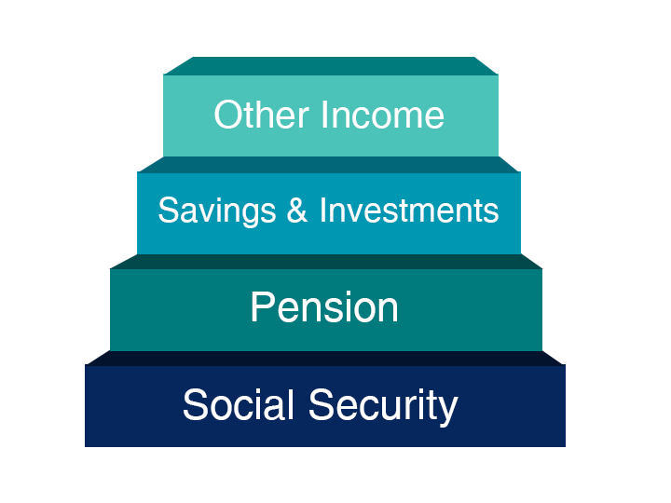
Notes:
You may have heard of the “three-legged stool” of retirement and these days, we like to remind people about investments and other income, as well.
Since Social Security replaces about 40% of preretirement income for the average worker, you need pensions, savings, investments and/or a retirement account such as myRA to have a comfortable retirement.
Again, remember that Social Security was never meant to be the only source of income for people when they retire.
Social Security provides a foundation on which to build retirement security. While planning for retirement, it is important that you know how much your Social Security benefit is likely to be. Also consider how much monthly income you will receive from your pension and investments. The rest of your pre-retirement income will need to be supplemented by your savings and other income. To help with your retirement income, you may want to visit the MyMoney.gov website.
This is a great website to visit, even if you already have a financial planner who helps you manage your portfolio. It will help you to be more informed about financial matters, so you can ask better questions to your trusted advisors.
And this site provides free, reliable, unbiased information on a variety of financial topics.
Unlike the investment advice offered on some private financial companies’ websites, no one is trying to sell you anything through this site, which is run by the federal government.

Slide 7
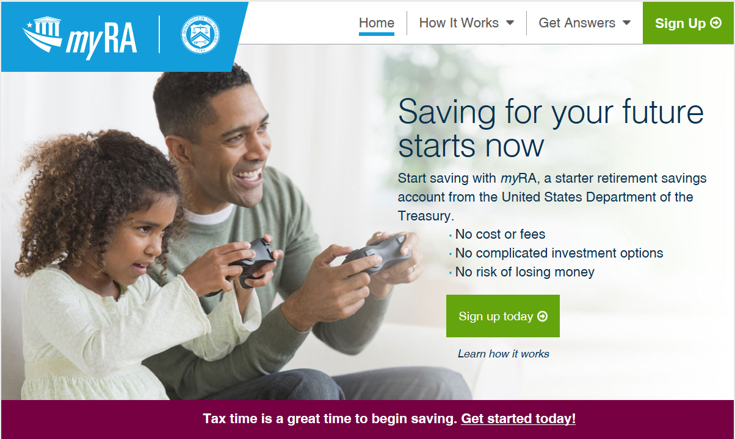
myRA.gov or 1-855-406-6972
Notes:
The U.S. Department of the Treasury has developed myRA, a retirement savings account for individuals looking for a simple, safe, and affordable way to save for their retirement.
myRA is a Roth IRA that invests in new U.S. Treasury retirement savings bonds. You can open an account, build up savings to $15,000, then transfer or roll over savings to a private-sector Roth IRA.
I don’t know about your situation, but millions of people don’t have access to a retirement savings plan at work or find it difficult to start saving money. Over thirty percent of all American households have no retirement savings. myRA removes some common barriers to saving.
With myRA:
There’s no cost and no fees to open and maintain an account;
The investment will not lose money;
U.S. Treasury backs the investment;
Account owners choose how much to save ($2, $20, $200 – whatever fits their budget);
If account owners change jobs, the account stays with them; and
Account owners can withdraw the money they put in without tax and penalty.
There are several ways to fund a myRA account:
From a paycheck. Account owners can set up automatic direct deposits with their employer(s) to their myRA.
From a checking or savings account. Account owners can set up recurring or one-time contributions from their checking or savings accounts to their myRA.
From a federal tax refund. At tax time, account owners can direct all or part of their federal tax return to their myRA.
Employers do not manage employee myRA accounts, contribute to them, or match employee contributions. At no cost to them, employers simply facilitate an ongoing payroll deduction from the employee’s paycheck to the designated myRA account in the amount the employee chooses.
You can sign up for a myRA account today by visiting www.myRA.gov or calling 855-406-6972 for questions and assistance.

Slide 8
We’ll Be Here For Your Family In The Future
Notes:
Social Security has continuously revised and transformed over time to meet the changing needs of the public. The combined OASI and DI Trust Funds will be able to pay all benefits in full and on time until 2034.
In the next section, we will look at a few life expectancy statistics, dive a little deeper into Social Security in the Future.

Slide 9
Birth Rates
Source: 2016 Trustees Report Table V.A1.
9
Notes:
The fertility rate in 1920 was about 3.2 children for all women of childbearing age. However, the rate declined dramatically during the depression.
Then, after World War II, a major increase in the fertility rate took place. We know the people born during that time of increase as the baby boomer generation.
But since 1960, there has been a major decline in the rate. This means there will be fewer future workers to support this large generation of baby boomer retirees.
Because of the changing demographics, over the years we have seen the ratio of workers to beneficiaries change.
In 1960 there were 5 people working for every 1 person drawing Social Security benefits, but today that radio is about 3 workers for each Social Security beneficiary. By 2035, when the baby boomer generation is in full retirement, there will be approximately 2 workers for each beneficiary.

Slide 10
Life Expectancy Statistics
A man reaching age 65 today can expect to live, on average, until age 84.3.
A woman turning age 65 today can expect to live, on average, until age 86.6.
And those are just averages. About one out of every four 65-year-olds today will live past age 90, and one out of 10 will live past age 95.
socialsecurity.gov/planners/lifeexpectancy.html
10
Notes:
The combined pressures of a massive baby boomer generation and increasing life expectancy will result in an American population with almost 20% of our projected population over the age of 65 by the year 2035.

Slide 11
Social Security in the Future
The two Social Security trust funds – Old-Age and Survivors Insurance (OASI) and Disability Insurance (DI) will be able to pay all benefits in full and on time until 2034.
The trust funds have reached the brink of depletion of asset reserves in the past, but Congress made substantial modifications to avoid this.
Even if legislative changes are not made before 2034, the trust funds will still be able to pay 79 percent of each benefit due.
11
Notes:
When you work, 85 cents of every Social Security tax dollar you pay goes to a trust fund that pays monthly benefits to current retirees and their families and to surviving spouses and children of workers who have died. The other 15 cents goes to a trust fund that pays benefits to people with disabilities and their families. From these trust funds, Social Security also pays the costs of managing the Social Security programs.
The Social Security Administration is one of the most efficient agencies in the federal government. For each dollar we receive, we spend less than one penny to manage the program.
There are two Social Security trust funds – Old-Age and Survivors Insurance (OASI) and Disability Insurance (DI).
Whether you’re just starting your career or are close to retirement, it’s important to understand these programs are directly dependent on the availability of asset reserves in their respective trust funds to pay benefits.
Social Security has evolved over time to meet the changing needs of the public.
Historically, the OASI and DI Trust Funds have reached times when dedicated tax revenue fell short of the cost of providing benefits and when the trust funds have reached the brink of asset reserve depletion. However, Congress approved the Social Security Amendments of 1977 and 1983, which reversed the cash flow of the program to positive levels and caused the substantial buildup of assets to the $2.8 trillion that exists today.
The 1983 amendments included an increase in the normal retirement age from 65 to 67 and introduced Social Security benefits income taxation with revenue credited to the trust funds.
The Social Security Trust Fund is fully funded until 2034.
Even if legislative changes are not made before 2034, Social Security will still be able to pay 79 percent of each benefit due.
The Social Security Administration’s Chief Actuary has a website with a wealth of data regarding the status of our Trust Funds. It includes online publications as well as a list of proposals to modify the Social Security program.
Here, you can also find online benefit calculators, information about Social Security Cost-of-Living Adjustments (COLA’s), and Congressional testimony and other communications by our Office of the Chief Actuary staff. Just visit SocialSecurity.gov/OACT.

Slide 12
Applying for Benefits
3 options available to apply:
Online
By phone 1-800-772-1213
At our office You choose the most convenient option for you! Note: Child and survivor claims can only be done by phone or in a field office (not online) at this time.
Notes:
You have three options, once you are ready to put in your application and start up your monthly benefits.
You can apply within 3 months of when you want your benefits to begin.
You have three options, when it comes time.
Your first option is to apply online at www.socialsecurity.gov. This is the most convenient way to apply.
Your second option is to call Social Security to schedule an appointment to apply over the telephone on a day and time that is convenient for you.
Your third option is to call Social Security to schedule an appointment to apply in-person at your local Social Security office with a face-to-face appointment.
Applying online is still the most convenient way to apply for benefits. You can apply for retirement benefits in as little as 15 minutes.

Slide 13
Notes:
The Social Security website is a valuable resource of information about all of Social Security’s programs and is accessible from a computer, tablet and smartphone. We encourage you to use our online retirement planning tools to plan for a secure financial future.

Slide 14
my Social Security
socialsecurity.gov/myaccount
Notes:
my Social Security is a convenient and secure suite of services designed to put you in control of your personal Social Security information, as well as help you manage your benefits when you are ready. Your account gives you the information you need whenever you want. All without calling or visiting a field office.
You can only open a my Social Security account for yourself. You cannot open an account for another person, even if you have his or her written consent. You may be unable to open a my Social Security account if you:
• Blocked electronic access to your personal Social Security information; • Recently moved or changed your name; or • Placed a freeze on your credit report.
Your online my Social Security account provides a variety of information to help you and your family. If you need help setting up your account, we have a 4-minute walkthrough video on our YouTube page.

Slide 15
my Social Security Services
If you receive benefits or have Medicare, you can:
Request a replacement Social Security card if you have a current Idaho Driver’s License and valid mailing address;
Get a benefit verification letter as proof that you are getting benefits;
Check your benefit and payment information and your earnings record;
Change your address and phone number;
Start or change direct deposit of your benefit payment;
Request a replacement Medicare card; and
Get a replacement SSA-1099 or SSA-1042S for tax season.
Notes:
So what can you do with a my Social Security account?
Your online my Social Security account provides a wealth of information to help you and your family plan for your financial future.
If you receive benefits or have Medicare, you can…

Slide 16
my Social Security Services
If you do not receive benefits, you can:
Request a replacement Social Security card if you have a current Idaho Driver’s License and valid mailing address;
Check the status of your retirement, disability or Medicare application or appeal;
Get a benefit verification letter as proof that you are not getting benefits;
Get your Social Security Statement to review:
Estimates of your future retirement, disability, and survivor benefits;
Your earnings to verify the amounts that we posted are correct; and
The estimated Social Security and Medicare taxes you’ve paid.
Notes:
If you do not receive benefits, you can…

Slide 17
How to open a my Social Security account
1
Visit socialsecurity.gov/myaccount
2
Select: Sign In or Create an Account
3
Provide some personal information to verify your identity.
4
Choose a “username” and “password” to create your account.
17
Notes:
To open a my Social Security account, you have to be at least 18 years of age, have a valid e-mail address, a Social Security number, and a U.S. mailing address.
To open your account, go to socialsecurity.gov/myaccount and select “Sign In or Create an Account.”
You will have to provide some personal Social Security information about yourself and give us answers to some questions only you are likely to know to verify your identity.
Next, you choose a “username” and an 8-character “password” to access your online account. This process protects you and keeps your personal Social Security information private.
You will also notice the option of adding an extra level of security to your account. By selecting “Yes, let’s start now” you are prompted to select an additional question to answer. With this feature, you will receive a temporary code via text message each time you attempt to log in. And you will use this code with your account password. Keep in mind that your cell phone provider’s message rates may apply.

Slide 18
Retirement!
Notes:
When most people think of Social Security, they think of retirement benefits —with good reason. Social Security is a lifeline for most retirees, keeping tens of millions out of poverty.
In the next section, we will talk about retirement, share some important details about retirement planning and discuss how Social Security is here to help secure today and tomorrow with financial benefits, information, and tools.

Slide 19
Retirement Benefit Statistics
As of December 2016, 41 million retired workers were receiving 56.1 billion dollars in Social Security benefits per month.
At the same time, 3 million dependents of retired workers were receiving 2.1 billion dollars in monthly Social Security benefits.
Notes:
As of December 2016, 41 million retired workers were receiving 56.1 billion dollars in Social Security benefits per month. At the same time, 3 million dependents of retired workers were receiving 2.1 billion dollars in monthly Social Security benefits

Slide 20
How Do You Qualify for Retirement Benefits?
By earning “credits” when you work and pay Social Security taxes
You need 40 credits (10 years of work) and you must be 62 or older
Each $1,300 in earnings gives you one credit
You can earn a maximum of 4 credits per year
Note: To earn 4 credits in 2017, you must earn at least $5,200.00.
20
Notes:
Credits are the "building blocks" Social Security uses to find out whether you have the minimum amount of covered work to qualify for each type of Social Security benefit.
If you stop working before you have enough credits to qualify for benefits, your credits will stay on your record. If you return to work later on, you can add more credits so you can qualify.
No benefits can be paid if you do not have enough credits.
In 2017, you must earn $1,300 in covered earnings to get one Social Security or Medicare work credit and $5,200 to get the maximum four credits for the year.
When you work and pay Social Security taxes, you earn up to a maximum of four "credits" for each year.
During your lifetime, you will probably earn more credits than the minimum number you need to be eligible for benefits; however, these extra credits do not increase your benefit amount.
Your average earnings during your working years determine how much your monthly payment will be.

Slide 21
How Social Security Determines Your Benefit?
Benefits are based on earnings
Step 1 -Your wages are adjusted for changes in wage levels over time
Step 2 -Find the monthly average of your 35 highest earnings years
Step 3 -Result is “average indexed monthly earnings”
21
Notes:
Credits are based on your total wages and self-employment income during the year, no matter when you did the actual work. You might work all year to earn four credits, or you might earn enough for all four in a much shorter length of time.
We are looking for the highest 35 years during a worker's lifetime of earnings, regardless of when earned.
Using this formula means that a worker who qualifies for a retirement benefit with just 10 years of work would have a lower benefit payment than someone who worked longer. That’s because we are looking at the highest 35 years of earnings. In this example, there would be 25 years with zero earnings.

Slide 22
What Is the Best Age to Retire?
Age You Choose to Start Receiving Benefits
Note: This example assumes a benefit of $1,000 at a full retirement age of 66
Notes:
Choosing when to retire is an important and personal decision. Financial experts say you’ll need 70-80% of your preretirement income to have a comfortable retirement. You’ll want to choose a retirement age based on your circumstances so you’ll have enough income when you need it.
As you can see on this chart, your monthly retirement benefit will be higher if you delay starting it. We calculate your basic Social Security benefit — the amount you would receive at your full retirement age — based on your lifetime earnings.
However, the actual amount you receive each month depends on when you start receiving benefits. You can start your retirement benefit at any point from age 62 up until age 70, and your benefit will be higher the longer you delay starting it. This adjustment is usually permanent: it sets the base for the benefits you’ll get for the rest of your life.
You may receive an annual cost-of-living adjustments and, depending on your work history, may receive higher benefits if you continue to work.
Let’s say your full retirement age is 66 and your monthly benefit starting at that age is $1,000. If you choose to start getting benefits at age 62, we’ll reduce your monthly benefit 25 percent to $750 to account for the longer period of time you receive benefits. If you choose to delay getting benefits until age 70, you would increase your monthly benefit to $1,320. This increase is from delayed retirement credits you earn for your decision to postpone receiving benefits past your full retirement age. The benefit at age 70 in this example is 32 percent more than you would receive each month if you had chosen to start getting benefits at full retirement age.

Slide 23
Year of Birth | Full Retirement Age | A $1000 retirement benefit taken at age 62 would be reduced by | A $500 spouse benefit taken at age 62 would be reduced by
1943-1954 | 66 | 25% | 30%
1955 | 66 and 2 months | 25.83% | 30.83%
1956 | 66 and 4 months | 26.67% | 31.67%
1957 | 66 and 6 months | 27.5% | 32.5%
1958 | 66 and 8 months | 28.33% | 33.33%
1959 | 66 and 10 months | 29.17% | 34.17%
1960 + | 67 | 30% | 35%
Notes:
Remember that when to start receiving retirement benefits is a personal choice. There isn’t a one fits all answer.
You should make an informed decision about when to apply for benefits based on your individual and family circumstances.
Factors you should consider when deciding the best age to retire:
Your current cash needs;
Your health and family longevity;
Whether you plan to work in retirement;
Whether you have other retirement income sources;
Your anticipated future financial needs and obligations; and,
The amount of your future Social Security benefits.
This chart gives an example of how much a $1,000 retirement benefit and a $500 retirement benefit would be reduced if someone took the benefit at age 62.
The increase in full retirement age was the result of the 1983 Amendments to the Social Security Act. Full retirement age increases apply to both Retirement Benefits and Survivors Benefits. Although we at Social Security have always used the term “full” retirement age, you may find that some people now refer to “full retirement age” as the “Normal Retirement Age”. Regardless of your full retirement age, reduced benefits can still be paid as early as age 62.
In addition, the Medicare eligibility age of 65 has not changed. We recommend that you apply for Medicare 3 months before your 65th birthday (unless you are already receiving Social Security benefits when you turn 65, in which case you will be automatically enrolled in Medicare).
Source: https://www.ssa.gov/oact/quickcalc/earlyretire.html

Slide 24
Year of birth | Normal Retirement Age (NRA) | Increase for each year of delayed retirement (until age 70) | Benefit, as a percentage of PIA, beginning at age--
 |  |  | 62 | 63 | 64 | 65 | 66 | 67 | 70
1943-54 | 66 | 8% | 75 | 80 | 86 ²⁄₃ | 93 ¹⁄₃ | 100 | 108 | 132
1955 | 66, 2 mo. | 8% | 74 ¹⁄₆ | 79 ¹⁄₆ | 85 ⁵⁄₉ | 92 ²⁄₉ | 98 ⁸⁄₉ | 106 ²⁄₃ | 130 ²⁄₃
1956 | 66, 4 mo. | 8% | 73 ¹⁄₃ | 78 ¹⁄₃ | 84 ⁴⁄₉ | 91 ¹⁄₉ | 97 ⁷⁄₉ | 105 ¹⁄₃ | 129 ¹⁄₃
1957 | 66, 6 mo. | 8% | 72 ¹⁄₂ | 77 ¹⁄₂ | 83 ¹⁄₃ | 90 | 96 ²⁄₃ | 104 | 128
1958 | 66, 8 mo. | 8% | 71 ²⁄₃ | 76 ²⁄₃ | 82 ²⁄₉ | 88 ⁸⁄₉ | 95 ⁵⁄₉ | 102 ²⁄₃ | 126 ²⁄₃
1959 | 66, 10 mo. | 8% | 70 ⁵⁄₆ | 75 ⁵⁄₆ | 81 ¹⁄₉ | 87 ⁷⁄₉ | 94 ⁴⁄₉ | 101 ¹⁄₃ | 125 ¹⁄₃
1960 and later | 67 | 8% | 70 | 75 | 80 | 86 ²⁄₃ | 93 ¹⁄₃ | 100 | 124
Notes:
Remember that when to start receiving retirement benefits is a personal choice. There isn’t a one fits all answer.
You should make an informed decision about when to apply for benefits based on your individual and family circumstances.
Factors you should consider when deciding the best age to retire:
Your current cash needs;
Your health and family longevity;
Whether you plan to work in retirement;
Whether you have other retirement income sources;
Your anticipated future financial needs and obligations; and,
The amount of your future Social Security benefits.
This chart gives an example of how much a $1,000 retirement benefit and a $500 retirement benefit would be reduced if someone took the benefit at age 62.
The increase in full retirement age was the result of the 1983 Amendments to the Social Security Act. Full retirement age increases apply to both Retirement Benefits and Survivors Benefits. Although we at Social Security have always used the term “full” retirement age, you may find that some people now refer to “full retirement age” as the “Normal Retirement Age”. Regardless of your full retirement age, reduced benefits can still be paid as early as age 62.
In addition, the Medicare eligibility age of 65 has not changed. We recommend that you apply for Medicare 3 months before your 65th birthday (unless you are already receiving Social Security benefits when you turn 65, in which case you will be automatically enrolled in Medicare).
Source: https://www.ssa.gov/oact/quickcalc/earlyretire.html

Slide 25
Retirement Estimator
Gives estimates based on your actual Social Security earnings record
You can use the Retirement Estimator if:
You have enough Social Security credits at this time to qualify for benefits and
You are not:
Currently receiving benefits on your own Social Security record;
Waiting for a decision about your application for benefits or Medicare;
Age 62 or older and receiving benefits on another Social Security record; or
Eligible for a Pension Based on Work Not Covered By Social Security.
socialsecurity.gov/estimator
Notes:
You can use the online Retirement Estimator at www.socialsecurity.gov/estimator to get immediate and personalized benefit estimates to help you plan for your retirement.
It’s a convenient, secure and quick financial planning tool.
The Retirement Estimator, is an interactive tool that allows you to create “what if” scenarios.
You can, for example, change your “stop work” dates or “expected future earnings” to create and compare different retirement options.

Slide 26
Working While Receiving Benefits
If you are | You can make up to | If you earn more, some benefits will be withheld
Under Full Retirement Age | $16,920/yr. | $1 for every $2
The Year Full Retirement Age is Reached | $44,880/yr. before month of full retirement age | $1 for every $3
Month of Full Retirement Age and Above | No Limit | No Limit
Note: If some of your retirement benefits are withheld because of your earnings, your benefits will be increased starting at your full retirement age to take into account those months in which benefits were withheld.
Notes:
The first thing we recommend is that you visit SocialSecurity.gov/pubs and search for the publication entitled, How Work Affects Your Benefits. It explains the rules you must follow in order to avoid an overpayment, and it gives some great examples for different scenarios that could apply to your individual situation.
You can get Social Security retirement or survivors benefits and work at the same time. However, if you’re younger than full retirement age, and earn more than certain amounts, your monthly benefit remains the same but the total amount of benefits you receive for the year will be reduced. The amount that your annual benefits are reduced, however, isn’t truly lost. Your monthly benefit will be increased at your full retirement age to account for benefits withheld due to earlier earnings.
Note that spouses and survivors, who receive benefits because they have minor or disabled children in their care, don’t receive increased benefits at full retirement age if benefits were withheld because of work. I should also mention that different rules apply if you work outside the United States. Contact us if you’re working (or plan to work) outside the country.
But for most of you, here’s how this works. If you work, and are full retirement age or older, you may keep all of your benefits, no matter how much you earn.
If you’re younger than full retirement age, there is a limit to how much you can earn and still receive full Social Security benefits. If you’re younger than full retirement age, we must deduct $1 from your benefits for each $2 you earn above the annual limit. For 2017, that limit is $16,920.
If you reach full retirement age during 2017, we must deduct $1 from your benefits for each $3 you earn above $44,880 until the month you reach full retirement age.
Starting with the month you reach full retirement age, there is no limit on how much you can earn and still receive all of your Social Security benefits.

Slide 27
For People Younger Than Full Retirement Age During 2017
If your monthly Social Security Benefit is | And you earn | You’ll receive yearly benefits of
$700 | $16,920 or less | $8,400
$700 | $17,000 | $8,360
$700 | $20,000 | $6,860
Notes:
This table provides you with some quick examples to demonstrate how much someone could receive in Social Security benefits for the year 2017, based on his or her monthly benefits and estimated earnings.
In this example, we have a person whose monthly retirement, spousal, or survivor benefit is $700.
In the first row, you see that as long as the person doesn’t earn more than the 2017 limit of $16,920, all benefits are paid for the year ($700 x 12 = $8,400).
In the second row, the person earns a little more than the limit. We take the earned amount, the $17,000, and subtract the limit of $16,920, which leaves $80. Since the offset is $1 in withholdings for every $2 over the limit, we divide $80 in half, leaving $40 to be withheld before he or she is paid Social Security. $40 is the amount that Social Security must withhold up front before the person receives any Social Security payments in 2017. The yearly benefit amount would then be $8,360, or $8,400 minus $40.
In the third row, the person earns $20,000 in gross wages and/or net profit from self employment (which is all that we consider when applying the earnings limit). $20,000 minus the limit of $16,920 means the person went over by $3,080. Since the offset is $1 in withholdings for every $2 over the limit, we divide $3,080 in half, leaving $1,540 to be withheld before he or she is paid Social Security in 2016. $8,400 minus $1,540 equals $6,860 in yearly benefits for this individual, even though the person earned more than $3,000 over the Social Security earnings limit!
So, as you can see, you CAN work and still get some Social Security benefits prior to your full retirement age. And remember that once you reach full retirement age, all of this goes away. You can earn as much as you desire without any worries about a Social Security earnings limit, once you reach full retirement age. But keep in mind that, as we mentioned earlier, the IRS may still apply taxes to your Social Security benefits.
We do realize that sometimes people who retire in mid-year already have earned more than the annual earnings limit. That’s why there is a special rule that applies to earnings for one year, usually the first year of retirement. Under this rule, you can get a full Social Security check for any whole month you’re retired, regardless of your yearly earnings. In 2016, a person younger than full retirement age for the entire year is considered retired if monthly earnings are $1,310 or less.
NOTE: the $700 benefit seems a bit low for an average benefit but it is just an illustrative example. There are definitely people receiving benefits at that $700 level. According to https://www.ssa.gov/OACT/ProgData/benefits/ra_mbc201512.html , there were 1.7 million OABs receiving between $600 and $699 per month, and another 2.3 million between $700 and $799.

Slide 28
Taxation of Social Security Benefits
If you:
file a federal tax return as an "individual" and your combined income* is
between $25,000 and $34,000, you may have to pay income tax on up to 50 percent of your benefits.
more than $34,000, up to 85 percent of your benefits may be taxable.
file a joint return, and you and your spouse have a combined income* that is
between $32,000 and $44,000, you may have to pay income tax on up to 50 percent of your benefits
more than $44,000, up to 85 percent of your benefits may be taxable.
are married and file a separate tax return, you probably will pay taxes on your benefits.
Visit IRS.gov and search for Publication 554, Tax Guide for Seniors, and Publication 915,
Social Security And Equivalent Railroad Retirement Benefits
Notes:
No one pays federal income tax on more than 85 percent of his or her Social Security benefits based on Internal Revenue Service (IRS) rules.
If you:
file a federal tax return as an "individual" and your combined income* is
between $25,000 and $34,000, you may have to pay income tax on up to 50 percent of your benefits.
more than $34,000, up to 85 percent of your benefits may be taxable.
file a joint return, and you and your spouse have a combined income* that is
between $32,000 and $44,000, you may have to pay income tax on up to 50 percent of your benefits
more than $44,000, up to 85 percent of your benefits may be taxable.
are married and file a separate tax return, you probably will pay taxes on your benefits.
Every January you will receive a Social Security Benefit Statement (Form SSA-1099) showing the amount of benefits you received in the previous year. You can use this Benefit Statement when you complete your federal income tax return to find out if your benefits are subject to tax.
Note that if you currently live in the United States and you misplaced or didn’t receive a form SSA-1099 or SSA-1042S, you can now can get an instant replacement form by using your online my Social Security account. If you don’t already have an account, you can create one online. To get your replacement form SSA-1099 or SSA-1042S, click the link that says “Sign In or Create an Account.” Once you are logged in to your account, select the "Replacement Documents" tab to request the form.
If you do have to pay taxes on your Social Security benefits, you can make quarterly estimated tax payments to the IRS or choose to have federal taxes withheld from your benefits. For more information about taxation of Social Security benefits, read page 14 of our Retirement Benefits booklet or visit the IRS.gov website and search for Publication 915, Social Security and Equivalent Railroad Retirement Benefits. You can also find some basic information on our website, SocialSecurity.gov, by typing the word “taxes” in the search box.

Slide 29
Taxation of Social Security Benefits
Your adjusted gross income + Nontaxable interest + ½ of your Social Security benefits = Your "combined income“
29

Slide 30
Dependent Benefits
Notes:
For some, marriage means a new name. If you legally change your name due to marriage, divorce, or any other reason, make sure that getting an updated Social Security card is on your To Do list. That way, we can continue to accurately keep track of your earnings so you get the benefits you deserve.
In this section, we will look at the benefits available to spouses, divorced spouses and children, and learn about the Government Pension Offset.

Slide 31
Dependent Benefit Statistics
As of December 2016, 3 million dependents of retired workers were receiving 2.1 billion dollars in Social Security benefits each month.
At the same time, 1.8 million dependents of disabled workers were receiving 640 million dollars in monthly Social Security benefits.
socialsecurity.gov/planners
Notes:
As of December 2016, 3 million dependents of retired workers were receiving 2.1 billion dollars in Social Security benefits each month. At the same time, 1.8 million dependents of disabled workers were receiving 640 million dollars in monthly Social Security benefits.
Source for all values is December 2016 beneficiary data found at https://www.ssa.gov/OACT/ProgData/icp.html.
When you are doing your financial planning, please remember that we pay benefits to children whose parents are eligible for Social Security retirement, disability, or survivor benefits. The child (or children) must be unmarried and under age 18, or under age 19 if still in high school. To receive benefits on a parent’s record past that point, the child must be unmarried and have a disability that began prior to age 22.
SSI, on the other hand, only pays benefits to the individual; not to his or her children.
You can find more information on our benefit planners page www.ssa.gov/planners. Here you can find planners to help spouses, divorced spouses, children, widows and widowers.

Slide 32
Spousal Benefits
Benefit is 35%-50% of worker’s unreduced benefit
Reduction for early retirement
If spouse’s own benefit is less than 50% of the worker’s, the benefits are combined
Does not reduce payment to the worker
Notes:
A spouse who has not worked or who has low earnings can be entitled to as much as one-half of the retired worker’s full benefit.
If you are eligible for both your own retirement benefits and for benefits as a spouse, we always pay your own benefits first. If your benefits as a spouse are higher than your retirement benefits, you will get a combination of benefits equaling the higher spouse benefit.
If spouses want to get Social Security retirement benefits before they reach full retirement age, the amount of the benefit is reduced. The amount of reduction depends on when the person reaches full retirement age.
However, if a spouse is caring for a child under age 16 or disabled, who gets Social Security benefits on the worker’s record, the spouse gets full benefits, regardless of age.

Slide 33
Year of Birth | Full Retirement Age | A $1000 retirement benefit taken at age 62 would be reduced by | A $500 spouse benefit taken at age 62 would be reduced by
1943-1954 | 66 | 25% | 30%
1955 | 66 and 2 months | 25.83% | 30.83%
1956 | 66 and 4 months | 26.67% | 31.67%
1957 | 66 and 6 months | 27.5% | 32.5%
1958 | 66 and 8 months | 28.33% | 33.33%
1959 | 66 and 10 months | 29.17% | 34.17%
1960 + | 67 | 30% | 35%
Notes:
This chart gives an example of how much a $1,000 retirement benefit and a $500 retirement benefit would be reduced if someone took the benefit at age 62.
The increase in full retirement age was the result of the 1983 Amendments to the Social Security Act. Full retirement age increases apply to both Retirement Benefits and Survivors Benefits. Although we at Social Security have always used the term “full” retirement age, you may find that some people now refer to “full retirement age” as the “Normal Retirement Age”. Regardless of your full retirement age, reduced benefits can still be paid as early as age 62.
In addition, the Medicare eligibility age of 65 has not changed. We recommend that you apply for Medicare 3 months before your 65th birthday (unless you are already receiving Social Security benefits when you turn 65, in which case you will be automatically enrolled in Medicare).
Source: https://www.ssa.gov/oact/quickcalc/earlyretire.html

Slide 34
Spousal Benefits Example 1
Husband turned 66 in 2015 and filed for SSA retirement (qualifies for 100% of his retirement)
His benefit is $2000 a month
Wife did not work. She turned 66 in 2017 and files for spousal benefits (50% of husband’s)
Her benefit is $1000 a month
Notes:
A spouse who has not worked or who has low earnings can be entitled to as much as one-half of the retired worker’s full benefit.
If you are eligible for both your own retirement benefits and for benefits as a spouse, we always pay your own benefits first. If your benefits as a spouse are higher than your retirement benefits, you will get a combination of benefits equaling the higher spouse benefit.
If spouses want to get Social Security retirement benefits before they reach full retirement age, the amount of the benefit is reduced. The amount of reduction depends on when the person reaches full retirement age.
However, if a spouse is caring for a child under age 16 or disabled, who gets Social Security benefits on the worker’s record, the spouse gets full benefits, regardless of age.

Slide 35
Spousal Benefits Example 2
Husband turned 66 in 2015 and filed for SSA retirement (qualifies for 100% of his retirement)
His benefit is $2000 a month
Wife did not work. She turned 62 in 2017 and files for spousal benefits ($1000 reduced by 30% = $300)
Her benefit is $700 a month (35% of his amount)
Notes:
A spouse who has not worked or who has low earnings can be entitled to as much as one-half of the retired worker’s full benefit.
If you are eligible for both your own retirement benefits and for benefits as a spouse, we always pay your own benefits first. If your benefits as a spouse are higher than your retirement benefits, you will get a combination of benefits equaling the higher spouse benefit.
If spouses want to get Social Security retirement benefits before they reach full retirement age, the amount of the benefit is reduced. The amount of reduction depends on when the person reaches full retirement age.
However, if a spouse is caring for a child under age 16 or disabled, who gets Social Security benefits on the worker’s record, the spouse gets full benefits, regardless of age.

Slide 36
Spousal Benefits Example 3
Wife is 66 and qualifies for $700 on her own record
Wife qualifies for a spousal benefit of $1000 on husband
She does NOT receive $1700
She receives her benefit of $700 and her spousal benefit of $300 to bring her total to $1000
Notes:
A spouse who has not worked or who has low earnings can be entitled to as much as one-half of the retired worker’s full benefit.
If you are eligible for both your own retirement benefits and for benefits as a spouse, we always pay your own benefits first. If your benefits as a spouse are higher than your retirement benefits, you will get a combination of benefits equaling the higher spouse benefit.
If spouses want to get Social Security retirement benefits before they reach full retirement age, the amount of the benefit is reduced. The amount of reduction depends on when the person reaches full retirement age.
However, if a spouse is caring for a child under age 16 or disabled, who gets Social Security benefits on the worker’s record, the spouse gets full benefits, regardless of age.

Slide 37
2015 Bi-Partisan Budget Act (BBA) Changes:
If you were born before January 2, 1954 and wait to reach your full retirement age, you can choose to receive only the spouse’s benefit and delay receiving your retirement benefit until a later date. If your birthday is January 2, 1954 or later, the option to take only one benefit at full retirement age no longer exists. When you file for one benefit, you will be filing for all retirement or spousal benefits.
socialsecurity.gov/planners/retire/deemedfaq.html
37
Notes:
You may have heard or read about the various filing strategies available to married couples, when it comes to Social Security retirement and spousal benefits. Due to a change in the law, some of those options are changing.
The first change in the law says that now, if you become eligible for Social Security benefits both as a retiree and as a spouse (or divorced spouse), and you want to go ahead and claim your benefits, you must file for both benefits.
This is called “deemed filing,” and it used to apply only prior to Full Retirement Age. Based on the law change, deemed filing now applies at any age for people who turned age 62 after January 1, 2016.
However, there are two exceptions to the deemed filing provision:
Child-in-Care Benefits: When a beneficiary is entitled to spousal benefits based on the child-in-care requirements and is eligible for retirement benefits, he or she may delay filing for the retirement benefit.
Receiving Both Disability And Spouse’s Benefits: When a beneficiary is entitled to disability and spouse’s benefits, he or she may delay filing for retirement benefits. If the disability benefits terminate before converting to retirement benefits, deemed filing applies in the month of termination of the disability benefit.

Slide 38
2015 BBA Example:
You were born on July 6, 1951 (age 66)
You qualify for $1000 on your own record at age 66 or you qualify for $1000 as a spouse
You can take the spousal benefit and let yours sit until age 70 when you would qualify for 132% of your own ($1000 x 132% = $1320) then switch.
socialsecurity.gov/planners/retire/deemedfaq.html
38
Notes:
You may have heard or read about the various filing strategies available to married couples, when it comes to Social Security retirement and spousal benefits. Due to a change in the law, some of those options are changing.
The first change in the law says that now, if you become eligible for Social Security benefits both as a retiree and as a spouse (or divorced spouse), and you want to go ahead and claim your benefits, you must file for both benefits.
This is called “deemed filing,” and it used to apply only prior to Full Retirement Age. Based on the law change, deemed filing now applies at any age for people who turned age 62 after January 1, 2016.
However, there are two exceptions to the deemed filing provision:
Child-in-Care Benefits: When a beneficiary is entitled to spousal benefits based on the child-in-care requirements and is eligible for retirement benefits, he or she may delay filing for the retirement benefit.
Receiving Both Disability And Spouse’s Benefits: When a beneficiary is entitled to disability and spouse’s benefits, he or she may delay filing for retirement benefits. If the disability benefits terminate before converting to retirement benefits, deemed filing applies in the month of termination of the disability benefit.

Slide 39
Voluntary Suspension
The 2015 BBA closed the loopholes on this retirement strategy. If you take your retirement benefit and then ask to suspend it to earn delayed retirement credits, your spouse or dependents (excluding divorced spouses) will not be able to receive benefits on your Social Security record while your own benefits are suspended.
socialsecurity.gov/planners/retire/suspendfaq.html
39
Notes:
The second change in the law involves what we call “voluntary suspension.”
If you take your retirement benefit and then ask to suspend it to earn delayed retirement credits, your spouse or dependents (excluding divorced spouses) generally will not be able to receive benefits on your Social Security record while your own benefits are suspended.
In addition, you will not be able to receive benefits on anyone else’s record during that time.
We know that some of these rules can be confusing, so we encourage you to visit our website for a comprehensive explanation and see some specific examples that illustrate how this plays out for married couples.

Slide 40
Benefits for Divorced Spouses
If you are divorced, and your marriage lasted 10 years or longer, you can receive benefits on your ex-spouse's record (even if he or she has remarried) if:
You are unmarried;
You are age 62 or older;
Your ex-spouse is entitled to Social Security retirement or disability benefits; and
The benefit you are entitled to receive based on your own work is less than the benefit you would receive based on your ex-spouse's work.
Notes:
If you are divorced, and your marriage lasted 10 years or longer, you can receive benefits on your ex-spouse's record (even if he or she has remarried) if:
You are unmarried;
You are age 62 or older;
Your ex-spouse is entitled to Social Security retirement or disability benefits; and
The benefit you are entitled to receive based on your own work is less than the benefit you would receive based on your ex-spouse's work.
Your benefit as a divorced spouse is equal to one-half of your ex-spouse's full retirement amount (or disability benefit) if you start receiving benefits at your full retirement age. The benefits do not include any delayed retirement credits your ex-spouse may receive.
If you remarry, you generally cannot collect benefits on your former spouse's record unless your later marriage ends (whether by death, divorce or annulment).
If your ex-spouse has not applied for retirement benefits, but can qualify for them, you can receive benefits on his or her record if you have been divorced for at least two years.
If you are eligible for retirement benefits on your own record and divorced spouse’s benefits, we will pay the retirement benefit first. If the benefit on your ex-spouse’s record is higher, you will get an additional amount on your ex-spouse’s record so that the combination of benefits equals that higher amount.
If you were born before January 2, 1954 and have already reached full retirement age, you can choose to receive only the divorced spouse’s benefit and delay receiving your retirement benefit until a later date. If your birthday is January 2, 1954 or later, the option to take only one benefit at full retirement age no longer exists. If you file for one benefit, you will be effectively filing for all retirement or spousal benefits.

Slide 41
Survivor and Auxiliary Benefits
Notes:
Life comes with many obstacles and challenges and the loss of a loved one can be both emotionally and financially difficult. Social Security provides a safety net to help if the unexpected happens. In this next section, we will discuss Social Security’s survivor benefits and eligibility factors.

Slide 42
Survivor Eligibility Factors
Child | Can receive benefit if not married and is under age 18 (or under age 19 if still in high school)
Disabled Child | Can receive benefits beyond age 18 if not married and was disabled before age 22
Widow / Widower | Can get full benefits at full retirement age – or reduced benefits at age 60 – or as early as age 50 if disabled – or at any age if caring for child under 16 or a disabled child
Notes:
Let’s take a look at how people become eligible for Social Security survivor benefits.
A child can receive benefit if he or she is not married and is under age 18 (or under age 19 if still in high school). A disabled child can receive benefits beyond age 18 if he or she is not married and was disabled before age 22.
A widow or widower can get full benefits at full retirement age – or reduced benefits at age 60 – or as early as age 50 if disabled – or at any age if caring for child under 16 or a disabled child.
The length of marriage requirement for a widow or widower to be eligible for benefits is 9 months, and for a surviving divorced spouse it is 10 years. Please note, there are exceptions to the duration of marriage requirements.
Generally, you cannot get widow’s or widower’s benefits if you remarry before age 60. But remarriage after age 60 (or age 50 if you are disabled) will not prevent you from getting benefit payments based on your former spouse’s work. Also, at age 62 or older, you may get benefits based on your new spouse’s work, if those benefits would be higher.

Slide 43
Survivor Benefits
When you pass away, your surviving spouse can:
Receive 100% of your full benefit if full retirement age; or
At age 60, receive 71.5% of your full benefit and increases each month you wait up to 100% if you start at full retirement age; or
Claim survivor benefits at any age between 60 and full retirement age.
43
Notes:
Next, let’s talk about how survivor benefits are calculated
So, it is possible to get a reduced survivor benefit on one record at age 60, then apply for a reduced – or unreduced – retirement benefit on the other record at age 62 or older.
Full benefits can be paid by Social Security to both the widow or widower and a divorced widow or widower. In other words, benefits paid to a surviving divorced spouse who is 60 or older (age 50 if disabled) will not affect the benefit rates for other survivors receiving benefits.

Slide 44
Benefits for Children under 18
A child must have:
A parent who’s disabled or retired and entitled to Social Security benefits; or
A parent who died after having worked long enough in a job where they paid Social Security taxes.
The child must also be:
Unmarried;
Younger than age 18;
18-19 years old and a full-time student (no higher than grade 12); or
18 or older and disabled. (The disability must have started before age 22.)
Notes:
https://www.ssa.gov/pubs/EN-05-10085.pdf
Your child can get benefits if they’re your biological child, adopted child, or dependent stepchild. (Sometimes, your child could also be eligible for benefits on their grandparents’ earnings.)
Within a family, a child can receive up to half of the parent’s full retirement or disability benefit. If a child receives survivors benefits, they can get up to 75 percent of the deceased parent’s basic Social Security benefit. There is a limit, however, to the amount of money that we can pay to a family. The family maximum payment is determined as part of every Social Security benefit computation. It can be from 150 to 180 percent of the parent’s full benefit amount. If the total amount payable to all family members exceeds this limit, we reduce each person’s benefit proportionately (except the parent’s) until the total equals the maximum allowable amount.

Slide 45
Spouse (living) benefits
Survivor (death) benefits
Can start from age 62 to Full Retirement Age (FRA)
50% at FRA or less if you start prior to FRA (reduction for each month you take it early)
Divorced spouses qualify if marriage lasted at least 10 years and other conditions are met
Can start from age 60 to Full Retirement Age (FRA)
71.5% at age 60 and increases each month you wait, up to 100% if you start at FRA
Divorced spouses qualify if marriage lasted at least 10 years and other conditions are met
45
Notes:
Here is a side-by-side comparison of spousal and survivor benefits.
The worker and his or her spouse must be married for one year (continuously) immediately before the day on which the application is filed.
(Note: The one-year requirement can be waived if the spouse is the natural mother or father of the worker’s biological child or if the spouse was entitled or potentially entitled to certain auxiliary or survivor’s benefits in the month before the month of marriage to the worker).
If a spouse is caring for a child under age 16 of the worker, the spouse could qualify regardless of age. When the youngest child turns 16, the spouse’s benefit will stop, even though the child’s benefit will continue. However, if the child is disabled, the spouse’s benefits will continue as long as the child is under his or her care.

Slide 46
You can switch to retirement as early as age 62 if that benefit is higher than your widows benefit.
46
Notes:
If you begin receiving survivor benefits, we recommend that you contact us at age 62 to see if you are eligible for a higher benefit on your own record.
If we calculate your retirement benefit and it is lower than what you are already receiving as a survivor, then we are not going to switch you to over to retirement and reduce your monthly benefit. Remember, retirement and survivor benefits both fall under the same umbrella of financial protection offered by Social Security.
However, if we calculate your retirement and it is higher than what you are already getting as a survivor, YOU HAVE A CHOICE.
You can either switch over immediately for the higher monthly payment, or you can stay on survivor benefits and switch over to retirement later on down the road … when something comes up and you need more money coming in … or as late as age 70 if you want to completely max-out your retirement (by getting all possible delayed retirement credits added to your calculation).
Contact Social Security to find out if you can switch to get a higher benefit amount. SSA will review your individual situation and make a determination.

Slide 47
Disability Benefits
Notes:
Disability means something different to each of us. More than likely, you know someone who has a disabling condition, whether it be a physical condition, a mental impairment, or both.
Social Security disability benefits provide modest coverage for severely disabled workers and their dependents, including our wounded warriors.
For many of our beneficiaries, their monthly disability payment represents most of their income. Even these modest payments can make a huge difference in the lives of people who can no longer work. They allow people to meet basic needs and the needs of their families.
In this section, we will discuss exactly how Social Security defines disability, talk about our disability programs, and take a look at several initiatives that can get people faster decisions on their disability claims

Slide 48
Disability Benefit Statistics
As of December 2016, Social Security paid an average monthly disability benefit of $1,171.15. That’s barely enough to keep a beneficiary above the poverty level ($12,060 annually).
56 million Americans, or 1-in-5 people in this country, live with disabilities.
48 million disabled Americans, or 1-in-10 people here, live with severe disabilities
Notes:
Stats:
- Social Security disability payments are modest. As of December 2016, Social Security paid an average monthly disability benefit of $1,171.15. That is barely enough to keep a beneficiary above the poverty level ($12,060 annually). (https://aspe.hhs.gov/poverty-guidelines)
(https://www.ssa.gov/oact/progdata/icp.html)
- 56 million Americans, or 1-in-5 people in this country, live with disabilities.
- 48 million disabled Americans, or 1-in-10 people here, live with severe disabilities.

Slide 49
Social Security Disability Insurance (SSDI)
The SSDI program pays monthly benefits to you and to certain members of your family if:
You have worked long enough, recently enough, and
You have a medical condition that has prevented you from working – or is expected to prevent you from working – at a substantial level for at least 12 months, or your medical condition is expected to end in death.
49
Notes:
Social Security’s disability definition is based on your medical condition and the fact that you are not expected to be able to do any work for at least 12 months or your condition is terminal. This work determination is based on your age, education and work experience.
The actual disability definition makes the clear distinction between Social Security’s disability requirements compared to other disability programs, such as Veterans and Workman’s Compensation.
After becoming eligible for a disability benefit, the law requires us to conduct a medical review to ensure that the beneficiary still qualifies for the program. This generally occurs every 3 to 7 years, depending on the severity of the disability.

Slide 50
Supplemental Security Income (SSI)
Social Security administers the Supplemental Security Income program, which pays benefits to disabled adults and children who have limited income and resources.
SSI benefits also are payable to adults age 65 and older who do not have disabilities, if these individuals meet the financial limits.
People who have worked long enough, recently enough, may be able to receive Social Security benefits – such as disability or retirement – as well as SSI.
50
Notes:
SSI stands for Supplemental Security Income. Social Security administers the SSI program, which pays monthly benefits to adults with limited income and resources who are disabled, blind, or age 65 or older. Blind or disabled children may also get SSI.
People who have worked long enough, recently enough, may be able to receive Social Security benefits – such as disability or retirement – and SSI benefits at the same time, if the amount of Social Security benefits in combination with the person’s other income falls below the SSI income limits.

Slide 51
SSDI vs. SSI
Social Security Disability Insurance | Supplemental Security Income
Payments come from the Social Security trust funds and are based on a person’s earnings. | Payments come from the general treasury fund, NOT the Social Security trust funds. SSI payments are not based on a person’s earnings.
An insurance that workers earn by paying Social Security taxes on their wages. | A needs-based public assistance program that does not require a person to have work history.
Pays benefits to disabled individuals who are unable to work, regardless of their income and resources. | Pays disabled individuals who are unable to work AND have limited income and resources.
Benefits for workers and for adults disabled since childhood. Must meet insured status requirements. | Benefits for children and adults in financial need. Must have limited income and limited resources.
Notes:
When you file an application for disability benefits with Social Security, we always check on your eligibility for both of our programs.
The same medical requirements apply to both programs, but the non-medical requirements differ.
Staff at your local Social Security field office review your non-medical eligibility. If you meet the non-medical requirements for SSDI, SSI, or both programs, we send your claim – or claims – to a medical examiner who works for the state of Idaho.
Specifically, the medical examiners work for a state agency called the Disability Determination Service, or DDS. Once the medical examiner makes a medical decision on your application, you receive notification by mail, and your local Social Security field office receives notification electronically. If your claim is approved, you start receiving monthly disability benefits. If denied, you have 60 days to file an appeal.
For SSDI, you must have recent work history in order to receive benefits. Adults must have worked and earned Social Security credits in 5 out of the 10 years prior to the onset of the disability.
For younger workers, however, less work is required. For example:
Before age 24:
1 ½ years of work in a three-year period before becoming disabled
Age 24-31:
work during half the time between age 21 and the time the disability began
Age 31 or older:
work during five out of the 10 years before the disability began
However, since you do not need to work and gain insured status for SSI, babies and older people who have never worked can receive SSI benefits. They just need to be blind, disabled, or age 65 or older and have limited income and resources.
Social Security has a specific set of rules that apply to disability beneficiaries. If you receive Social Security disability benefits or Supplemental Security Income payments, you must report all earnings to Social Security.

Slide 52
Disability Work Incentive Programs
The Social Security Red Book explains our work incentives, which are employment-support provisions intended to assist you in your efforts to become self-sufficient through work while on disability.
Employment supports can help you find a job or start a business, protect your cash and medical benefits while you work, or help you save money to go to school.
Substantial Gainful Activity and Trial Work Period
socialsecurity.gov/redbook
Notes:
One of the Social Security Administration’s (SSA) highest priorities is to support the efforts of disabled beneficiaries who want to work by developing policies and services to help them reach their employment goals. Our employment-support provisions are intended to assist you in your efforts to become self-sufficient through work. Employment supports can help you find a job or start a business, protect your cash and medical benefits while you work, or save money to go to school. If your benefits end because of your work and you have to stop working later, employment supports can make it easy to begin receiving benefits again. The Social Security Disability Insurance (SSDI) and Supplemental Security Income (SSI) programs include a number of employment support provisions commonly referred to as work incentives.
The Red Book, which can be found on our website, serves as a general reference source about the employment-related provisions of Social Security Disability Insurance and the Supplemental Security Income Programs for educators, advocates, rehabilitation professionals, and counselors who serve people with disabilities. Although you may use the Red Book as a self-help guide, please remember that if you need information specific to your situation regarding eligibility or benefits, you may need to contact us.
We also have further information on our website about working while disabled. Just visit socialsecurity.gov/pubs and search for Working While Disabled: How We Can Help. It explains how we can help you transition back to work if your health condition improves.

Slide 53
Working While Disabled: What’s New in 2017?
The Substantial Gainful Activity (SGA) amount for individuals with disabilities, other than blindness, increased from $1,130 to $1,170.
The SGA amount for individuals who are blind increased from $1,820 to $1,950 for 2017.
The monthly earnings amount that we use to determine if a month counts for the Trial Work Period month is $840 per month in 2017.
The amount of earnings that will have no effect on eligibility or benefits for SSI beneficiaries who are students is $7,200 a year. (SSI Only)
Notes:
There are several important adjustments to the work incentive programs that went into effect January 1, 2017. Details about these changes can be found in the Red Book.
The Substantial Gainful Activity (SGA) amount for individuals with disabilities, other than blindness, increased from $1,130 to $1,170 for 2017.
The SGA amount for individuals who are blind increased from $1,820 to $1,950 for 2017.
The monthly earnings amount that we use to determine if a month counts for the Trial Work Period month is $840 per month in 2017.
The Supplemental Security Income (SSI) Federal Benefit Rate (FBR) is $735 per month for an eligible individual and $1,103 per month for an eligible couple.

Slide 54
Medicare
Part A = Hospital Insurance
Part B = Medical Insurance
Part C = Medicare Advantage Plans
Part D = Prescription Drug Plans
Visit Medicare.gov for details
54
Notes:
Medicare is our country’s health insurance program for people age 65 or older. People younger than age 65 with certain disabilities, or permanent kidney failure, or amyotrophic lateral sclerosis (Lou Gehrig’s disease), can also qualify for Medicare.
Medicare has 4 parts:
1. Part A is Hospital Insurance which covers most inpatient hospital expenses. The 2017 deductible for Part A is $1,316.
2. Part B is Medical Insurance which covers 80% of doctor bills & other outpatient medical expenses after your first $183in approved charges. The 2016 standard monthly premium is $134. There is no monthly premium for Part A if you are insured for retirement benefits. After you retire, your health insurance may require for Medicare to pay first. Many supplemental plans require you to sign up for Medicare Part B. The Medicare premium most beneficiaries pay represents 1/4 of the actual cost, and the Federal government covers the balance of the cost.
3. Part C involves the Medicare Advantage Plans, which are health plan options offered by Medicare-approved private insurance companies . When you join a Medicare advantage plan, you can get the benefits and services covered under Part A, Part B, and in most plans, Part D.
4. Part D is Medicare Prescription Drug Coverage, which covers a major portion of your prescription drug costs. Your out-of-pocket costs—monthly premiums, annual deductible and prescription co-payments—will vary by plan. You enroll with a Medicare-approved prescription drug provider, not by contacting Social Security. Each Medicare Advantage plan can charge different out-of-pocket costs, but they must follow rules established by Medicare. Medicare-approved prescription drug plans cover a major portion of your prescription drug costs.

Slide 55
Medicare
Enrollment
Initial Enrollment Period
Begins 3 months before your 65th birthday and ends 3 months after that birthday
Special Enrollment Period
If 65 or older and covered under a group health plan based on your – or your spouse’s – current work.
General Enrollment Period
January 1 – March 31
Notes:
Medicare has three enrollment periods:
Initial Enrollment Period-- your initial enrollment period has a 7-month enrollment period. It begins three months before your 65th birthday, includes the month you turn age 65, and ends three months after that birthday.
Special Enrollment Period-- If you are age 65 or older, you or your spouse are still working and you are covered under a group health plan based on that current employment, you may not need to apply for Medicare medical insurance (Part B) at age 65. You may qualify for a "Special Enrollment Period" (SEP) that will let you sign up for Part B a the time you retire.
General Enrollment Period - If you didn't sign up for Part A and/or Part B (for which you must pay premiums) when you were first eligible, and you aren’t eligible for a Special Enrollment Period, you can sign up during the General Enrollment Period between January 1–March 31 each year. You may have to pay a late enrollment penalty for as long as you have Part B coverage.

Slide 56
If you enroll in this month of your initial enrollment period: | Then your Part B Medicare coverage starts:
One to three months before you reach age 65 | The month you reach age 65
The month you reach age 65 | One month after the month you reach age 65
One month after you reach age 65 | Two months after the month of enrollment
Two or three months after you reach age 65 | Three months after the month of enrollment
56
Notes:
This chart shows when your Medicare will become effective if you apply during your initial enrollment period.
If you apply during the 3-month window prior to the month you turn age 65, your Medicare kicks in the 1st day of the month you reach age 65.

Slide 57
The standard Part B premium for 2017 is $134.00.
If you’re single and file an individual tax return, or married and file a joint tax return:
Modified Adjusted Gross Income | Part B monthly premium amount | Prescription drug coverage monthly premium amount
Individuals with a MAGI of $85,000 or less Married couples with a MAGI of $170,000 or less | 2017 standard premium $134.00 | Your plan premium
Individuals with a MAGI above $85,000 up to $107,000 Married couples with a MAGI above $170,000 up to $214,000 | Standard premium + $53.50 | Your plan premium + $13.30
Individuals with a MAGI above $107,000 up to $160,000 Married couples with a MAGI above $214,000 up to $320,000 | Standard premium + $133.90 | Your plan premium + $34.20
Individuals with a MAGI above $160,000 up to $214,000 Married couples with a MAGI above $320,000 up to $428,000 | Standard premium + $214.30 | Your plan premium + $55.20
Individuals with a MAGI above $214,000 Married couples with a MAGI above $428,000 | Standard premium + $294.60 | Your plan premium + $76.20
Notes:
This graphic shows the Medicare premiums for each income bracket.
IRMAA: If you're in a higher-income household, you may be subject to an income related monthly adjustment amount.
HSA Information: You should not have an HSA if you are enrolled in Medicare as there may be negative tax implications. Recommended to contact your tax professional for more information.

Slide 58
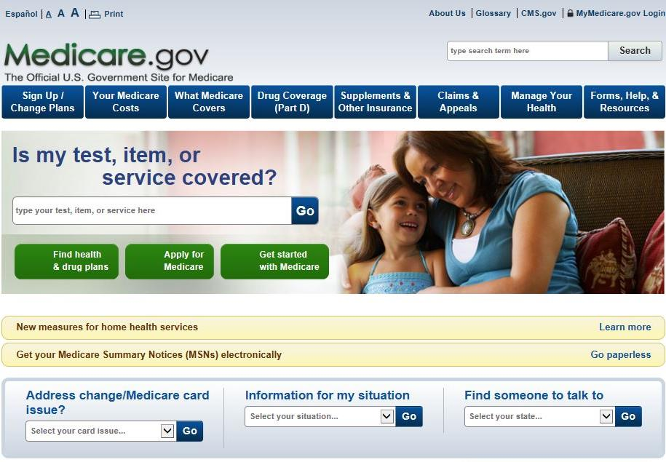
1-800-MEDICARE or Medicare.gov
Notes:
Please keep in mind that although you apply for Medicare by contacting Social Security, and we have some Medicare information on our website, it is actually another federal government agency, Centers for Medicare & Medicaid Services, commonly referred to as “CMS” that administers the program.
CMS is your main source for information regarding Medicare
Social Security helps you apply for Medicare Parts A and B, and we send your application information electronically to CMS.
We can also take your application for Extra Help with Medicare Part D.
If you sign up for Part B, we deduct the premium from your monthly Social Security benefit – and send it to CMS – before you receive your payment from us each month.
If you enroll in Medicare only, CMS will bill you for your Part B premiums until you go on Social Security.
If you have any questions regarding the Medicare program, you can call CMS at 1-800-MEDICARE or visit Medicare.gov
You can also contact your local SHIBA office.

Slide 59
Extra Help Program
Medicare beneficiaries may qualify for Extra Help with their Medicare prescription drug plan costs.
Find out if you qualify at socialsecurity.gov/extrahelp
Notes:
Extra Help is available for beneficiaries with limited resources and income to help pay for the costs related to a Medicare prescription drug plan. These costs include monthly premiums, annual deductibles and prescription co-payments. Extra Help is estimated to be worth about $4,000 per year.
You may apply for Extra help online, over the phone, or in your local Social Security office, which will review your application and send you a letter to let you know if you qualify. There are 6 main advantages to applying online for Extra Help:
The online application takes you through all of the questions to help you answer them completely
You can apply from the convenience of any computer, at your own pace
If you have to take a break, you can stop and return to the application later without losing the information you already filled in
If you don’t have or use a computer, someone else like a friend, relative, or caregiver can help you fill out the application
Our online application is safe and secure
It’s generally much faster to apply online. There’s no mail time as there is with a paper application, so decisions usually can be made more quickly.

Slide 60
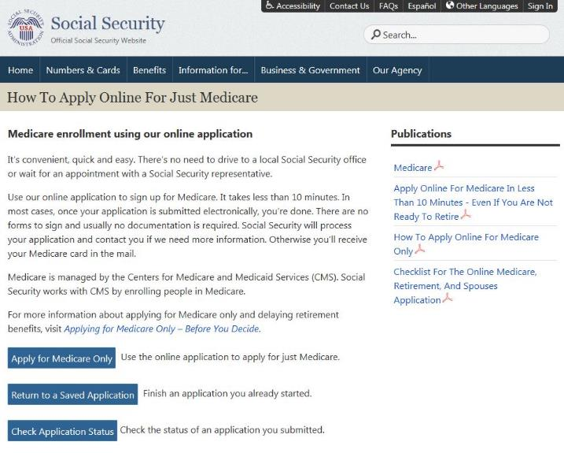
Medicare Applications
If you already have Medicare Part A and wish to add Medicare Part B, simply take or mail forms CMS 40-B and CMS-L564 to your local Social Security office
socialsecurity.gov/medicare/apply.html
Notes:
You can use our website to apply for Medicare Parts A and B. If you apply online for Medicare Part A only – and refuse Part B – you can enroll in Part B later.
When you decide to add Part B later, you will not need to file a new application on our website. You just need to complete two forms, which are available via our homepage. Just click on the Forms button.
One form is CMS 40-B (Application for Enrollment in Medicare Part B Medical Insurance), and the other is CMS-L564 (Request for Employment Information). Form 40-B is where you indicate when you want your Part B coverage to start. You will take Form CMS-L564 to your – or your spouse’s – human resources department for them to complete, so that we can see that you have been continuously covered under a group health plan since you turned 65 … and can therefore get Part B without a penalty.
It works best if you give these forms to us at the same time, in an envelope.
You can also call us to ask that we mail these forms to you, if you don’t want to print them from our website.
For a handout that provides additional details on applying for Medicare only, visit ssa.gov/pubs and type in “How to Apply Online for Medicare Only.”

Slide 61
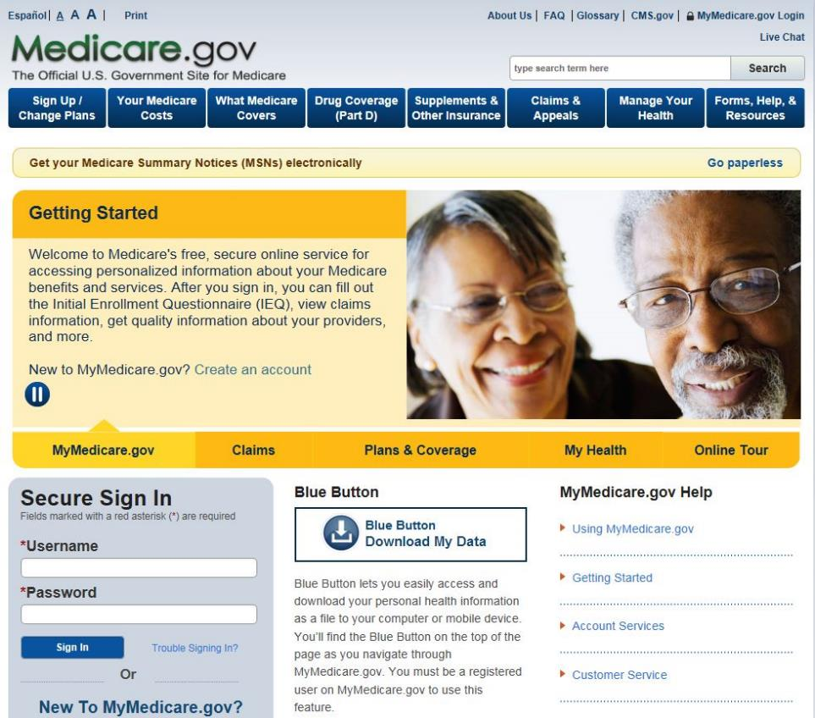
MyMedicare.gov
Notes:
Medicare has a free, secure online service for accessing personalized information about your Medicare benefits and services. It is available at MyMedicare.gov.
After you sign in, you can fill out the Initial Enrollment Questionnaire (IEQ), view claims information, get quality information about your providers, and more.
On the MyMedicare.gov website, you will see the Blue Button, which lets you easily access and download your personal health information as a file to your computer or mobile device.
You must be a registered user on MyMedicare.gov to use the Blue Button feature.
For more information or help with the site, please contact the Centers for Medicare & Medicaid Services at 800-MEDICARE (800-633-4227).

Slide 62
Notes:
At Social Security, we’re securing today and tomorrow.
Thank you for your participation in today’s program.
We wish you a safe, happy, and successful tomorrow.

Slide 63
AABD Medicaid
(Aid for the Aged, Blind and Disabled)
Presented by Laela Wilmot, Benefits Program Manager Regions 5 and 6

Slide 64
Application
Paper copy from local Health & Welfare office
Can be mailed in
Can be faxed in
Can be emailed in
Can be taken to a local office
Downloaded from Idaho H & W site at www.healthandwelfare.idaho.gov
Apply online at idalink.idaho.gov
Notes:
Refer to Jose’s presentation

Slide 65
Traditional Application Not Required
A traditional application is not required if the customer visits their local office.
The customer will meet with a benefits specialist to complete a verbal application.
If verification of circumstances cannot be obtained by making collateral contacts, extra time is allowed to provide necessary information.
Notes:
Refer to Jose’s prsentation

Slide 66
Basic Eligibility Criteria
Resident of the State of Idaho
Meet citizenship criteria or meet the legal non resident status
Meet Age or Disability Criteria
Estate Recovery rules
Meet income and resource guidelines
Meet level of care for long term care services

Slide 67
Residency
Voluntarily living in Idaho and have no immediate intention of leaving.

Slide 68
Citizenship
Must be a US Citizen or a Qualified Non-Citizen.
US Citizens must provide documentation supporting their Citizenship and Identity
Qualified Non-Citizens are required to provide proof that they are in the US legally. Must have been in the US a minimum of 5 years with few exceptions.

Slide 69
Citizenship
No proof required for those who receive:
Supplemental Security Income (SSI)
Social Security Disability Insurance (SSD)
Medicare
Social Security Administration has already taken the necessary steps to verify citizenship criteria.Administration (SSA)

Slide 70
Aged and Disabled
65 years of age or older
Under age 65 and meets the definition of blindness or disability used by SSA
Does not require an application for SSA benefits.

Slide 71
Potential Income
Before Medicaid can be approved, you must apply for all benefits due to you.
Social Security (Except Supplemental Security Income)
Other retirement payments

Slide 72
SSI and Medicaid
SSI recipients are categorically eligible for Medicaid no matter the amount of the SSI payment.
Recipients of other SSA payments are not categorically eligible for Medicaid.
Social Security Disability Insurance (SSDI)
Retirement, Survivors, Disability Insurance (RSDI)
Note: There are separate applications for Medicaid and Social Security Payments.

Slide 73
Estate Recovery
If full Medicaid is received at the age of 55 or older, any resources in an estate at time of death may be subject to recovery of medical expenses.
Lien is put on property by the State of Idaho
Never recover more than medical costs paid by Medicaid.

Slide 74
Long Term Care Medicaid
Home and Community Based Services
Own Home
Community Setting
Cost less than Nursing Home
Nursing Home Assistance
Nursing Facility
Eligibility based on ability to care for self determined by a nurse reviewer from the Division of Medicaid.
Notes:
Income limit $2,219 ($2,199)

Slide 75
Over Income for Long-term Care
Current income limit for 2017 (updates annually):
$2,225 for an individual per month
$4,430 for a couple per month
Can set up an Income Trust also known as a “Miller Trust”
Contact Idaho Legal Aid
Contact Information: www.idaholegalaid.org
or
Request assistance from an elder law attorney

Slide 76
Resource/Property
Limit for an individual is $2000.
Limit for a couple is $2000 each.
Value of resources owned on the “Snap Shot” date are verified

Slide 77
Snap Shot Date
First day of 30 continuous days of long-term care
1st day as determined by a physician which the care was needed
1st day of nursing home admission
1st day of moving to assisted living
Department reviewer determines the appropriate date if the individual still lives at home.
Notes:
Include Resource Assessment in the packet
Linda’s Part

Slide 78
Resource Assessment
Spousal Share is ½ of couple’s countable resources based on the verified value on “Snap Shot” date.
Couple’s are given the option to spend down the resources countable to the spouse needing care.

Slide 79
Resource Spend-down
Pay for care privately
Settle personal debt
Prepay burial, for self and spouse
Disposal of excluded resources does not reduce countable assets
Do not transfer anything without receiving adequate consideration (fair market value)

Slide 80
Asset Transfers
Look-back 5 years to determine if an Asset Transfers occurred.
Assets transferred without fair consideration
Penalty for Long-Term Care determined based on value vs. average cost = months of ineligibility
Notes:
$5813

Slide 81
Medicare Savings Programs
Qualified Medicare Beneficiary (QMB) – Income at or below 100% Federal Poverty Guidelines = currently $1025 for an individual and $1373 for a couple (updates annually)
Specified Low-Income Medicare Beneficiary (SLMB) Income above 100% to 120% = currently $1226 for an individual and $1644 for a couple (updates annually)
Qualified Individual (QI) Income above 120% up to 135% = currently $1377 for an individual and $1847 for a couple (updates annually)
Resource Limit is $7,390 for an individual and $11,090 for a couple.
Medicare Savings Programs are not subject to Estate Recovery.
Notes:
Currently QMB is $1010 ($990), slmb $1208 ($1188), QI $1357 ($1337)

Slide 82
Medicare Savings Programs
Low-Income Subsidy “Extra Help” applications through SSA are also an application for the Medicare Savings Programs, unless the customer requests not to apply.

Slide 83
QMB
Pays for Medicare:
Part B premiums
Part A in some circumstances
Deductibles
Co-Pays
QMB benefits begin the month after approval

Slide 84
SLMB & QI
Pays for:
Medicare Part B premiums
Coverage can begin up to 3 month prior to the Application month
QI has limited funding

Slide 85
Eligibility Information
Refer to www.livebetteridaho.org to easily find information regarding eligibility for all welfare programs as well as many other resources available in the community.

Slide 86
Learn more about Medicaid and other assistance offered by the Department of Health and Welfare at:
http://www.healthandwelfare.idaho.gov
or call:
The Idaho Care Line by dialing 211

