Slide 1

Office on Aging
Located on the csi twin falls campus
PO Box 1238
Twin Falls, Idaho 83303
208.736.2122

Slide 2
Office on Aging
Shawna Wasko, M.OLP
Public Information/Contracts Manager/Group Facilitator
Widowed Wellness Programs of Idaho, Inc. Caregiver Support Group Grandparents as Parents support group

Slide 3

Office on Aging
Our Goal:
Is to enable people to live in their own homes:
As long as they can
As comfortably as they can
As safely as they can.

Slide 4
Office on Aging
The csi office on aging provides
a wide range of services to
seniors aged 60 and older
and to family members of a senior citizen.

Slide 5
Office on Aging
The csi office on aging serves the eight
Counties of the magic valley:
Blaine, camas, cassia, gooding, Jerome,
Lincoln, minidoka, and twin falls

Slide 6
Office on Aging
Aging & Disability Resource Center
Helps people with questions about long term care. It helps identify needs; educate as to options & resources; empower them to make informed choices; & assist them to access desired resources

Slide 7
Office on Aging
Adult Protection Services
Are mandated by Law to investigate allegations of abuse, neglect, or exploitation of a vulnerable adult (18 or older, who is unable to make, implement, or communicate decisions due to mental/physical impairment).

Slide 8
Office on Aging
Adult Protection Services
What to report to adult protection (can be anonymous):
Physical/Mental Abuse: unexplained bruises, falls, scratches, lacerations, contusions, etc.
Neglect: Malnourishment, no food, no clothing, failure to obtain needed medical care, no heat, no running water.

Slide 9
Office on Aging
Adult Protection Services
What to report to adult protection:
Self-Neglect: Social isolation, no food, no heat, no running water, malnourishment, failure to obtain needed medical care
Exploitation: Unusual account activity, unpaid bills, inappropriate legal documents

Slide 10
Office on Aging
Information & Assistance
Is the gateway to senior services in the Magic Valley. They can help identify needs, & make referrals to resources and services to meet those needs.

Slide 11
Office on Aging
Ombudsman Program
Works to assist residents of long-term care facilities to protect their health, rights, safety, and welfare.

Slide 12
Office on Aging
Ombudsman Program
They investigate complaints for seniors that involve accessing care, resident rights, facility or home-based care issues, Medicaid, Medicare, social security and other agencies

Slide 13
Office on Aging
Ombudsman Program
They investigate complaints, in 55+ facilities, for seniors that involve accessing care, resident rights, facility or home-based care issues, Medicaid, Medicare, social security and other agencies.

Slide 14

Office on Aging
Senior medicare patrol
Helps you learn how to
Protect, detect and report
Medicare fraud, abuse & errors.

Slide 15
Office on Aging
Medicare Saving program
Mippa
Can give you extra help to assist with Medicare expenses.
Income limits apply

Slide 16
Office on Aging
Support Groups
Meet regularly for education, discussion & peer support.
Caregiver support group Grandparents as parents support groups widowed wellness programs of Idaho, Inc.

Slide 17
Office on Aging
3 things you need to know
Spousal Impoverishment
Compassionate Allowances
Aid and Attendance: must be a pensioned Veteran

Slide 18
Office on Aging
Senior Corps programs
Retired & senior Volunteer program
Provides volunteer opportunities to people 55 years of age & older

Slide 19
Office on Aging
Senior Corps programs
Foster Grandparent program
Provides volunteer opportunities in educational and care oriented settings. They assist children to overcome learning challenges.

Slide 20
Office on Aging
Senior Corps programs
Senior Companion program
Offers one-on-one companionship between frail, elderly, & homebound individuals and senior volunteers. They help complete everyday tasks such as grocery shopping, bill paying, & transportation.

Slide 21
Office on Aging
Contracted services
Homemaker: assist with light housekeeping & general chores
Respite Care: offers caregivers a break with companionship, supervision, & assistance, with such tasks as bathing, dressing, & other care receiver needs.

Slide 22
Office on Aging
Contracted services
Transportation: services provide rides for seniors to senior centers, medical appointments, shopping and other locations.

Slide 23
Office on Aging
Contracted services
Senior Dining & Activities: are offered at 16 senior centers and 2 meal sites throughout the Magic Valley.

Slide 24
Office on Aging
Senior Centers
1 in 6 seniors in idaho struggle with Hunger
Congregate Meals: On track to serve 98,280 Meals in 2017
Home Delivered Meals: on track to serve 73,692 Meals in 2017
Live longer with less dementia

Slide 25
Office on Aging
Biggest Risk to Seniors:
Loneliness

Slide 26
Office on Aging
Lifespan respite summit
Friday, july 7, 2017
Scam Jam
Friday, September 8, 2017
Both Conference on CSI Campus

Slide 27
Office on Aging
Volunteers Needed: we can not do our job without you!
Senior Corps Programs: Foster Grandparent-senior companions ombudsman program shiba: senior health insurance benefits advisors senior centers: home delivered meals – table set up-food service

Slide 28


Today’s AARP—Making the most of life after 50

Slide 29

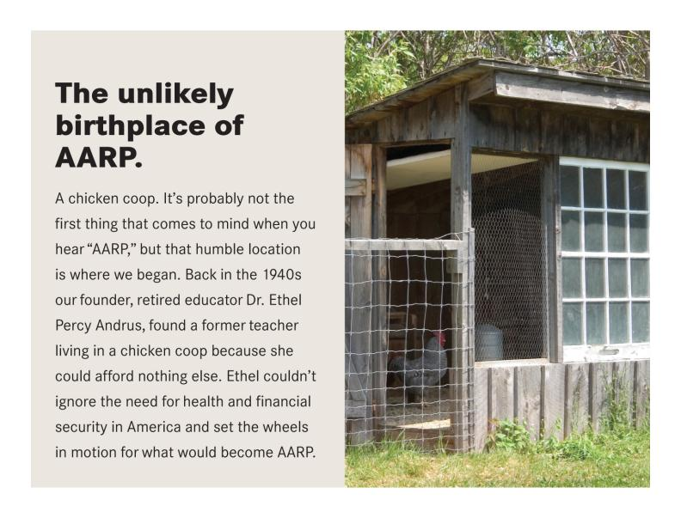
AARP History
Notes:
How did AARP even get started? Well it started with a chicken coop and a volunteer wanting to make a difference.
Once upon a time in 1940s, Ethel Percy Andrus, a retired educator from California spent her time helping other retired teachers.
You see, one day she tried to look up a Spanish teacher at an address given to her by a concerned shop owner in town.
A young woman came to the door and said, “No, no one by that name lives here.” Dr. Andrus was about to leave when a neighbor told her, “Oh, you must mean the poor old woman who lives out back.” Well, “out back” turned out to be a literal renovated chicken coop where this retired Spanish teacher lived on her miserable pension with her cats. She couldn’t afford to pay rent and pay for her medicines as well. For Dr. Andrus this was the moment. She began to visit 46 insurance companies who all refused to do business with her—all refused to offer health insurance to retirees. Until the last one.
Dr. Andrus then put her focus towards the challenges ALL retired Americans faced.
She started the National Retired Teachers Association (NRTA), which is still a part of AARP today.

Slide 30

OVERVIEW
Non-profit nonpartisan social welfare organization
Retirement is not required
Nationwide membership of more than 38 million members, larger than the population of Canada
Idaho members make up about 11% the total population of Idaho

Slide 31

Mission
To enhance the quality of life for all as we age.
Vision
A society in which all people live with dignity and purpose, and fulfill their goals and dreams.
Motto
To serve, not to be served.
Notes:
The vision is a direct quote of Dr. Andrus herself, when she founded AARP. A society in which everyone ages with dignity and purpose, and in which AARP helps people fulfill their goals and dreams. This sounds great doesn’t it? Well in order to make this happen we have to remember the mission as well.
The mission has evolved into a statement of purpose for AARP. AARP is dedicated to enhancing the quality of life for all as we age. We lead positive social change and deliver value to members through advocacy, service, and information.

Slide 32
Increasing our Social Impact
Health Security
Caregiving & long term care
Independence & dignity
Financial Resilience
Retirement savings plans & financial knowledge
Travel
Fraud and scam protection
Personal Fulfillment
Connecting digitally
A healthier lifestyle
Brain health
Tax Aide
Social Security
New Knowledge Adventures
Notes:
AARP’s work falls under three broad priorities: Health Security, Financial Resilience, and Personal Fulfillment.
Under health security AARP:
preserves and defends Medicare,
works to ensure adequate health care coverage,
supports people caring for older relatives or friends and;
fosters brain health programs.
Financial resilience efforts include
improving access to retirement savings plans,
protecting Social Security, preventing fraud through the Fraud Watch Network and other efforts, and;
offering AARP Foundation Tax-Aide, a program that each year helps people file their taxes.
Personal Fulfillment can take many forms including learning adventures.

Slide 33









AARP IDAHO
REAL POSSIBILITIES IN ACTION
Special
Events
Multicultural

Slide 34
AARP Smart Driver Courses
    Sharpen your driving skills
    Refresh your knowledge of the rules of the road
More than 1700 Idaho “graduates” from the program
Aarp.org/safedriver
Notes:
Across the state, more than 70 volunteers are conducting classes designed specifically for older drivers giving them the confidence and understanding they need to stay safe on Idaho roads.

Slide 35
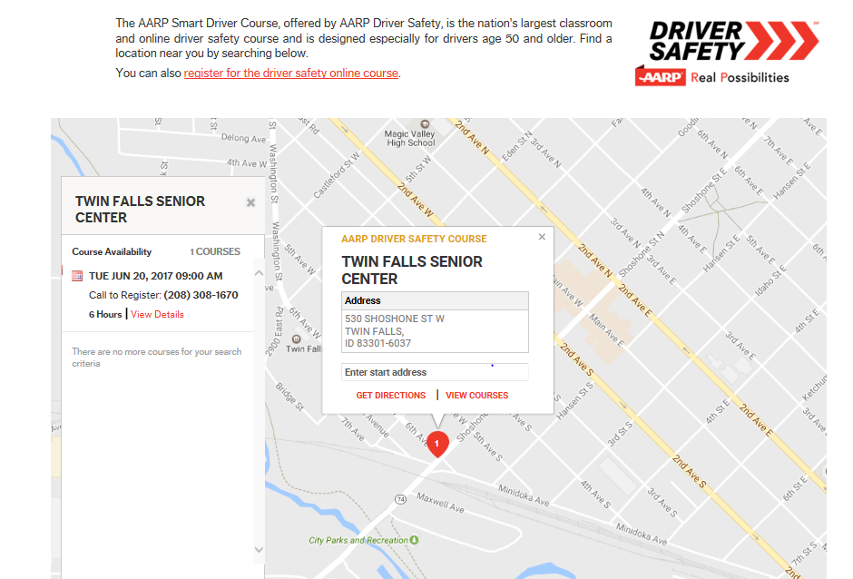
Notes:
If you go to aarp.org/safedriver you can input your zip code and search for the next class near you.

Slide 36
Free tax assistance and preparation service for all Idaho taxpayers
Volunteers are trained and IRS-certified
281+ tax aide volunteers statewide
19,104 Tax Forms submitted 2017 tax year
Aarp.org/taxaide
    Program runs from February through April

Slide 37
Federal and State Advocacy
Medicare
Social Security
Health Care
Support for Family Caregivers
Retirement Savings
Livable Communities
Taxes
Utility Rate Changes
Notes:
AARP advocates to local, state and federal legislators and policy makers about your interests and concerns such as these.

Slide 38
Combating Social Isolation/Staying Mentally Sharp
New Knowledge Adventures (Treasure Valley)
    A learning and education program with affordable classes of interest on everything from home repair, camping, sports, exercise, computers, smart phones, movies, music, theatre, and more
Staying Sharp
    Science-based activities, challenges, recipes and articles across the five pillars of brain health.

Slide 39

  Gives local tools and resources needed to identify and stay protected from fraud and identity theft
  Uses workshops and conferences to help thousands of people stay safe from con-artists
  Issues timely email fraud alerts
  AARP Fraud Watch Helpline
      877-908-3360
  Sign up at www.aarp.org/fraudwatchnetwork

Slide 40
Social Security Benefits Calculator
Calculates the best retirement age for you to claim your Social Security benefits
Shows how to maximize benefits
Helps pre-retirees better visualize the complex rules around working while collecting benefits before their full retirement age
Find it here:
    http://www.aarp.org/work/social-security/social-security-benefits-calculator.html

Slide 41
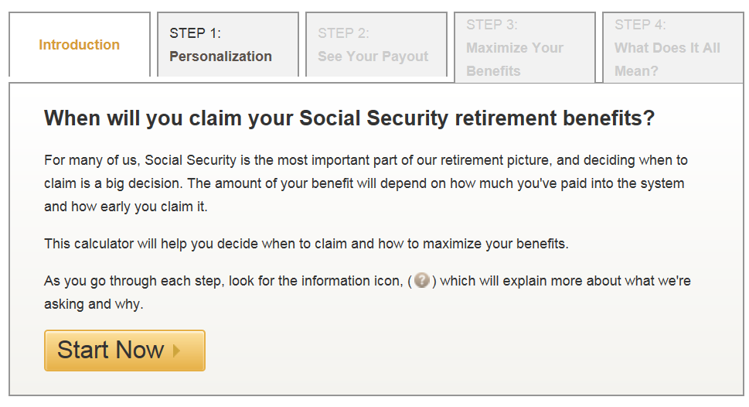
Social Security Benefits Calculator Example

Slide 42
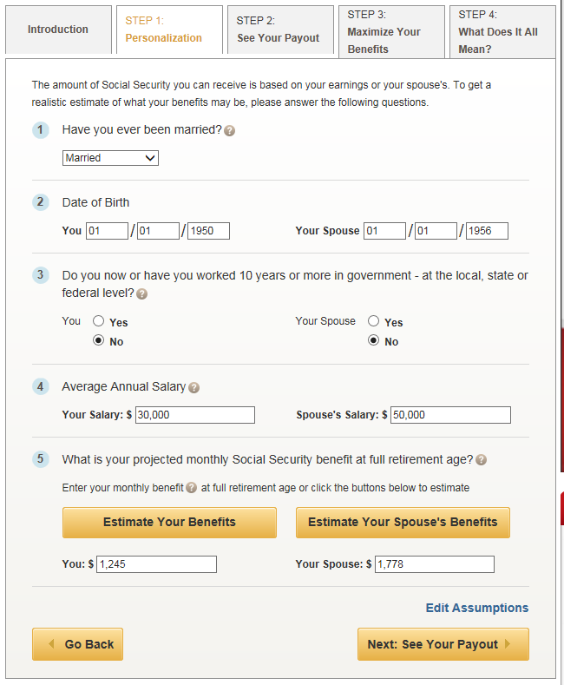

Slide 43
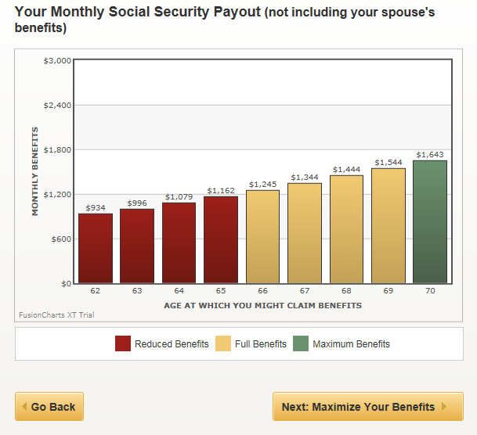

Slide 44
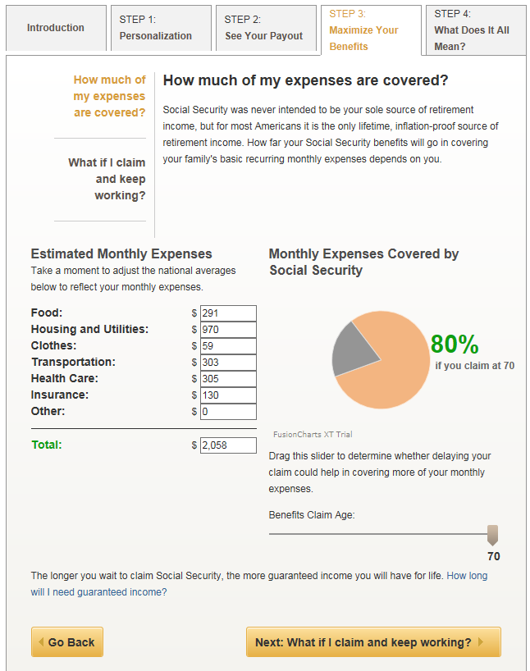

Slide 45
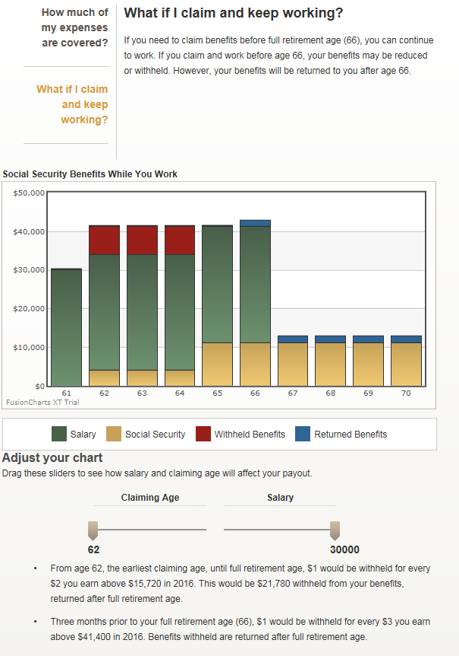

Slide 46
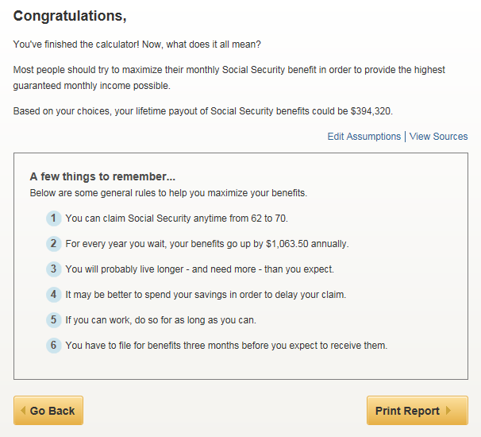

Slide 47
AARP’s Real Possibilities for you
Volunteer Opportunities
AARP Now App
AARP Website (www.aarp.org)
    AARP Work and Jobs
    Caregiving Resources
    Medicare Resource Center
    Planning for Retirement
    Much, Much More!
Facebook/Twitter
Fun with Purpose Opportunities

Slide 48

QUESTIONS/COMMENTS?
AARP Idaho
(866) 295-7284
Lupe Wissel
State Director
Cathy McDougall
Associate State Director of Outreach
Randy Simon
Associate State Director of Communications
Françoise Cleveland
Associate State Director of Advocacy
Pam Root
Senior Operations Associate
Notes:
Thank you for your time. Please let us know if you have any questions. Age is but a number, it’s what you do with the number that really counts.

Slide 49










VETERAN TRAINING SUMMIT 2017
Veteran 101/VA BENEFITS OVERVIEW
Idaho Division of Veteran Services
“Caring for America’s Heroes”
PRESENTED BY:
BILL HEYOB AND DARRYL HEISEY

Slide 50
Veteran Services
“Caring for America’s Heroes”
AGENDA
What is a Veteran?
What is County, State and Federal VA?
Service Connected Veterans
Non-Service Connected Pension Benefits

Slide 51
Veteran Services
“Caring for America’s Heroes”
What is a Veteran?
38 CFR 3.1- Definition of Veteran-
A person who served in the active military, naval, or air service and who was discharged or released under conditions other than dishonorable.
For Compensation and Dependency and Indemnity the term Veteran includes a person who died on active duty and whose death was not due to willful misconduct.
For Death Pension, the term Veteran includes a person who died in active service under conditions which preclude payment of service connected death benefits, provided such person had completed at least 2 years honorable military, naval or air service.

Slide 52
Veteran Services
"Caring for America's Heroes"
VETERAN
Basic Eligibility:
90 days active duty (other than active duty for training) prior to Sep 7, 1980 (enlisted) or Oct 16, 1981(officers).
After this period, a Veteran must have served 24 consecutive months of honorable service or completed the full amount of prescribed time.

Slide 53
Veteran Services
"Caring for America's Heroes"
Department of Veteran Affairs- Isn’t it all the same Office?
The VA is broken up into three specific Departments-
- Veteran Benefit Administration
- Comp Service
- Pension Service
- VA Home Loans
- Education
- VR&E
- Veterans Health Administration
- VA Hospitals
- CBOCS
- National Cemetery Administration

Slide 54
Veteran Services
"Caring for America's Heroes"
VETERAN AFFAIRS
National, State, County and Post Level Representatives:
Each Level of Representatives provide different services to Veterans:
National-Level Representatives: (Veteran Service Organizations)- VFW, American Legion, DAV, AMVETS, MOPH, VVA, FRA, MCL, etc…

Slide 55
Veteran Services
"Caring for America's Heroes"
VETERAN AFFAIRS
State Level Representation: Each State has their own benefits available to Veterans: (Idaho)
- Office of Veterans Advocacy
- State Service Officers
- State Veteran Homes
- State Veteran Cemetery
- Education/State Certifying Official

Slide 56
Veteran Services
"Caring for America's Heroes"
VETERAN AFFAIRS
County Level Representation: (Idaho)
Works for the County Commissioners
Most are not accredited with any VSO’s
Have very limited access to VA information
  VetraSpec Software
Fall under a State Service Officer Outreach Area
  State Service Officer provide training, oversight, and review of claims forms before they are submitted to the VA.
  Do not actually work for the State of Idaho!

Slide 57
Veteran Services
"Caring for America's Heroes"
VETERAN AFFAIRS
Post Level Representation:
  Every Veteran Service Organization has post-level Service Officers
    Grass Roots-Level
    Not Accredited
    Mainly a resource/Information Source
    Refer Veterans to an Accredited VSO.

Slide 58
Veteran Services
“Caring for America’s Heroes”
Service Connected Veterans:
Have a VA Disability Rating of 0% to 100%.
0%- No Monetary Compensation
10%- Monthly Compensation, VA Home Loan Funding Fee Waived
20%- Eligible for Vocational Rehabilitation
30%- Eligible for Additional Dependency Benefits
40%- State Reduced Hunting/Fishing License and Big Game Tags
50%- Concurrent Receipt, Priority Group 1 at VAMC
70%- Long Term Healthcare at VA Contract Care Facilities
100% P&T- Dental, Chapter 35 Ancillary, State Benefits, SMC

Slide 59
Veteran Services
“Caring for America’s Heroes”
Service Connected Types:
Direct Injury
Aggravated Condition
Presumptive
Secondary
1151 Claim

Slide 60
Veteran Services
“Caring for America’s Heroes”
Direct Service Connection
Purple Heart Recipient
Injured while in the service
Involved in a motor vehicle accident while on active duty or Active for Training
Experienced In-Service Traumatic Event(s)

Slide 61
Veteran Services
“Caring for America’s Heroes”
Presumptive Service Connection
Definition: Any chronic disease that the VA has recognized as a result of service or exposure.
VA assumes that certain diseases can be related to a Veteran’s qualifying military service. We call these "presumptive diseases."

Slide 62
Veteran Services
“Caring for America’s Heroes”
Presumptive Service Connection
ALS Lou Gehrig’s Disease/MS
Agent Orange Presumptive
Gulf-War Presumptive
Atmospheric Nuclear Weapon Tests
Within one year of exit from service

Slide 63
Veteran Services
“Caring for America’s Heroes”
Presumptive Service Connection
ALS Lou Gehrig’s Disease
Any Veteran who served 90 days or more and is diagnosed with ALS
Multiple Sclerosis
Becomes manifest within 7 years after leaving service

Slide 64
Veteran Services
“Caring for America’s Heroes”
1151 Claim
DISABILITY CAUSED BY VAMC
HOSPITAL CARE
MEDICAL OR SURGICAL TREATMENT
(EVIDENCE MUST SHOW CAUSATION)

Slide 65
Veteran Services
“Caring for America’s Heroes”
Agent Orange Presumptives
VA has recognized certain cancers and other health problems as presumptive diseases associated with exposure to Agent Orange or other herbicides during military service. Veterans and their survivors may be eligible for disability compensation or survivors' benefits for these diseases

Slide 66
Veteran Services
“Caring for America’s Heroes”
Agent Orange Presumptives
AL Amyloidosis
A rare disease caused when an abnormal protein, amyloid, enters tissues or organs
Chronic B-cell Leukemias
A type of cancer which affects white blood cells
Chloracne (or similar acneform disease)
A skin condition that occurs soon after exposure to chemicals and looks like common forms of acne seen in teenagers. Under VA's rating regulations, it must be at least 10 percent disabling within one year of exposure to herbicides.

Slide 67
Veteran Services
“Caring for America’s Heroes”
Agent Orange Presumptives
Diabetes Mellitus Type 2
A disease characterized by high blood sugar levels resulting from the body’s inability to respond properly to the hormone insulin
Hodgkin’s Disease
A malignant lymphoma (cancer) characterized by progressive enlargement of the lymph nodes, liver, and spleen, and by progressive anemia
Ischemic Heart Disease
A disease characterized by a reduced supply of blood to the heart, that leads to chest pain

Slide 68
Veteran Services
“Caring for America’s Heroes”
Agent Orange Presumptives (cont’d)
Multiple Myeloma
A cancer of plasma cells, a type of white blood cell in bone marrow
Non-Hodgkin’s Lymphoma
A group of cancers that affect the lymph glands and other lymphatic tissue
Parkinson’s Disease
A progressive disorder of the nervous system that affects muscle movement

Slide 69
Veteran Services
“Caring for America’s Heroes”
Agent Orange Presumptives (cont’d)
Peripheral Neuropathy, Acute and Subacute
A nervous system condition that causes numbness, tingling, and motor weakness. Currently, it must be at least 10 percent disabling within one year of herbicide exposure and resolve within two years. VA proposed on Aug. 10, 2012, to replace "acute and subacute" with "early-onset" and eliminate the requirement that symptoms resolve within two years.
Porphyria Cutanea Tarda
A disorder characterized by liver dysfunction and by thinning and blistering of the skin in sun-exposed areas. Under VA's rating regulations, it must be at least 10 percent disabling within one year of exposure to herbicides.

Slide 70
Veteran Services
“Caring for America’s Heroes”
Agent Orange Presumptives (cont’d)
Prostate Cancer
Cancer of the prostate; one of the most common cancers among men
Respiratory Cancers (includes lung cancer)
Cancers of the lung, larynx, trachea, and bronchus
Soft Tissue Sarcomas (other than osteosarcoma, chondrosarcoma, Kaposi’s sarcoma, or mesothelioma)
A group of different types of cancers in body tissues such as muscle, fat, blood and lymph vessels, and connective tissues

Slide 71
Veteran Services
“Caring for America’s Heroes”
Gulf-War Presumptives
VA presumes certain chronic, unexplained symptoms existing for 6 months or more are related to Gulf War service without regard to cause. These "presumptive" illnesses must have appeared during active duty in the Southwest Asia theater of military operations (Iraq, Kuwait, Saudi Arabia) or by December 31, 2021, and be at least 10 percent disabling

Slide 72
Veteran Services
“Caring for America’s Heroes”
Gulf-War Presumptives (cont’d)
- Chronic Fatigue Syndrome
- Fibromyalgia
- Functional gastrointestinal disorders Examples include irritable bowel syndrome (IBS), functional dyspepsia, and functional abdominal pain syndrome.

Slide 73
Veteran Services
“Caring for America’s Heroes”
Gulf-War Presumptives (cont’d)
- Undiagnosed illnesses with symptoms that may include but are not limited to: abnormal weight loss, fatigue, cardiovascular disease, muscle and joint pain, headache, menstrual disorders, neurological and psychological problems, skin conditions, respiratory disorders, and sleep disturbances.

Slide 74
Veteran Services
“Caring for America’s Heroes”
CAMP LEJEUNE CONTAMINATED WATER
PRESUMPTIVE CONDITIONS
In 1980s contaminants were found in two wells that provided water to Camp Lejeune, N. C. 30 days (cumulative) from August 1, 1953 through December 31, 1987

Slide 75
Veteran Services
“Caring for America’s Heroes”
CAMP LEJEUNE CONTAMINATED WATER (EIGHT)
PRESUMPTIVE CONDITIONS
Adult Leukemia
Aplastic anemia and other myelodysplastic syndromes
Bladder Cancer

Slide 76
Veteran Services
“Caring for America’s Heroes”
CAMP LEJEUNE CONTAMINATED WATER
PRESUMPTIVE CONDITIONS
Kidney Cancer
Liver Cancer
Multiple myeloma
Non-Hodgkin’s lymphoma
Parkinson’s disease

Slide 77
Veteran Services
“Caring for America’s Heroes”
Atmospheric Nuclear Weapon Tests
For Veterans who participated in a radiation-risk activity during service (including "Atomic Veterans"), VA assumes that certain cancers are related to their exposure. These are called "presumptive diseases."

Slide 78
Veteran Services
“Caring for America’s Heroes”
Atmospheric Nuclear Weapon Tests (cont’d)
VA recognized presumptive conditions:
- Cancers of the bile ducts, bone, brain, breast, colon, esophagus, gall bladder, liver (primary site, but not if cirrhosis or hepatitis B is indicated), lung (including bronchiolo-alveolar cancer), pancreas, pharynx, ovary, salivary gland, small intestine, stomach, thyroid, urinary tract (kidney/renal, pelvis, urinary bladder, and urethra)
- Leukemia (except chronic lymphocytic leukemia)
- Lymphomas (except Hodgkin’s disease)
- Multiple myeloma (cancer of plasma cells)

Slide 79
Veteran Services
“Caring for America’s Heroes”
Secondary Service Connection
A disability which is due to or the result of a service-connected disease or injury and medically linked to the service-connected condition shall be service connected.
(38CFR 3.102) Reasonable Doubt

Slide 80
Veteran Services
“Caring for America’s Heroes”
Secondary Service Connected Examples
S/C Flat feet- causes knee-hips-lumbar
S/C Lower back- causes neuropathy lower extremities
S/C Diabetes Mellitus Type II-eyes/heart/edema/loss of appendages etc.
S/C Cervical Neck- causes migraines

Slide 81
Veteran Services
“Caring for America’s Heroes”
Additional Benefits for 100% Service Connected Veterans
Housebound Status
Need for Regular Aid and Attendance
VA FORM 21-2680 (MED EXAM)

Slide 82
Veteran Services
"Caring for America's Heroes"
REFERENCE MATERIALS
www.va.gov United States Department of Veterans Affairs
CFR 38 Part 0-17 Pensions, Bonuses and Veterans’ Relief (July 1, 2012) www.ecfr.gov
CFR 38 Part 18 to End Pensions, Bonuses, and Veterans’ Relief (July 1, 2012) www.ecfr.gov
Federal Benefits for Veterans Dependents and Survivors (2012 Edition)
The Office of Public Health and Research Organizations/National Association of Science Institute of Medicine www.publichealth.va.gov/studies-data.asp

Slide 83
Veteran Services
“Caring for America’s Heroes”
What is VA Pension for veterans and/or veteran’s widow?
Pension is a benefit paid to wartime veterans or qualifying widow who have limited or no income, and who are age 65 or older, or, if under 65, who are permanently and totally disabled.
Veterans or widows who are more seriously disabled may qualify for Housebound or Aid and Attendance benefits. These are benefits that are paid in addition to the basic pension rate.

Slide 84
Veteran Services
“Caring for America’s Heroes”
Defining Housebound and A&A
Housebound
When an individual is substantially confined to their immediate premises because of permanent disability.
Aid & Attendance (A&A)
Requiring the aid of another person in order to perform personal functions required in everyday living, such as bathing, feeding, dressing, attending to the wants of nature, adjusting prosthetic devices, or protecting the individual from the hazards of their daily environment

Slide 85
Veteran Services
“Caring for America’s Heroes”
NONSERVICE CONNECTED IMPROVED PENSION
How do I qualify for this needs based benefit?
- Veteran with Honorable service
-War time period of service
-Age (65+) or under 65 who are totally and permanently disabled (SSD/ Nursing Home)
- Meets income levels
NOTE: If Veteran is has a current Service Connected disability, the Veteran can only receive the greater of the two benefits.

Slide 86
Veteran Services
“Caring for America’s Heroes”
Wartime Periods recognized by the VA:
*WWII: Dec 7, 1941 to Dec 31, 1946 w/continuous service to July 26, 1947
*Korean War: June 27, 1950 to January 31, 1955
*Vietnam War: Feb 28, 1961 to May 7, 1975 or Aug 5, 1964 to May 7, 1975
*Gulf War: Aug 2, 1990 to present date or until proclaimed (ended)

Slide 87
Veteran Services
“Caring for America’s Heroes”
NONSERVICE CONNECTED IMPROVED PENSION (cont)
NEEDS BASED BENEFIT
Medical condition (nonservice) that prohibits work
Examples: Blind/Alzheimer's/Dementia/Congestive Heart condition/chronic breathing (assistance with two or more medical issues)
housebound/need for regular aid and attendance

Slide 88
Veteran Services
“Caring for America’s Heroes”
CALCULATING INCOME LEVELS TO QUALIFY
ANNUAL HOUSEHOLD INCOME
— OUT OF POCKET MEDICAL EXPENSES
————————————————————
NET INCOME
Example: $ 24,000 (Income)
— 5,000 (Med Expenses)
————
$ 19,000 (Net Income)

Slide 89
Veteran Services
“Caring for America’s Heroes”
INCOME LEVELS TO QUALIFY
Maximum Annual Pension Rate (MAPR)
Single Veteran
Yearly income must be less than
SINGLE: $12,907.00
HB: $15,773.00
AA: $21,531.00
To be deducted, medical expenses must exceed 5% of MAPR, or, $645

Slide 90
Veteran Services
“Caring for America’s Heroes”
INCOME LEVELS TO QUALIFY (cont’d)
Maximum Annual Pension Rate (MAPR)
Married Veteran
Yearly income must be less than
Married: $16,902.00
HB: $19,770.00
AA: $25,525.00
To be deducted, medical expenses must exceed 5% of MAPR, or, $802

Slide 91
Veteran Services
“Caring for America’s Heroes”
Common Factors that can Disqualify an individual
ASSETS that exceed $80,000
Asset examples: Bank Account Balance, Investments, Real Property
NOTE: Your primary residence and vehicle do not count as assets.

Slide 92

Veteran Services
“"Caring for America's Heroes"”
Questions?
Briefing Presented by: Bill Heyob and Darryl Heisey

