Slide 1
Welcome to the Patient Financial Navigator Foundation, Inc.
“MEDICARE 101”

Slide 2
Medicare = Assistance with Medical costs after 65
Social Security Benefits = Monthly payments- 62/early or 65/66/67+

Slide 3
Social Security History
The Great Depression
Oct 29, 1929-1939
Social Security Act signed by FDR on Aug 14, 1935
Taxes were collected starting Jan 1937
First payments made 1940.

Slide 4
Who is paying …. Today’s workers help pay for current retirees; not their own future benefits.
Money collected per paycheck under “Medicare’ does not go into your personal savings account with your name on it for when you need it.
Same for Social Security taxes
Current recipients of SS and Medicare are using current money being withheld.
BABY BOOMERS ARE HERE!

Slide 5
Social Security Check will get a 2.8% boost in 2019
The Social Security Administration announced that the cost-of-living adjustment for 2019 will be 2.8 %. *$35 approx.
In 12 years/2030 – 1 in 5 Americans will be of retirement age/65.
By 2035, those over 65 and older will outnumber those under 18 by about 2 mil.
Only about ½/50% of all employees are covered by a retirement plan.
Recent study by Bankrate.com:
70 % of non-retired Americans plan to work as long as possible during retirement.

Slide 6
What Is Medicare? Created 1965- tax funded
Introduction
A health insurance program for
People 65 years of age and older
People under age 65 with certain disabilities
People with End-Stage Renal Disease (ESRD)
Administered by Centers for Medicare & Medicaid Services (CMS) (July 1965)
Enrollment by Social Security Administration (SSA) or Railroad Retirement Board (RRB)
Notes:
Medicare was created by Congress in 1965. It is a health insurance program for:
People age 65 and older
People under age 65 with disabilities who have been receiving Social Security disability benefits for a set amount of time (24 months in most cases)
People of any age with End-Stage Renal Disease (ESRD) (permanent kidney failure requiring dialysis or a kidney transplant)
President Lyndon Johnson signed the Medicare and Medicaid programs into law July 30, 1965. Medicaid became effective January 1, 1966, and Medicare became effective July 1, 1966. Medicare is the nation’s largest health insurance program, currently covering about 43 million Americans.
While Medicare is administered by the Centers for Medicare & Medicaid Services (CMS), the Social Security Administration (SSA) is responsible for enrolling most people in Medicare. The Railroad Retirement Board (RRB) is responsible for enrolling railroad retirees in Medicare.

Slide 7
Applying for Medicare
Introduction
Apply 3 months before age 65
Don’t have to be retired
Part A/Hospital = no cost is worked 40 quarters. Part B and Part D = monthly premiums
Contact the Social Security Administration &/or..
Enrollment automatic if receiving Social Security or Railroad Retirement benefits
Visit “MyMedicare.gov” to access your personalized Medicare information.
Notes:
The Social Security Administration advises people to apply for Medicare benefits 3 months before age 65. People do not have to be retired to get Medicare. Unlike Social Security (for which the full retirement age is gradually increasing to 67), people can still receive full Medicare benefits at age 65.
Medicare benefits can begin no earlier than age 65 except for some people with a disability or End-Stage Renal Disease.
People who are already receiving Social Security benefits (for example, getting early retirement) will be automatically enrolled in Medicare without an additional application. They will receive a Medicare card and other information about 3 months before age 65 or their 25th month of disability benefits.

Slide 8
Medicare
Enrollment
Initial Enrollment Period
Begins 3 months before your 65th birthday and ends 3 months after that birthday
Special Enrollment Period
If 65 or older and covered under a group health plan based on your – or your spouse’s – current work.
General Enrollment Period
January 1 – March 31
Notes:
Medicare has three enrollment periods:
Initial Enrollment Period-- your initial enrollment period has a 7-month enrollment period. It begins three months before your 65th birthday, includes the month you turn age 65, and ends three months after that birthday.
Special Enrollment Period-- If you are age 65 or older, you or your spouse are still working and you are covered under a group health plan based on that current employment, you may not need to apply for Medicare medical insurance (Part B) at age 65. You may qualify for a "Special Enrollment Period" (SEP) that will let you sign up for Part B a the time you retire.
General Enrollment Period - If you didn't sign up for Part A and/or Part B (for which you must pay premiums) when you were first eligible, and you aren’t eligible for a Special Enrollment Period, you can sign up during the General Enrollment Period between January 1–March 31 each year. You may have to pay a late enrollment penalty for as long as you have Part B coverage.

Slide 9
Traditional Medicare
Introduction
Medicare Basics
Part A
Hospital Insurance
Part B
Medical Insurance
Outpt Hospital Services
Part D
Prescription Drug
Notes:
Medicare now has three parts. Medicare Part A is Hospital Insurance. Medicare Part B is Medical Insurance, which helps cover doctors’ services and outpatient care.
Medicare also has prescription drug coverage, which is called Part D.

Slide 10
Patient – New Medicare Cards- no longer SS#
Between 4-18 and 4-19,
New Medicare Beneficiary Identifier.
MBI # will be a combination of
numbers and uppercase letters.
EX) 1EG4-TE5-MK72
Ensure address is current.
SSA.gov/my account
Transition period thru Dec 2019.

Slide 11
Medicare Coverage Basics (See handout)
Introduction
Part A | Inpatient hospital care Skilled nursing care Home health care Hospice care
Part B | Doctors’ services Outpatient hospital care Preventive services Diagnostic tests Non-hospital based therapies, imaging, surgery centers, labs Durable medical equipment
Part D | Outpatient prescription drugs
Notes:
Part A helps pay for inpatient hospital stays but also covers skilled nursing care, home health care, and hospice care.
Part B helps cover doctors’ services and outpatient care such as preventive services including screening tests and vaccinations, diagnostic tests, some therapies, and durable medical equipment like wheelchairs and walkers.
Medicare drug coverage helps pay for outpatient prescription drugs.
Let’s talk about Part A and Part B of Medicare.

Slide 12
Medicare Part A- Tax based
Introduction
Most people receive Part A premium free- must have 40 worked quarters. 99% pay nothing
People with less than 10 years of Medicare (30-39 quarters)- covered employment can still get Part A if worked less 30 quarter
Will pay a premium of $248/$441/$407/$411 per month/2012/13/15/16 $422 for 2018, $437 2019
For information about Part A entitlement
Call SSA 1-800-772-1213/get signed up
Contact Medicare 1-800-663-4227; Medicare.gov
Notes:
Most people don’t have to pay a monthly payment (premium) for Medicare Part A because they or their spouse paid Medicare or FICA taxes while they were working. (FICA stands for "Federal Insurance Contributions Act." This is the tax withheld from your salary, or that you pay from your self-employment income, that funds the Social Security and Medicare programs.) When people pay these taxes on their earnings, it is called “Medicare-covered employment.”
If a person and his or her spouse did not pay Medicare taxes while they were working, or did not work long enough (10 years in most cases) to qualify for premium-free Part A, he or she may still be able to get Medicare Part A by paying a monthly premium. In 2007, the Part A premium is $226 or $410, depending on how long the person worked in Medicare-covered employment.
For information on Part A entitlement, enrollment, or premiums, call the Social Security Administration at 1-800-772-1213 or 1-800-325-0778 for TTY users.

Slide 13
Enrolling in Medicare Part B
Introduction
Pay monthly Part B premium
Base with higher amt based on income /beginning in 2007. Average monthly premium for Part B $134 per month 2017& 18, $135.50 2019.
Initial Enrollment Period (IEP)
7 months starting 3 months before month of eligibility
General Enrollment Period (GEP)
January 1 through March 31 each year
Premium penalty!!
10% for each 12-month period eligible but not enrolled
Paid for as long as the person has Part B
Notes:
People can choose whether or not to enroll in Part B (Medical Insurance). Those who enroll are responsible for a monthly premium for Medicare Part B, which is $93.50 in 2007.
(Note: starting January 1, 2007, some people with higher annual incomes—over $80,000 if you file an individual tax return or over $160,000 if you are married filing jointly—pay a higher Part B premium. These amounts change each year. Most people still pay the standard Part B premium.)
People can sign up for Part B any time during a 7-month period that begins 3 months before the month they become eligible for Medicare. This is called the Initial Enrollment Period (IEP).
People who don’t take Part B when they are first eligible may have to wait to sign up during a General Enrollment Period (GEP). This period runs from January 1 through March 31 of each year, with coverage effective July 1 of that year.
Most people who don’t take Part B when they are first eligible will also have to pay a premium penalty of 10% for each full 12-month period they could have had Part B but didn’t sign up for it, except in special situations. In most cases, they will have to pay this penalty for as long as they have Part B.
Reference: Enrolling in Medicare, CMS pub. 11036

Slide 14
Enrolling in Medicare Part B
Introduction
Some people can delay enrolling in Part B with no penalty
If covered under employer or union group health plan. “Credible Coverage” (Still working)
Based on current employment
Person or spouse (Called: Working Aged)
Will get a Special Enrollment Period (SEP)
Sign up within 8 months after coverage ends or retire or penalties
But no coverage until signed up. Don’t let a lapse occur!
Notes:
Most people covered by a group health plan based on current employment (their own or their spouse’s) can delay enrolling in Part B without a penalty.
These people get a Special Enrollment Period. They can enroll in Part B anytime they are still covered by the employer or union group health plan based on current employment, or during the 8 months following the month the employment ends or the group health plan coverage ends, whichever is first. Most people who sign up for Part B during a Special Enrollment Period don’t pay higher premiums.

Slide 15
Paying the Part B Premium
Introduction
Taken out of monthly payments
Social Security /SSA
Railroad retirement/RRB
Federal government retirement (Plan: Federal BX)
Income adjustments can impact the monthly premium.
NOTE: There is help with premiums for low income seniors. Medicaid – Aid for Aged, Blind and Disabled.
Notes:
People who choose Medicare Part B usually have the premium automatically taken out of their monthly Social Security or Railroad Retirement payment. Federal government retirees may be able to have the premium deducted from their retirement check.
For information about Medicare Part B premiums, people can call the agency that enrolled them in Medicare (SSA or RRB), or the Office of Personnel Management (OPM) for retired Federal employees.
Medicare sends a quarterly bill for Medicare Part B premiums to people who don’t get a retirement payment. The bill can be paid by credit card, check, or money order.
People may also choose to have their Part B premiums automatically deducted from their bank account using the Easy Pay option. (Easy Pay may also be used to pay the premium for Part A.) People can contact 1-800-MEDICARE (1-800-633-4227) to request a Medicare Easy Pay Authorization Form.

Slide 16
Original/Traditional Medicare Plan – Medicare Costs
Original Medicare
Go to any health care provider that accepts Medicare - nationwide
Patients are responsible for out of pocket amounts
Part A – Inpt deductible
$1156 deductible/2012 /$1184 in 2013/$1260 in 2015 , $1288 in 2016. $1316 for 2017; $1340 for 2018; $1364 2019
Deductible is due every 60 days that the pt is out of the hospital. If out of the hospital/Part A for 60 days = another $1364 inpt deductible is due. If 2 admits within the same 60 day period = 1 -$1364 deductible for the 1st admit only.
Additional costs after 60 days if no break in services. Coinsurance days 61-90 $289 per day./$296 2013/$315 2015, $322 2016.
91-150 Lifetime Reserve days $578 per day/$592 2013./$630 2015 ; $644 2016
Pt pays 100% after 150 days without a 60 day break
$ amt increases each year for the additional days
Notes:
People in the Original Medicare Plan may go to any doctor, specialist, hospital, or other health care provider that accepts Medicare.
While most people don’t pay a premium for Part A, they are responsible for a Part A deductible for inpatient hospital stays. The deductible is the amount a person with Medicare must pay for health care before Medicare begins to pay. There is a deductible of $992 in 2007 for hospital stays up to 60 days, and additional costs for longer stays. Costs are different for other Part A services.
People pay a monthly premium for Part B ($93.50 in 2007) and are also responsible for the Medicare Part B deductible, which is $131 in 2007. This means that in 2007 a person with Medicare is responsible for the first $131 of his or her Medicare-approved Part B medical services before Medicare Part B starts paying for care. In addition, a person who needs blood is responsible for the first three pints. These amounts amounts can change every year.
People with Original Medicare also are responsible for some copayments or coinsurance for Part B services. The amount depends on the service but is 20% in most cases.
After people get health care services, they get a Medicare Summary Notice (MSN) showing Medicare’s payments. This notice lists the service received, what was charged, what Medicare paid, and how much the person may be billed.
Some people have other health insurance coverage, such as a plan from a former employer, that may cover some or all of these costs. In a few minutes we’ll talk about private insurance policies called Medigap that also may help with these costs. For people who can’t afford to pay these costs, there are special programs that can help, which we’ll also discuss later.

Slide 17
Let’s make this real- Traditional Inpatient
Hospital billed for 4 day medical inpt stay. Billed Medicare $16,900.
Medicare pays a flat fee for the entire stay based on the diagnoses that were treated during the stay. *DRG
Hospitals are required to ‘accept assignment’ with inpt services and must absorb/write off all charges beyond the DRG payment with consideration of the $1364 inpt deductible.
The total payment from Medicare to the hospital: DRG payment *no consideration for charges*
less the inpt deductible due every 60 days =
Total payment from Medicare. All remaining charges are absorbed.
EX) $16,900
DRG payment $10,000 --- from which the inpt deductible of $1,340 is withheld and collected from the pt
TOTAL Medicare $ 8,660 ($10,000 - $1,364 = $8,636) 51% of billed charges
Amount written off: $ 6,900 (difference between DRG payment and billed charges. Required)

Slide 18
Another “Real” Example
Outpt Hospital Services –Part B/Traditional
Outpt Xray is ordered as part of an ER visit
Doctor ordered; medically necessary due to the nature of the ER visit
Chest Xray 2 V CPT code 77110 Charge: $200
ER level 4 visit CPT code 99284 Charge: $400
Total: $600 $600
Medicare pays according to the CPT code. (Same process with provider offices)
Payment:
77100 Medicare flat payment: $44.00 of which the pt pays a froze amt/regardless of charges $9.00 ($35.00 pd by Medicare)
99284 Medicare payment: $230 of which the pt pays a frozen amt/regardless of charges $12.00 ($218 pd by Medicare)
TOTAL Medicare payment: $253 plus pt portion $21.00 = TOTAL FROM ALL: $274 46% (if deductible of $185 has been met)
Hospital accepts assignment and absorbs/writes off: Difference between charges $600- $274 = $326
***Different for critical access hospitals/under 25 beds (Ex: Jerome, Burley, Rupert ++)

Slide 19
Skilled Nursing Facility + Critical Access = Swing Beds
Requires 3 clinically appropriate days as an inpt to have SNF coverage
100% coverage of skilled care up to 20 days
21-100 days, SNF per day out of pocket of $144.50 2012/$148 2013/$157.50 2015/ $161 2016 $164.50 per day 2017; $167.50 per day 2018
Very difficult to meet ‘skilled’ up to 100 days a year.
Long term care/LTC = maintenance = no coverage
Many seniors “ spend down” and live in LTC on Medicaid benefits.

Slide 20
Medigap/Supplemental Insurance- Pays after Traditional/Original Medicare
Medigap
Health insurance policy to cover the out of pocket deductibles and coinsurance.
Sold by private insurance companies
Must say “Medicare Supplement Insurance”
Covers “gaps” in the Original Medicare Plan/not Medicare Advantage/Part C
Deductibles, coinsurance, copayments
Average monthly premium of $180
Golden rule: If Medicare approves the service, the supplemental insurance will also approve the service. They are the payer AFTER Medicare.
Notes:
We’ve talked about the Original Medicare Plan. Now let’s talk about Medigap.
The Original Medicare Plan pays for many health care services and supplies, but it doesn’t pay all of a person’s health care costs. A Medigap policy is a health insurance policy sold by private insurance companies to fill the “gaps” in coverage under the Original Medicare Plan, like deductibles, coinsurance, and copayments. Some Medigap policies also cover benefits that Medicare doesn’t cover, like emergency health care while traveling outside the United States.
The insurance companies that sell these policies must follow Federal and state laws that protect people with Medicare. The Medigap policy must be clearly identified as “Medicare Supplement Insurance.”
A Medigap policy only works with the Original Medicare Plan. If you join a Medicare Advantage Plan or other Medicare plan, your Medigap policy can’t pay any deductibles, copayments, or other cost-sharing under your Medicare plan.
In all states except Massachusetts, Minnesota, and Wisconsin, a Medigap policy must be one of 12 standardized plans (A - L) so people can compare them easily. Each plan has a different set of benefits. The benefits in any Medigap plan A – L are the same for any insurance company. It’s important to compare Medigap policies, because costs can vary. (Note: insurance companies don’t have to offer every Medigap plan. Each company decides which Medigap policies it will sell and the price for each plan, with state review and approval.)

Slide 21
Big changes to Plan F & Plan C- Supplemental Insurance
As part of the Medicare Access and CHIP Re-Authorization Act of 2016, Plan F & C will no longer be for sale as of Jan 2020 for those NEW to Medicare.
No Supplemental plans will be sold that cover outpatient Part B yearly deductible. The patient will now pay the deductible. $185/2019
If you already have these plans – you purchased them as a supplemental insurance plan prior to 2020- you can keep them. No NEW Plans can be sold.

Slide 22
Making it real – SS $ with Traditional Medicare Monthly Reductions
Women live to 85 yrs
Ave Social Security $1200
- Part B premium $135.50
- Part D premium $50
- Plan F supplemental insurance for out of pocket $180
NOTE: With the change of Part B/outpt deductible due for new Medicare patients – premium coming down?
Total premium monthly reductions: $230.50
Remainder to live on:
$834.50
**Without Supplemental Insurance, all Part A & Part B deductibles and coinsurance would be due from pt –as used.

Slide 24
Part C/Medicare Advantage Fall enrollment period: 10-15 thru 12-7 yearly.
All plans have to offer the basic Traditional Benefits. Private insurance companies sell Medicare Advantage plans.
They can offer more services, not less.
They cannot impose any pre-existing conditions or others that are not related to Traditional Medicare
Part C – usually packages Part A, B, and D into 1 out of pocket monthly premium. The co-payments are tied directly to each insurance plan. All are different.
“Do over” –Jan- March 30th each year.

Slide 25
What is the Regulation for Managed Medicare? (Dr Ronald Hirsch/Accretive Health, 2016 PA & UR Boot camp**)
Medicare Advantage/Part C plans must provide their enrollees with all basic benefits covered under original Medicare. Consequently, plans may not impose limitations, waiting periods or exclusions from coverage due to pre-existing conditions that are not present in original Medicare.
MA plans need not follow original Medicare claims processing procedures. MA plans may create their own billing and payment procedures as long as providers – whether contracted or not – are paid accurately, timely and with an audit trail.
Medicare Managed Care Manual, Ch 4

Slide 26
Medicare Advantage/Part C/Managed Medicare
Created from the Medicare Prescription Drug, Improvement, and Modernization Act of 2003.
Private insurance companies are paid a per member-per month fee to manage the Medicare pt. Higher risk based pt = higher monthly fees.
Maximum amt out of pocket to be paid by a patient. *No max with Traditional*
No ability to purchase Medicare Supplemental insurance for out of pocket

Slide 27
Considerations when making a change to Medicare Advantage- From a patient
Her supplemental insurance amt was increasing $50 a month. On her fixed income, the monthly deductions went up to $350 out of her $1300 Social Security Check. It was time to look for help!
It is all about the doctors in her network.
It is all about new monthly costs and ongoing out of pocket costs.
It was her drugs /Part D being covered and her out of pocket expense.
She got a list of providers and hospitals in her area. Hospital she used was included. Her PCP was included; but she had to get a new OB/GYN.
With these hurdles out of the way, it was time to seriously look ‘at the cost.’

Slide 28
Cost considerations – Traditional VS MA
Traditional: Monthly costs = $351 and going up.
Co-pays with drugs/$10-$70 per month and no “cap” on out of pocket Part B patient portion.
Could see any provider, travel anywhere and still be in network.
No prior authorization process.
Can see any provider who accepts Traditional Medicare.
If after inpt care is needed, there is no prior authorization required. Physician orders ‘skilled’ care.
Hospital has Medicare rules – such a 2 MN rule, Local Coverage Determination limitations, but all done internally. Provider was the same.

Slide 29
MA PLAN IN THE MID WEST
Medicare Advantage: Monthly premium is $38. (Immediate savings of approx. $300 per month)
There is a copayment for all services as there is no ability to have a Medicare Supplement with MA plans.
Copayment for drugs - $0,$3, or $9 – depending on the drug tier. Some tier 2 drugs can be up to $70
Copayment for doctor appts- $10 primary care, $40 specialists.
Lab tests are capped at $5 each
Outpt procedures are capped at $295 each. Copayment for the doctor cap $25. Pre-op testing cap $5
Has a daily inpt amount due – not to exceed the Traditional Inpt deductible.
Allowance of $60 monthly for over the counter meds. Order from United’s website.
VOLUME: Economies of Scale – huge power when negotiating with providers.

Slide 30
More Considerations with MA
Out of network – when traveling – is a serious issue. Emergency care would be covered but ongoing care – out of network penalties.
Prior authorization was required for all care. Delays in getting approved/scheduled.
Has deductible total out of pocket of $3995.
After emergency care/out of area – needs extended care. It will be out of network/penalties. Need to get back in-network!
MA is paid a Per member, per month, based on subscriber’s historical health record and yearly updates. MA is paid No addition money for actual services.(Think telehealth)
Social Determinants of Health: Additional benefits for subscribers:
Dental insurance (not with Traditional
Health Club costs (not with T, keep the pt healthy)
Vision costs (not with T)
Others she has not tapped into yet…
She stated: Need to stay healthy but looks great

Slide 31
It is not the same cost in all areas of the country
The MA plans are sold ‘per county.’
If there is a smaller population with less risk sharing to bring down costs to the MA plan, there could be higher costs or not sold at all.
Choice is less with smaller counties/communities.
Cost is different/could be higher in smaller populated areas.
Out of network – significant as coverage is ‘community/county’ providers.
Let’s look at Idaho:
Populated areas can have multiple plans.
Costs are approx. $285 per month for MA plans being sold.
Some rural counties have no plans being sold.
Less provider networks to use.

Slide 32
Medicare Prescription Drug Coverage/Part D
Medicare Drug Coverage
Coverage began January 1, 2006
No coverage for outpt medications at all prior to 2006
Available to all people with Medicare A and/or B
Must enroll, not automatic
Same enrollment rules as Part B.
Provided through
Medicare Prescription Drug Plans
Medicare Advantage and other Medicare plans
Insurance Plans sell Part D
Not Federal Government/Private Insurances
Notes:
All people with Medicare now have the option to join a plan that covers prescription drugs.
Anyone who has Medicare Part A (Hospital Insurance), or Medicare Part B (Medical Insurance), or both Part A and Part B, is eligible to join a Medicare drug plan and must enroll in a plan to get Medicare prescription drug coverage. However, people who live outside the U.S. or who are incarcerated may not enroll and are not eligible for coverage.
CMS contracts with private companies offering Medicare Prescription Drug Plans to negotiate discounted prices on behalf of their enrollees.
People may also receive Medicare drug coverage through a Medicare Advantage Plan or other Medicare plan if they are enrolled in one. Some employers and unions may provide Medicare prescription drug coverage through employer/union group plans to their retirees. (Note: Medigap policies with prescription drug coverage aren’t Medicare drug plans.)
It’s important for people with Medicare to understand that Medicare prescription drug coverage is not automatic. So while this coverage is available to all people with Medicare, they must take action to get it.

Slide 33
Prescription Drug Plans- Sold thru private insurance companies
Medicare Drug Coverage
At a minimum, must offer standard benefit
Check list of drugs against formulary and tiers
Members may pay
Monthly premiums – based on income with the base of $31.17 per month/2013- varies by plan going forward. Average $50 monthly
Annual deductible, no more than $320 (plan specific)
True out of pocket/TrOOP. Pt pays out of pocket drug costs to $3750 2018; $3820 2019. Met TrOOP/donut hole /covr gap
Move to Catastrophic coverage of Part D-$5000 2018; $5100 2019. Cost reduced to $3.30 generic and $8.25 brand.
Can be included in Part C package pricing.
Notes:
Costs vary depending on the plan. Plans must provide a standard (minimum) level of coverage. Plans may offer more coverage and/or additional drugs generally at a higher monthly premium. The actual coverage and costs of the Medicare drug plans can be found on www.medicare.gov or by calling 1-800-MEDICARE (1-800-633-4227).
In general for coverage in 2007, people pay
A monthly premium, which is different for different plans. Some plans have $0 premiums. Others have higher premiums but might cover more. The average national monthly premium in 2007 is about $24.
Deductible. This is the amount people must pay for covered prescriptions each year before the plan starts to pay. Some plans have a $0 deductible (usually for a higher premium). No plan can have a deductible higher than $265 in 2007.
Copayment/Coinsurance. This is the amount people must pay for each prescription after meeting the deductible. In some plans, the copayment (a set amount) or coinsurance (a percentage of the cost) is the same for any prescription. In other plans, there are different levels or “tiers” with different costs. The amount may vary depending on how much the person has spent that year. There may be a point during the year when the person will be paying 100% coinsurance, called a coverage gap. Some plans do not have this coverage gap.
Once people spend $3,850 out-of-pocket for covered drug costs during 2007, they pay 5% (or a small copayment) for the rest of the calendar year. This is called catastrophic coverage, and it could start even sooner in some plans. All these amounts can change each year.

Slide 34
Why Is Coordination of Benefits/COB Necessary? Who is primary payer?
Prior to 1980, Medicare was primary
Federal law changed (“saving the Medicare benefit”)
Medicare Secondary Payer (MSP)
Certain employers’ insurance pays as primary
Determination based on all available insurance
Medicare Modernization Act (MMA) 2003
Requirements for plans providing drug coverage
Improved oversight and communications
Notes:
Why is Medicare coordination of benefits necessary?
Before the Medicare Secondary Payer (MSP) provisions of the law were enacted in 1980, Medicare was usually the primary payer for all people with Medicare, whether or not they were insured elsewhere.
The MSP provisions require that:
Certain group health plans and other (non-group health plan) insurance sources pay as the primary insurer AND
The primary payment determination be based on all available insurance.
In addition, provisions of the Medicare Modernization Act (MMA) :
Require plans that provide prescription drug coverage to coordinate their health insurance benefits with Medicare prescription drug coverage. MMA also requires Part D plans to coordinate with other entities that provide prescription drug coverage.
Establish new ways to improve sharing of information and oversight for coordination activities, like electronic prescribing.

Slide 35
What Is MSP?
Medicare Secondary Payer/MSP mandates
Certain insurance pays health care bills before Medicare pays
Identify other insurance that may pay first
Medicare is primary
In the absence of other insurance
When retiring – commercial insurance/employer based insurance is no longer primary.
EXCEPTION: Federal employees have different package.
3 months prior to turning 65, expect a Questionnaire asking about your employment status. If you retire, IMPORTANT to get your historical data updated with the retirement date.
If you had an accident, expect a Questionnaire regarding the details. They are looking for who is primary – not Medicare.
Notes:
MSP mandates that certain types of insurance pay health care bills first and that Medicare pay second.
Other insurance that may pay first includes: group health plan insurance, no-fault insurance, liability insurance, workers’ compensation, and the Federal Black Lung Program. We will discuss each of these situations in more detail later.
In the absence of other insurance, Medicare is always primary.
In most cases, except the situations just mentioned, Medicare is also primary for prescription drug coverage.
Reference: COB Fact Sheets: MSP Claims Investigation Fact Sheet for Providers

Slide 36
Other Possible Payers primary to Medicare
No-fault or liability insurance
Workers’ compensation
Federal Black Lung Program
COBRA continuation coverage
Employer group health plans /EGHP (20 employees)
Working Aged *19% working over 65/ 2017*
Military coverage (VA and TRICARE For Life)
Others
Notes:
Other types of coverage a person with Medicare might have include:
No-fault or liability insurance
Workers’ compensation
Federal Black Lung Program
COBRA continuation coverage
Employer/union and retirement group health plans, including
Federal Employee Health Benefits Program
Military coverage through veterans’ benefits (VA) and TRICARE for Life (TFL)
Others
CMS consolidates the Medicare paid claim crossover process through the COB Agreement (COBA) program. The COBA program established a national standard contract between the Coordination of Benefits Contractor and other health insurance organizations for transmitting enrollee eligibility data and Medicare paid claims data. This means that Medigap plans, Part D plans, employer supplemental plans, self-insured plans, the Department of Defense, title XIX state Medicaid agencies, and others rely on a national repository of information with unique identifiers to receive Medicare paid claims data for the purpose of calculating their secondary payment.
Reference: www.cms.hhs.gov/COBAgreement/

Slide 37
Working thru ‘who is primary payer”
Medicare is the only insurance
When the pt is retired..MEDICARE IS PRIMARY
Other source of coverage is
Medicaid- payer of last resort (Pt with Medicare/Medicaid -= usually low income)
Retiree benefits – depending on what the retirement package is
Indian Health Service
Veterans benefits and TRICARE for Life
COBRA continuation coverage
Except 30-month coordination period for people with End-Stage Renal Disease (ESRD)
Notes:
It is important to understand who pays first. Let’s first review when Medicare is primary.
For most people with Medicare, Medicare is their primary payer, meaning Medicare pays first on their health care claims. Some situations where Medicare is the primary payer include:
Medicare is the sole source of medical, hospital, or drug coverage
A Medigap policy or other privately purchased insurance policy not related to current employment covers amounts not covered by Medicare
Coverage is through Medicaid and Medicare, with no other coverage primary to Medicare
Retiree coverage, in most cases. To find out how a plan works with Medicare, check the plan’s benefits booklet or plan description provided by the employer or union, or call the benefits administrator
Health care services provided by Indian Health Service
TRICARE For Life
Veterans health care coverage
Coverage under COBRA, except for people entitled to Medicare based on End-Stage Renal Disease (ESRD) who are still within their 30-month coordination period. (We’ll talk more about this coverage later.)

Slide 38
Medicare is Secondary
To Employer Group Health Plans (EGHP)
Working aged: EGHP with 20 or more employees
Disability: EGHP with 100 or more employees
ESRD/End Stage Renal Disease= EGHP of any size
30-month coordination period
To non-EGHP involving
Workers’ Compensation (WC)
Black Lung Program
No-fault/liability insurance
Notes:
Some people with Medicare have other insurance or coverage that must pay before Medicare pays its share. This applies no matter how the person receives benefits from Medicare, whether from the Original Medicare Plan or a Medicare Advantage Plan. Let’s take a look at situations in which Medicare is the secondary payer.
According to law, Medicare is generally the secondary payer in the following situations:
Working Aged and EGHP – A person with Medicare based on being age 65 or older is covered through current employment of him/herself or a spouse by a firm with 20 or more employees; or if the employer is part of a multi-employer group health plan where at least one employer in the plan has 20 or more employees.
Disability and EGHP – If a person with Medicare based on disability is covered through his or her current employment or a family member’s current employment in an large firm with 100 or more employees
ESRD and EGHP – If a person with Medicare based on ESRD is covered by an EGHP of any size, the plan is primary for an initial 30-month coordination period, and then Medicare becomes primary. The EGHP coverage does not need to be based on the current employment of the person, spouse, or family member.
Medicare is also the secondary payer in most non-GHP situations involving
Workers’ Compensation – The person with Medicare is covered under WC due to job-related illness, injury, or disease
Black Lung – The person with Medicare has black lung disease and is covered under the Federal Black Lung Program
No-fault/liability – The person with Medicare received health care that may be covered by no-fault or liability insurance, such as in the case of an accident

Slide 39
EGHP…Working Aged
Age 65 or older AND
Working and covered by EGHP or
Covered by working spouse’s EGHP
Medicare is generally secondary payer
If employer has 20 or more employees
For self-employed, if covered by EGHP of employer with 20 or more employees
Notes:
Next, let’s define the term “working aged.” Working aged means that a person is at least age 65 and
Currently working and covered by an EGHP, or
Covered by an EGHP of a working spouse of any age.
Medicare is the secondary payer to an EGHP for the working aged
If the employer employs at least 20 employees
OR
If a smaller employer belongs to a multi-employer plan where at least one employer has 20 or more employees, unless the plan has formally requested to be exempt from making primary payments on behalf of that employer.
Medicare is also the secondary payer for self-employed individuals who are 65 or over and covered by an EGHP of an employer that has 20 or more employees.
The employee or spouse may choose to drop EGHP coverage and elect Medicare as his or her primary payer. If the employee or spouse chooses to drop the EGHP coverage, that employer cannot then offer, or subsidize, another plan that will pay as a supplement to Medicare.
Note: Federal Law requires employers with 20 or more employees to offer their employees age 65 or over and their spouses of any age the same coverage under the same conditions offered to employees and their spouses who are under age 65, i.e., coverage that is primary to Medicare. This equal-benefit rule applies to coverage offered to full-time and part-time employees.

Slide 40
Plus more working past 65…
“More Americans age 65 & over are still punching the clock and the last time the percentage was this high was when John F Kennedy was in the White House, 1962. “
“Last month, 19% of Americans age 65 and over were still working, according to government data released Fri. That’s the highest rate since, 1962 and it caps a long trend higher since the figure bottomed out at 10% in 1985.”
Why? Some work to feel engaged. Others do not have enough money to retire. Employee Benefit Institute survey: Nearly 1/3 of all workers with less then $10,000 in savings will work until 70. *Associated Press 5-7-17
Medicare Secondary Payer to commercial insurance
PS By 2020 – 10,000 people will be turning 65 daily! WOW!

Slide 41
Let’s look at a MSP with Retired Worker and working spouse. (CMS/Medicare ex.)
Beneficiary/husband is 71 years old and on Medicare. He has Great West insurance from Ford as a retired Ford Motors auto worker.
His spouse is 63 and she works for Sprint. She covers the beneficiary/spouse with her Wellpoint insurance.
The beneficiary has coverage under three policies: Traditional Medicare, Great West/Ford retiree and Wellpoint/spouse’s insurance. Who is primary?
Medicare secondary payer/MSP guidelines requires that Wellpoint pay before Medicare for the husband as Wellpoint coverage is ACTIVE due to the employment status of the wife and Sprint has more than 20 employees/EGHP.
Great West /retiree benefit from previous employer does not pay before Medicare because the beneficiary/husband does not have current employment status with Ford.
For Husband – 1st Wellpoint, then Medicare and then Great West.
Spouse/wife is still working and has listed husband as having coverage.
When wife retires or no longer covers spouse – Husband has Medicare and then Great West/retirement insurance is never primary as there is no active employment with Ford.

Slide 42
Large EGHP…Medicare Due to Disability
Have Medicare based on disability AND
Working and covered by large EGHP (LGHP) or
Covered by LGHP of working spouse
Or other family member
Medicare is secondary payer
If employer has 100 or more employees or
Self-employed, if covered by LGHP of employer with 100 or more employees
Notes:
Medicare is the secondary payer for people who are under age 65 and entitled to Medicare because of a disability, if they are covered by a large EGHP (LGHP) through current employment, either their own or that of a family member. In this instance, the employer must have 100 or more employees.
Medicare is also secondary payer for people with Medicare who are under 65 and disabled if they are self-employed, or a family member is self-employed, and they are covered by an LGHP of an employer that has 100 or more employees.
If any one employer within a multiple employer health plan has 100 or more employees, Medicare is secondary for all, including individuals associated with employers within the group that have less than 100 employees.

Slide 43
If you are in an accident…
Primary payment will always be the insurance company/cited person from the accident report. EX) Car insurance pays, any liability lawsuit pays, and if anything is still owing – the provider bills Medicare.
All funds from insurance and liability lawsuits must be used to resolve healthcare related bills.
BE AWARE ---Settlements.

Slide 44
For More Information
1-800-MEDICARE (1-800-633-4227)
TTY users call 1-877-486-2048
www.mymedicare.gov
www.cms.hhs.gov
State Health Insurance Assistance Program (SHIP)
Medicare & You handbook
Other publications
Notes:
If you need more information about Medicare, the following resources are available:
1-800-MEDICARE (1-800-633-4227). This is the official Medicare helpline. You can call any time. TTY users should call 1-877-486-2048
www.medicare.gov on the web
The State Health Insurance Assistance Program (SHIP). SHIP phone numbers can be found in the Medicare & You handbook and on the medicare.gov website
The Medicare & You handbook, mailed each fall to all Medicare households
Other Medicare publications, which you can get through 1-800-MEDICARE or the Medicare website

Slide 45
And Now Key questions to ask when Preparing to Turn 65

Slide 46
Situation 1: You are still working with commercial /employer based insurance
You can sign up for Part A/hospital coverage. No cost if worked 40 quarters
Now – do you leave your commercial insurance and move to Part B/outpt and doctor and Part D/drugs?
Begin your homework:
1) What is your monthly premium?
2) What is the deductible with the current employer plan? High deductible of $3500 and then 80/20 or 70/30? Every employer has their own deductible/package.
3) What is the drug benefit? Do you have a co-insurance for generic? A different one for specialty drugs?
Now compare Part B/Outpt premiums $135/approx. –based on income
Now compare Part D/drug premiums $80 approx.
Now look at the drugs you are on and the ongoing medical care you may need. There is an out of pocket amount for all Medicare Part B and Part D. Does the math work in your case?

Slide 47
Situation 2: You and your spouse are covered by your commercial plan
Same questions as Situation 1 – but now add – cost for spouse in the premium to do the employer based coverage.
What is the deductible ? Family or individual? Premiums – spouse included.
If you/age 65 decide to go with Medicare A, B, D – what happens to your wife’s coverage? If the 65 yr old is the one with insurance and CANCELS his coverage, how will the wife get coverage?
Look to the Marketplace/Exchange. Individual coverage is available along with subsidies for lower income adults. Wife would get insurance on her own. Commercial plan are sold on the exchange so individual deductible, monthly premiums, etc.

Slide 48
Situation 3: You are retired from employer/before 65 and have coverage thru this employer as a ‘retirement benefit.”
Every employer has an unique ‘retirement benefit’ package! ALWAYS VALIDATE.. ASSUME NOTHING! Many do not have any; some do.
One case example:
Husband retired from large employer at 60. They gave him a FAMILY coverage benefit. His wife is employed but does not have coverage. Using his for her insurance and daughter. There is a monthly premium.
As he prepared to turn 65, previous employer started sending letters informing: “You are turning 65, we are moving you to Medicare. Plz advise if you are moving to Traditional/Original Medicare or a Medicare Advantage plan.” No mention is made of continued coverage for the spouse or daughter. (Doing nothing is not an option.)
In multiple conversations, it was made clear the employer did not intend to keep a) 65 yr on their plan but b) would keep the family for a separate , new premium.
His drug coverage could be kept thru this plan. Does not need Part D
His Part A and Part B would move to Medicare. New monthly premium for retired employee.
His employer retirement plan could be billed for separate Medicare deductibles and they would process under their yearly deductible. Pt would be paying until his commercial deductible has been met.

Slide 49
Complexity from all directions- Patients impacted
Patients unaware they are ‘seamlessly converted ‘ to the Mgd Medicare Plan when they had the same carrier as a Commercial plan. HOLY MOLY!
See www.washingtonpost.com/national/health-science/senior-surprise-getting-switched-with-little-warning-into-Medicare-advantage/2016/07/26.
Patients received letter /one of many as they approach 65. They MUST opt OUT of the plan or they are seamlessly being enrolled. “With Medicare’s specific approval, a health insurance company can enroll a member of its marketplace or other commercial plan into its Medicare Advantage plan…which takes effect within 60 days unless the member opts out.”
Many pts without their doctor and more money out of pocket as didn’t know they were part of a Mgd Plan!!!

Slide 50
When Can I Sign Up for Medicare Part B?
Medicare Enrollment Periods:
Initial – at age 65
Special – if still working- 8 mons after retiring to get signed up with no penalties
General – January-March
50

Slide 51
Medicare Has Four Parts
Part A - Hospital Insurance
Covers most inpatient hospital expenses
Yearly deductible $1340 each 60 days/2018
Part B - Medical Insurance
Covers ave. 80% doctor bills & other outpatient medical expenses after yearly deductible in approved charges
2017 & 2018 standard monthly premium $134.00
Plus co-payment for each visit/outpatient service.
Notes:
There is no monthly premium for Part A if you are insured for retirement benefits.
After you retire, your health insurance may require for Medicare to pay first. Many supplemental plans require you to sign up for Medicare Part B. The Medicare premium most beneficiaries pay represents 1/4 of the actual cost. The Federal government covers the balance of the cost.

Slide 52
Medicare Has Four Parts
Part C – Medicare Advantage Plans
Health plan options offered by Medicare-approved private insurance companies
When you join a Medicare advantage plan, you can get the benefits and services covered under Part A, Part B, and in most plans, Part D
Part D – Medicare Prescription Drug Coverage
Covers a major portion of your prescription drug costs
Your out-of-pocket costs—monthly premiums, annual deductible and prescription co-payments—will vary by plan
You enroll with a Medicare-approved prescription drug provider not Social Security
Notes:
Each Medicare Advantage plan can charge different out-of-pocket costs, but they must follow rules established by Medicare.
Medicare-approved prescription drug plans cover a major portion of your prescription drug costs.
NOTE FOR HIGHER-INCOME BENEFICIARIES ONLY: If you have higher income, the law requires an adjustment to your monthly Medicare Part B (medical insurance) and Medicare prescription drug coverage premiums. Higher-income beneficiaries pay higher premiums for Part B and prescription drug coverage. This affects less than 5 percent of people with Medicare, so most people do not pay a higher premium.

Slide 53
Medicare
Enrollment
Initial Enrollment Period
Begins 3 months before your 65th birthday and ends 3 months after that birthday
Special Enrollment Period
If 65 or older and covered under a group health plan based on your – or your spouse’s – current work.
General Enrollment Period
January 1 – March 31
Notes:
Medicare has three enrollment periods:
Initial Enrollment Period-- your initial enrollment period has a 7-month enrollment period. It begins three months before your 65th birthday, includes the month you turn age 65, and ends three months after that birthday.
Special Enrollment Period-- If you are age 65 or older, you or your spouse are still working and you are covered under a group health plan based on that current employment, you may not need to apply for Medicare medical insurance (Part B) at age 65. You may qualify for a "Special Enrollment Period" (SEP) that will let you sign up for Part B a the time you retire.
General Enrollment Period - If you didn't sign up for Part A and/or Part B (for which you must pay premiums) when you were first eligible, and you aren’t eligible for a Special Enrollment Period, you can sign up during the General Enrollment Period between January 1–March 31 each year. You may have to pay a late enrollment penalty for as long as you have Part B coverage.

Slide 54
If you enroll in this month of your initial enrollment period: | Then your Part B Medicare coverage starts:
One to three months before you reach age 65 | The month you reach age 65
The month you reach age 65 | One month after the month you reach age 65
One month after you reach age 65 | Two months after the month of enrollment
Two or three months after you reach age 65 | Three months after the month of enrollment
56
Notes:
This chart shows when your Medicare will become effective if you apply during your initial enrollment period.
If you apply during the 3-month window prior to the month you turn age 65, your Medicare kicks in the 1st day of the month you reach age 65.

Slide 55
The standard Part B premium for 2017 is $134.00.
If you’re single and file an individual tax return, or married and file a joint tax return:
Modified Adjusted Gross Income | Part B monthly premium amount | Prescription drug coverage monthly premium amount
Individuals with a MAGI of $85,000 or less Married couples with a MAGI of $170,000 or less | 2017 standard premium $134.00 | Your plan premium
Individuals with a MAGI above $85,000 up to $107,000 Married couples with a MAGI above $170,000 up to $214,000 | Standard premium + $53.50 | Your plan premium + $13.30
Individuals with a MAGI above $107,000 up to $160,000 Married couples with a MAGI above $214,000 up to $320,000 | Standard premium + $133.90 | Your plan premium + $34.20
Individuals with a MAGI above $160,000 up to $214,000 Married couples with a MAGI above $320,000 up to $428,000 | Standard premium + $214.30 | Your plan premium + $55.20
Individuals with a MAGI above $214,000 Married couples with a MAGI above $428,000 | Standard premium + $294.60 | Your plan premium + $76.20
Notes:
This graphic shows the Medicare premiums for each income bracket.
IRMAA: If you're in a higher-income household, you may be subject to an income related monthly adjustment amount.
HSA Information: You should not have an HSA if you are enrolled in Medicare as there may be negative tax implications. Recommended to contact your tax professional for more information.

Slide 56
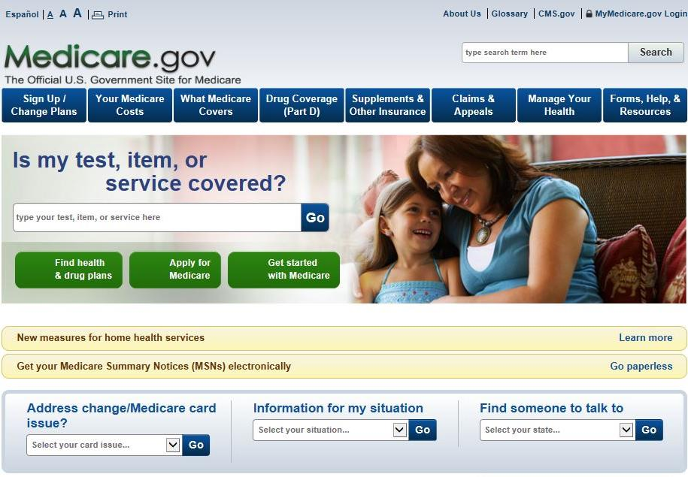
1-800-MEDICARE or Medicare.gov
Notes:
Please keep in mind that although you apply for Medicare by contacting Social Security, and we have some Medicare information on our website, it is actually another federal government agency, Centers for Medicare & Medicaid Services, commonly referred to as “CMS” that administers the program.
CMS is your main source for information regarding Medicare
Social Security helps you apply for Medicare Parts A and B, and we send your application information electronically to CMS.
We can also take your application for Extra Help with Medicare Part D.
If you sign up for Part B, we deduct the premium from your monthly Social Security benefit – and send it to CMS – before you receive your payment from us each month.
If you enroll in Medicare only, CMS will bill you for your Part B premiums until you go on Social Security.
If you have any questions regarding the Medicare program, you can call CMS at 1-800-MEDICARE or visit Medicare.gov
You can also contact your local SHIBA office.

Slide 57
Welcome
Medicare
Choosing a Plan
Scott Standley
Scott.standley@hubinterntional.com
208-737-6875

Slide 58
The material appearing in this presentation is for informational purposes only and should not be construed as advice of any kind, including, without limitation, legal, accounting, or investment advice. This information is not intended to create, and receipt does not constitute, a legal relationship, including, but not limited to, an accountant-client relationship.
Although this information may have been prepared by professionals, it should not be used as a substitute for professional services. If legal, accounting, investment, or other professional advice is required, the services of a professional should be sought.
Disclaimer

Slide 59
Coverage Decision
Mandatory
Option 1 Option 2
Original
Medicare
Supplements
& Part D
Med Advantage
Part C
Must have
Part A & B
Most have Rx
Can not buy a separate Rx
Part A
Supplement purchased to fill the gaps
Part B
Rx policy purchased separately

Slide 60
Coverage Decision
Medicare Part A & B mandatory
Supplements
Highest Premium to Low – Age & Tobacco bracketed – No prescription Drug coverage
Plan F – Covers 100% of what Medicare does cover. – Important – Not all facilities nor providers except Medicare. You will be responsible for all claims that Medicare DOES NOT cover. Plan F will not be available to newly eligible Medicare people nor to people wanting to change from other policies types in 2020. Blue Cross premium range from $194.53 to $333.48
Plan N – Covers everything the same as Plan F except Part B deductible of $185.
Blue Cross premiums range from $149.70 to $256.52
Plan G - Covers everything the same as Plan N except vision exams.
Blue Cross premiums range from $145.89 to $250.45.
Plan A - Does not cover either deductibles for Part A nor Part B, no Foreign coverage, skilled nursing nor Vision coverage.
Blue Cross premium range from $132.61 to $227.65.
Plan K - Similar to Plan A except 50% hospice care, covers Skilled Nursing and vision.
Blue Cross premium range from $$100.00 to $171.20.
** this is a brief explanation of benefits and does not include all detail of coverage.

Slide 61
Plan | A | B | C | D | Plan F | Plan G | Plan K | L | M | Plan N
Medicare Part Coinsurance and Hospital Costs | X | X | X | X | X | X | X | X | X | X
Medicare Part B coinsurance or copay | X | X | X | X | X | X | 50% | 75% | X | X
First 3 pints of Blood | X | X | X | X | X | X | 50% | 75% | X | X
Part A Hospice Care coinsurance or copay | X | X | X | X | X | X | 50% | 75% | X | X
Coinsurance for Skilled Nursing |  |  | X | X | X | X | 50% | 75% | X | X
Medicare Part A Deductible |  |  | X | X | X | X | 50% | 75% | 50% | X
Medicare Part B deductible |  |  | X |  | X
Medicare Part B excess Charges |  |  |  |  | X | X
Foreign Travel emergency |  |  | 80% | 80% | 80% | 80% |  |  | 80% | 80%
Out of Pocket Limits |  |  |  |  |  |  | $5,560 | $2,780
Plan F has an option, not offered by Blue Cross, called a high deductible Plan F. Coverage same as Plan F after a paid calendar year deductible of $2.300.
Plan N pays 100% of Part B coinsurance except for a copy of up to $20 on office visits and $50 for emergency room visits that don’t result in an inpatient admission.

Slide 62
Blue Cross – Medicare Advantage Plans This is a brief representation of benefits and only of one company – there are several different company s with different benefit options
All Option are HMO | True Blue Rx Gem | True Blue RX | True Blue Rx Option l | True Blue Rx Option ll | True Blue No RX
Premiums | $29 | $$70 | $146 | $89 | $29
Part B Rx Drugs | Usually administered in an inpatient hospital setting, like chemotherapy drugs. These are not Part D prescription drugs 20% |  |  |  | 10%
Max Out of Pocket | $5,900 | $6,700 | $6,700 | $6,700 | $3,000
Inpatient Co-Pays | $325/day – 4 days | $250/day – 6 days | $225/day-5days | $300/day-5days | $100/day-5 days
Outpatient Co-Pay | $300 | $250 | $250 | $325 | $100
P C P Office Visit | $5 | $10 | $30 | $40 | $25
Specialist Office Visit | $40 | $35 | $30 | $40 | $25
Emergency Care | $90
Urgent care | $40 | $40 | $25 | $40 | $25
Rx Co-Pays Tier 1 Tier 2 Tier 3 Tier 4 Tier 5 | $0 $6 $31 $90 30% | $0 $6 $31 $90 33% | $0 $6 $35 $85 33% | $0 $12 $37 $90 29% | NO Coverage
This is a brief example of one company’s benefit and premiums. There are many companies available depending on county of your preeminent residence.

Slide 63
Med Advantage companies available per county*
Companies Counties | Blue Cross | Pacific Source | Select Health
Blaine |  | X | X
Camas |  | X
Gooding |  | X | X
Jerome |  | X | X
Lincoln |  | X
Twin Falls | X | X
Cassia | X |  | X
Minidoka | X |  | X
Owyhee | X | X | X
* This does not include all available insurance companies in our area

Slide 64
Information you will need to get started
Your Medicare card with effective dates for both Part A and Part B. The initial letter has the information also. The effective date of you chosen plan will be the same as Part B or the first of the month following your sign up date if later than Part B effective date.
List of the current Prescriptions. Your agents will run the prescription to show the cost on each company’s formulary.
Your current Health Providers, Primary Care & Specialist. Your agent will make sure they except Medicare and/or they are in the network.
Write down all the questions you might have. Your agent can help you understand and answer this complicated procedure.

Slide 65
Medicare.gov
The official web site provided by the Center of Medicare and Medicaid Service, CMS.
Has all the detail information provided in the presentation
Direct you to Social Security site to enroll in Medicare on line.
Compares all the Medicare Advantage and Prescription Drug plans available in your area.
Look up all physicians that will except Medicare reimbursement.
Look up all drugs and get the price per pharmacy, generic alternatives and formulary info per insurance company.

Slide 66
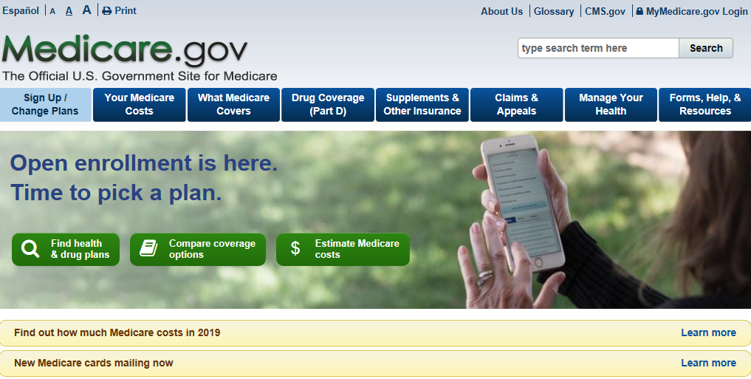

Slide 67
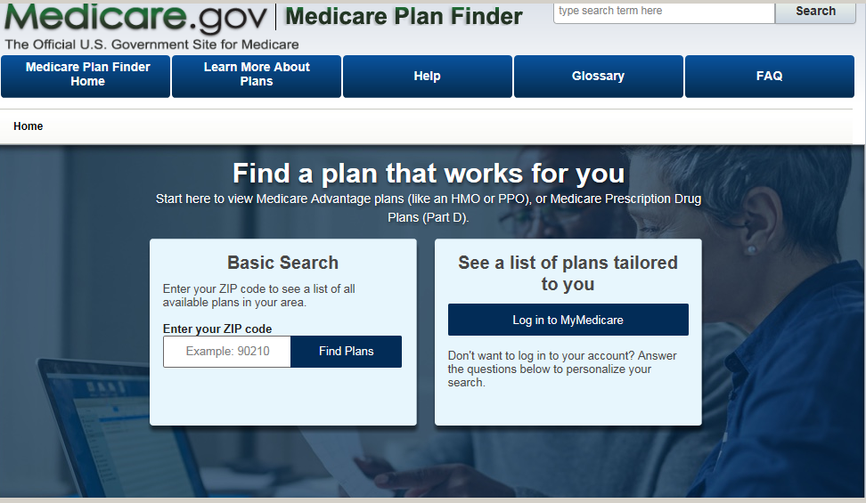

Slide 68
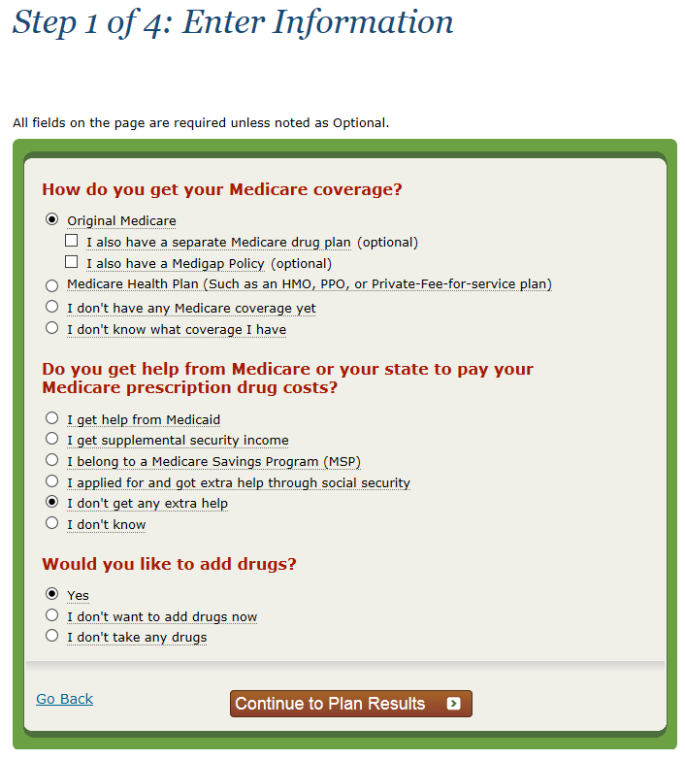

Slide 69
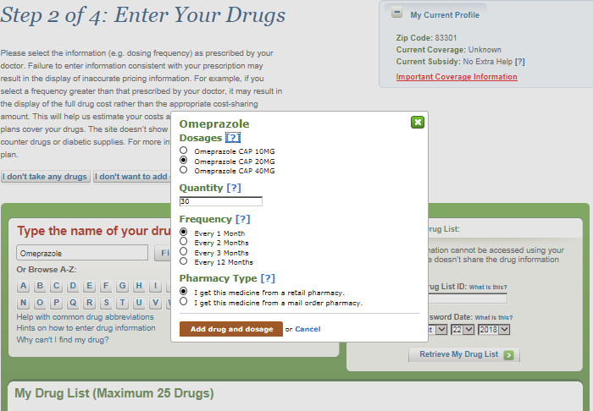

Slide 70
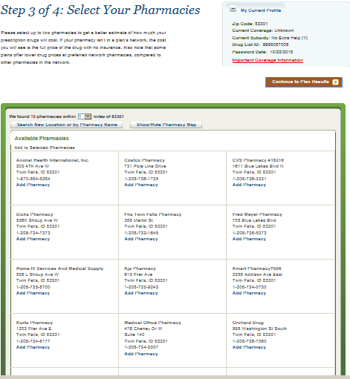

Slide 71
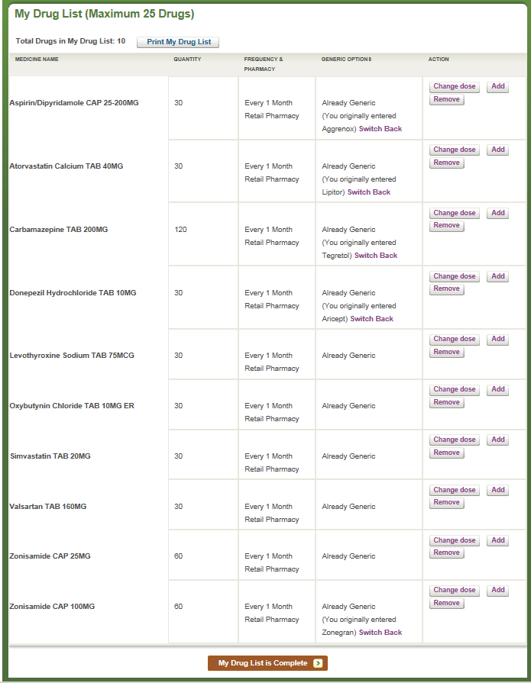

Slide 72
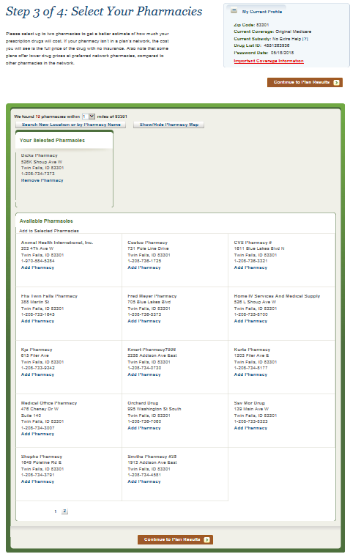

Slide 73
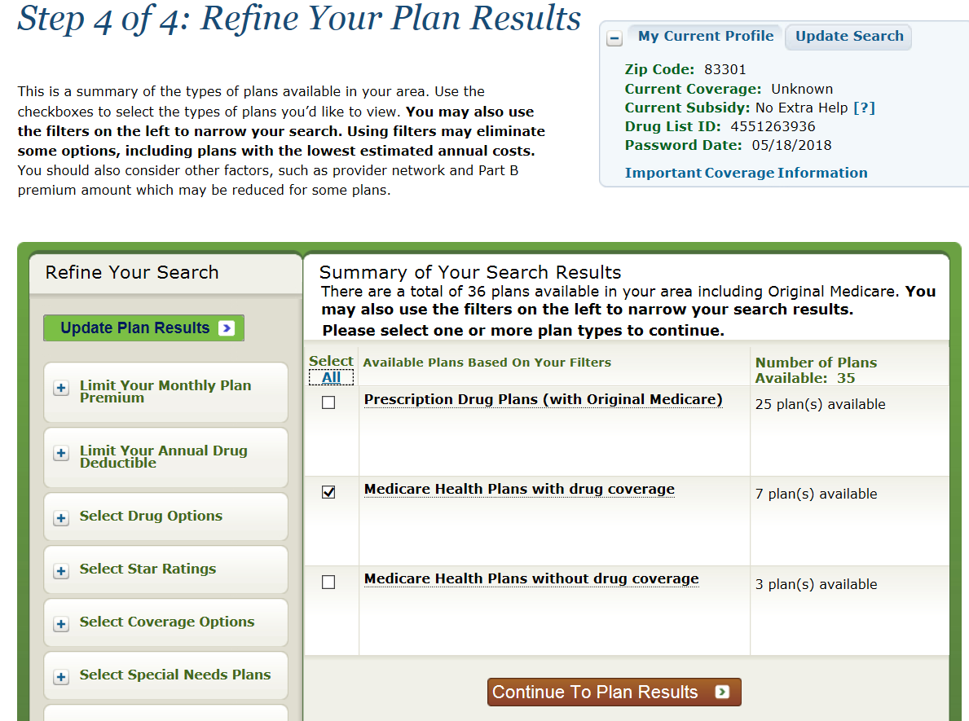

Slide 74
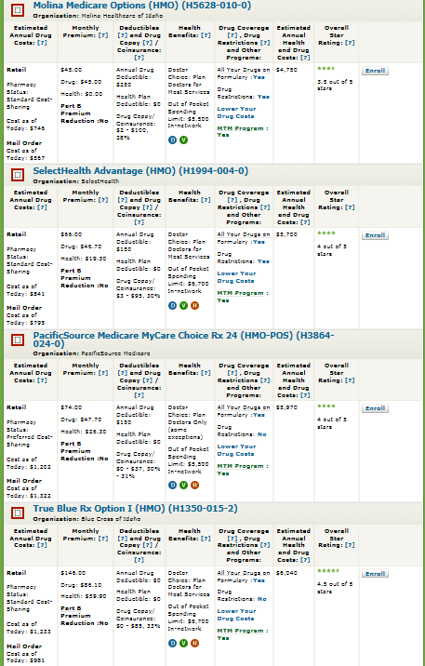
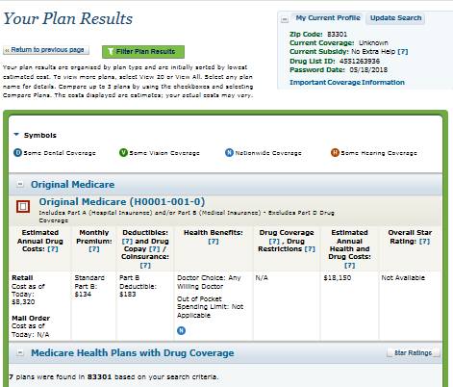

Slide 75
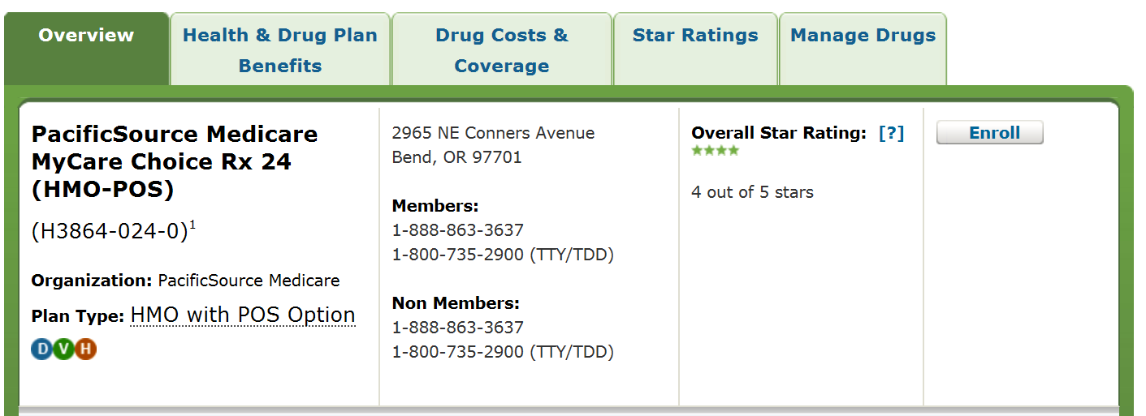

Slide 76
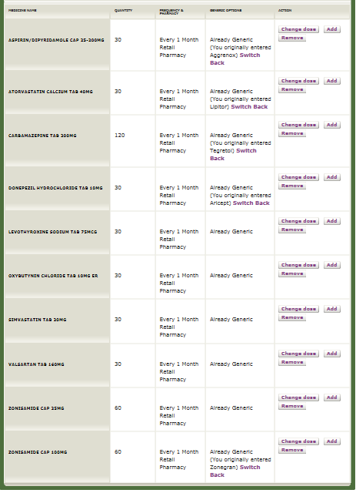

Slide 77
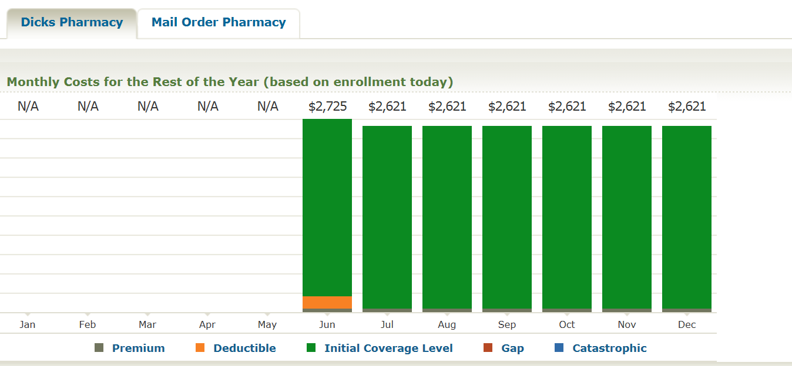

Slide 78
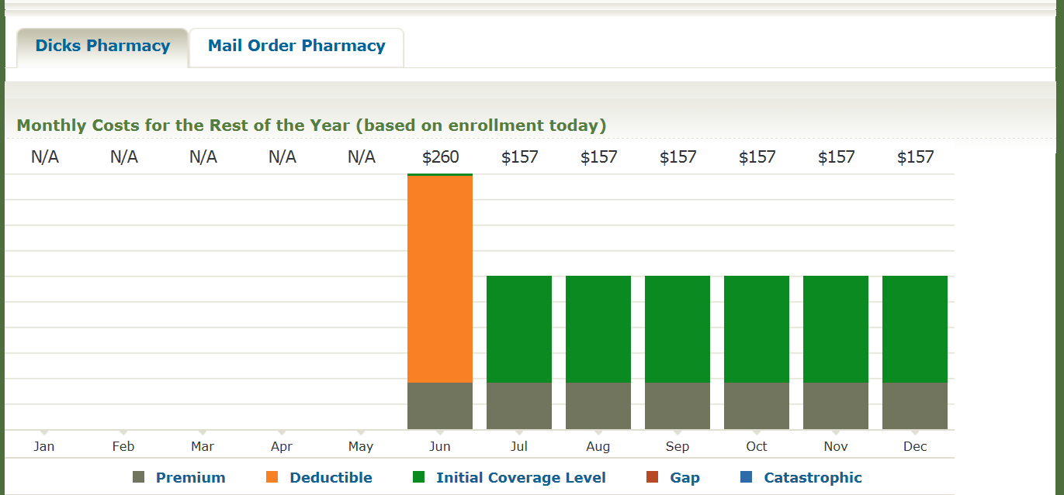

Slide 79
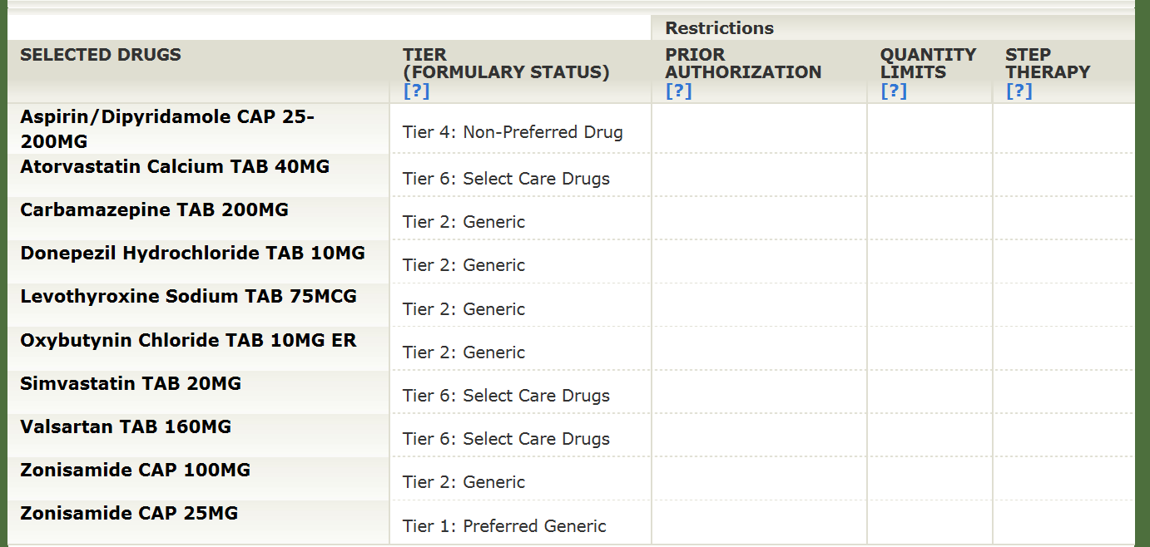

Slide 80
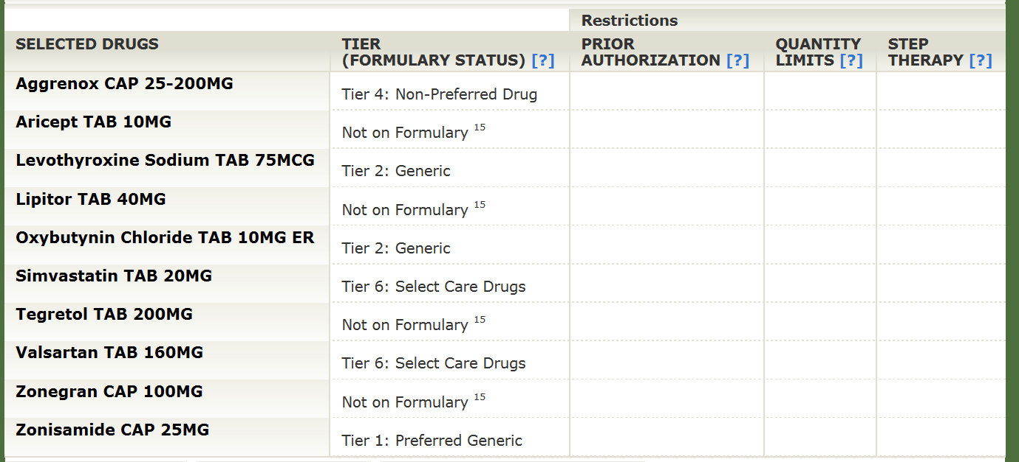

Slide 81
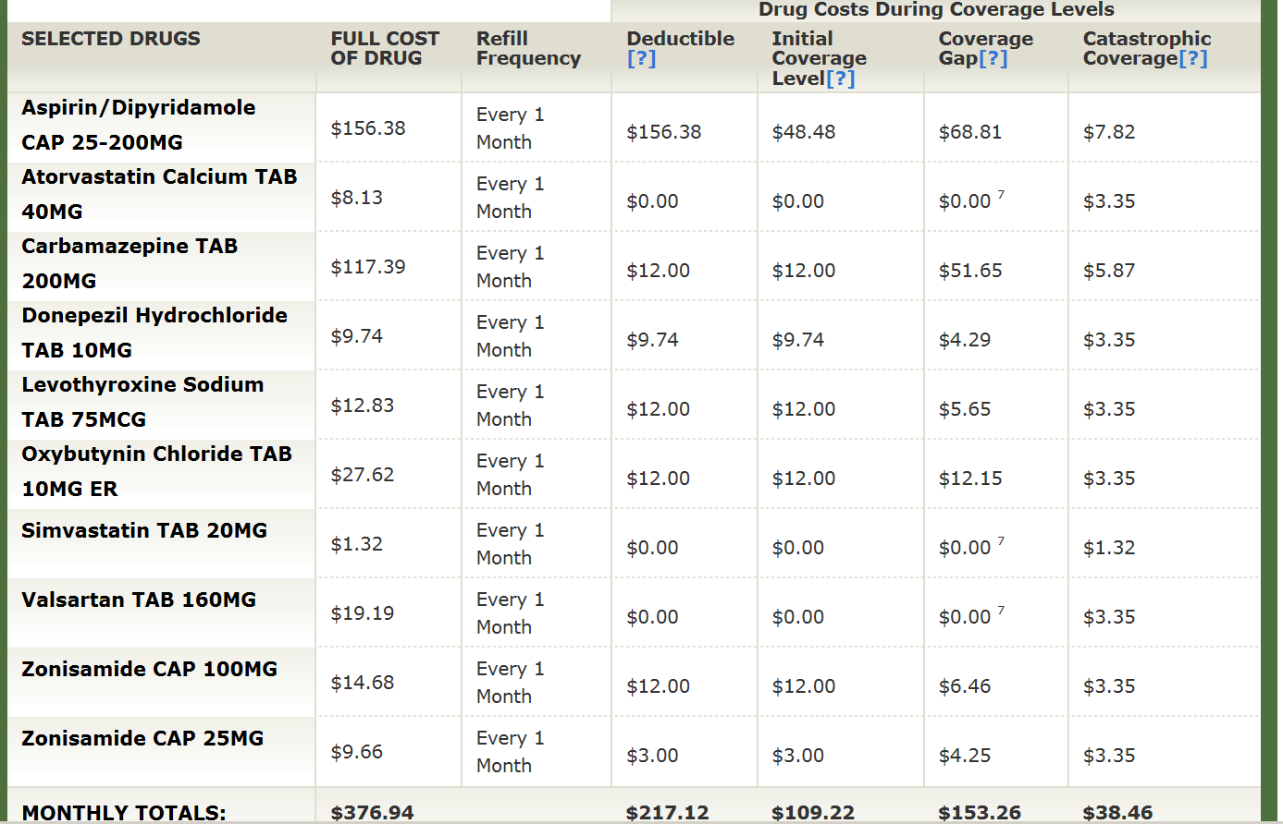

Slide 82
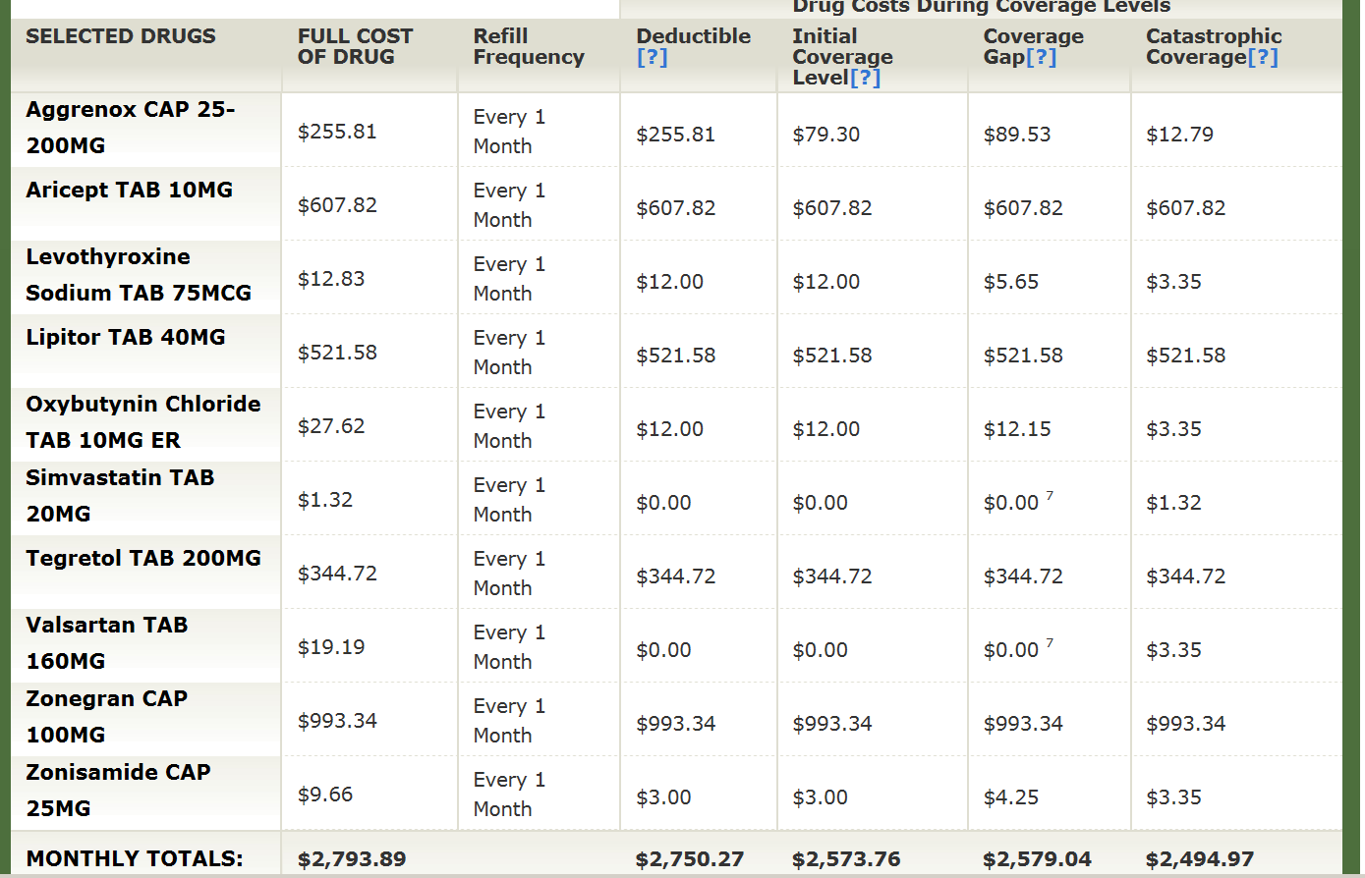

Slide 83
Time for our 1st break
Write Questions and give to us for the 12:05 Q& A with faculty
See you back at 10:25 am

