Slide 1
Office on Aging
Located on the csi twin falls campus
PO Box 1238
Twin Falls, Idaho 83303
208.736.2122

Slide 2
Office on Aging
Shawna Wasko, M.OLP
Public Information/Contracts Manager/Group Facilitator
Widowed Wellness Programs of Idaho, Inc. Caregiver Support Group Grandparents as Parents support group

Slide 3
Office on Aging
Our Goal:
Is to enable people to live in their own homes:
As long as they can
As comfortably as they can
As safely as they can.

Slide 4
Office on Aging
The csi office on aging provides
a wide range of services to
seniors aged 60 and older
and to family members of a senior citizen.

Slide 5
Office on Aging
The csi office on aging serves the eight
Counties of the magic valley:
Blaine, camas, cassia, gooding, Jerome,
Lincoln, minidoka, and twin falls

Slide 6
Office on Aging
Aging & Disability Resource Center
Helps people with questions about long term care. It helps identify needs; educate as to options & resources; empower them to make informed choices; & assist them to access desired resources

Slide 7
Office on Aging
Adult Protection Services
Are mandated by Law to investigate allegations of abuse, neglect, or exploitation of a vulnerable adult (18 or older, who is unable to make, implement, or communicate decisions due to mental/physical impairment).

Slide 8
Office on Aging
Adult Protection Services
What to report to adult protection (can be anonymous):
Physical/Mental Abuse: unexplained bruises, falls, scratches, lacerations, contusions, etc.
Neglect: Malnourishment, no food, no clothing, failure to obtain needed medical care, no heat, no running water.

Slide 9
Office on Aging
Adult Protection Services
What to report to adult protection:
Self-Neglect: Social isolation, no food, no heat, no running water, malnourishment, failure to obtain needed medical care
Exploitation: Unusual account activity, unpaid bills, inappropriate legal documents

Slide 10
Office on Aging
Information & Assistance
Is the gateway to senior services in the Magic Valley. They can help identify needs, & make referrals to resources and services to meet those needs.

Slide 11
Office on Aging
Ombudsman Program
Works to assist residents of long-term care facilities to protect their health, rights, safety, and welfare.

Slide 12
Office on Aging
Ombudsman Program
They investigate complaints in 58+ facilities, for seniors that involve accessing care, resident rights, facility or home-based care issues, Medicaid, Medicare, social security and other agencies

Slide 13
Office on Aging
Support Groups
Meet regularly for education, discussion & peer support.
Caregiver support group Grandparents as parents support groups widowed wellness programs of Idaho, Inc.

Slide 14
Office on Aging
Contracted services
Homemaker: assist with light housekeeping & general chores
Respite Care: offers caregivers a break with companionship, supervision, & assistance, with such tasks as bathing, dressing, & other care receiver needs.

Slide 15
Office on Aging
Contracted services
Transportation: services provide rides for seniors to senior centers, medical appointments, shopping and other locations.

Slide 16
Office on Aging
Contracted services
Senior Dining & Activities: are offered at 16 senior centers and 2 meal sites throughout the Magic Valley.

Slide 17
Office on Aging
Senior Centers
1 in 6 seniors in idaho struggle with Hunger
Congregate Meals: On track to serve 101,900 Meals in 2018
Home Delivered Meals: on track to serve 72,800 Meals in 2018
Live longer with less dementia

Slide 18
Office on Aging
Biggest Risk to Seniors:
Loneliness

Slide 19
Office on Aging
Caregiver Crisis in America
36 million Americans provide care for an aging relative
¾ of these caregivers work outside the home
Many have full time jobs and kids at home

Slide 20
Office on Aging
Caregiver Crisis in America
In 1950 only 7% of population over 65
In 15 years, 20% of American will be senior citizens
We do not have enough caregivers: Medicaid explodes

Slide 21
Office on Aging
Caregiver Crisis in America
Today 5 million people have Alzheimer’s Disease (AD)
We will have 16 million with AD by 2050
Caregivers make about $10 an hour with no benefits

Slide 22
Office on Aging
Caregiver Crisis in America
47% of working caregivers have used up all or most of their savings
1 in 5 family caregivers were so financially strained they had to move into the same house with their care receiver

Slide 23
Office on Aging
Caregiver Crisis in America
In a National alliance for caregivers and the Ad association, 40% of those providing care for people with AD showed signs of depression and extreme emotional stress

Slide 24
Scams and Schemes
Fraud Prevention education
By
Taenia Hudson
Senior Medicare Patrol coordinator
CSI Office on Aging

Slide 25
What is the Senior Medicare Patrol?
SMPs...
Help preserve the integrity of the Medicare program
Rely on volunteers to help perform SMP work
Help Medicare beneficiaries prevent, detect, and report health care fraud
Notes:
The Senior Medicare Patrol is here to help you avoid these problems.
Senior Medicare Patrol programs, or SMPs, help Medicare and Medicaid beneficiaries prevent, detect, and report health care fraud. By doing so, we help preserve the integrity of the Medicare and Medicaid programs. Because this work often requires face-to-face contact to be most effective, SMPs nationwide rely on approximately 5,000 volunteers who are active each year to help in this effort.
Suggested Handout: SMP Brochure (available in multiple languages)
www.smpresource.org > Resources for SMPs > SMP Resource Library

Slide 26
New Medicare cards
Your card is unique will include the numbers 0 thru 9 and will not include the letters s, l o I, b and z
Destroy your old card once you receive your new card
Treat your new card like a credit card – protect it!
Medicare will never call you uninvited and ask for personal or private information

Slide 27
Lottery
Scams
IRS
Scams
Romance
Scams
Phone
Scams

Slide 28
10 things you can do to avoid fraud
Spot Imposters
Do online searches
Don’t believe your caller id
Don’t pay upfront for a promise
Consider how you pay
Talk to Friend or relative
Hang up on robocalls
Do not answer unknown numbers
Be skeptical about free trials
Don’t deposit a check and wire money back
Sign up for free scam alerts from the FTC at ftc.gov/scams
IT’S SHREWD TO BY RUDE – HANG UP OR BETTER YET DO NOT ANSWER

Slide 29
Thank you

Slide 30
AN OUNCE OF PREVENTION,
WHAT IS IT WORTH?
Keeping Yourself Injury Free in Life
Bryan Wright PT, DPT, Cert. MDT, OCS

Slide 31
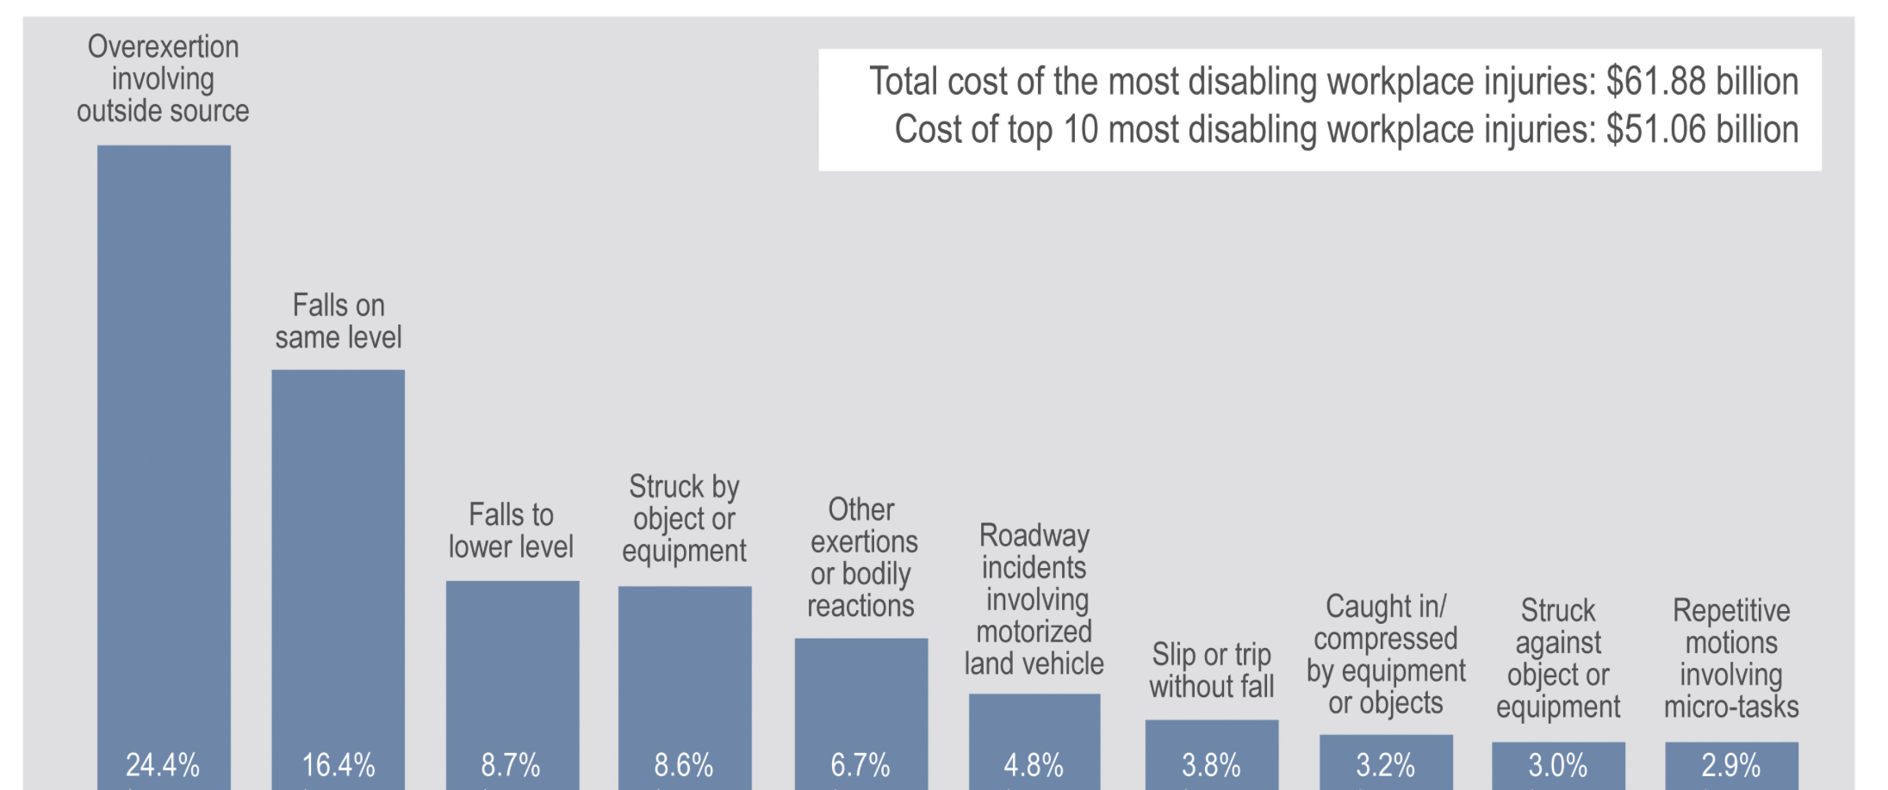
INJURY RISK
Notes:
2-24 - MVA
25-64 - Drug Overdose
65 + - Falls

Slide 32
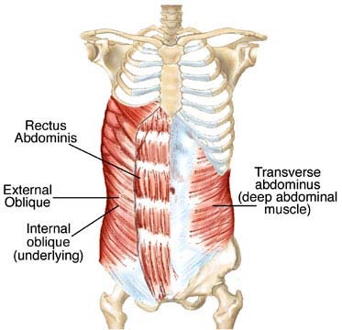
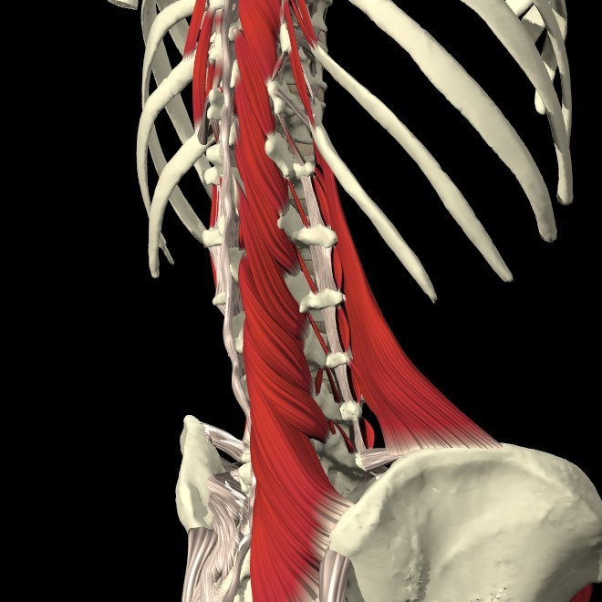
PREVENTION IS BEST
Motion is Lotion
Nerve Movement
Deep layer Strength
Habits of daily living

Slide 33
OPTIMAL LOAD

Slide 34
RISK FACTORS
Repetitive Motion
Prolonged Position
Awkward Body Position
High Loads or Forces
Poor Rest
Low Fitness

Slide 35
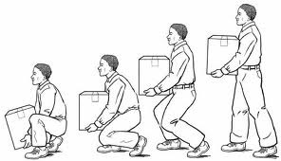
BODY MECHANICS
Plan ahead
Keep curve
Avoid twisting the back
Break it up
Avoid prolonged positions
Keep Load Close to Body

Slide 36
TOP 10 HAZARDS
Weather Conditions: Ice and Snow
Contaminants on the Floor
Indoor Walking Surface Irregularities
Outdoor Walking Surface Irregularities
Inadequate Lighting
Stairs and Handrails
Stepstools and Ladders
Tripping Hazards: Clutter, Loose Cords, etc.
Improper Use of Floor Mats and Runners
Poor Drainage: Pipes and Drains

Slide 37
TAKE HOME TIPS
4. Secure Bathrooms
5. Corral Toys / Other
6. Install Supports
Rule of 2s
Stabilize Staircases
Clear Steps
Notes:
- Make sure all staircases have solid handrails, securely affixed flooring, adequate lighting, and safety gates if there are small children in the home.
- Secure rugs to avoid slipping and water pooling on slick surfaces. Non-slip stickers are another good way to keep everyone in your home from slipping in the shower.
- Provide an easy space for kids to stow toys and make sure every playdate ends without injury. Secure skateboards, bikes, and other mobile toys in a safe area where family members and visitors won’t trip on them.
- Install safety rails to help family members old and young safely get in and out of the shower. Or use these Balance Assist Bars, which are small enough to fit in any shower, and more than one can be added to provide extra support to older family members and others who need additional help.

Slide 38
Over 60 & Getting Fit
Monday, Wednesday, Friday
9-9:50
CSI Gymnasium
FREE!

Slide 39
Active Aging Classes (60+)
Zumba Gold
Zumba Gold Toning
Weight Training
Yoga
Pilates
Water Fitness ($47)
CSI Gymnasium
$35/semester/class

Slide 40
Shelly Wright Professor General & Liberal Studies Director Over 60 & Getting Fit & Active Aging Programs Gym 227 208.732.6483 | Fax 208.734.0245 www.csi.edu

