Slide 1
Over 60 & Getting Fit
Monday, Wednesday, Friday
9-9:50
CSI Gymnasium
FREE!

Slide 2
Active Aging Classes (60+)
Zumba Gold
Zumba Gold Toning
Weight Training
Yoga
Pilates
Water Fitness ($47)
CSI Gymnasium
$35/semester/class

Slide 3
Shelly Wright Professor General & Liberal Studies Director Over 60 & Getting Fit & Active Aging Programs Gym 227 208.732.6483 | Fax 208.734.0245 www.csi.edu

Slide 4
SHIBA
Free, Unbiased Medicare Information for Idaho

Slide 5
WHAT IS SHIBA?
SHIBA stands for “Senior Health Insurance Benefits Advisors”.
SHIBA is part of the Consumer Affairs Bureau of the Idaho Department of Insurance (DOI).
SHIBA is funded by the Idaho Department of Insurance and federally by the Administration for Community Living (ACL).

Slide 6
A NATIONWIDE ORGANIZATION
SHIBA is part of a nationwide program known as
SHIP - “State Health Insurance Assistance Program”.
There is a SHIP program in every State. In Idaho we are called SHIBA. In other states it may be known as SHINE, HICAP, SHIIP.
SHIPs are usually housed under various state agencies such as Department of Insurance, Agencies on Aging, or the Governor’s office.

Slide 7
WHAT DOES SHIBA DO?
Conducts Community Education about Medicare
Provides one-on-one Medicare counseling
Assists with complex Medicare issues
Conducts Outreach and Advocacy
Educates on Fraud and Abuse

Slide 8
SHIBA OFFERS INFORMATION ON
Getting started with Medicare –turning 65 or disabled
Comparing Medigap, Medicare Advantage, and Medicare Prescription Drug Plan choices
Getting help with Medicare costs
Understanding your medical bills
Filing appeals and grievances
Evaluating long-term care insurance

Slide 9
HOW DOES SHIBA WORK?
Idaho SHIBA has 11 paid staff members statewide.
There are counseling sites in nearly every county.
Regional Offices:
Coeur d’Alene
Pocatello
Boise

Slide 10
THE PROBLEM?
With over 300,000 people eligible for Medicare in Idaho, if SHIBA coordinators counseled each beneficiary, the beneficiaries would each get a 4 minute counseling session.
Most counseling sessions take between 1 to 1½ hours.
HOW
So, does SHIBA make it work?

Slide 11
THE ANSWER!
SHIBA RELIES ON WELL-TRAINED
VOLUNTEERS!

Slide 12
ABOUT VOLUNTEERS
SHIBA recruits, trains, certifies and supports a network of counselors who assist Medicare beneficiaries in their local communities.
SHIBA volunteer counselors are compassionate and responsible people dedicated to helping others. They receive expert, ongoing training.
SHIBA counselors deliver information that empowers their neighbors to make informed decisions about Medicare.

Slide 13
HOW DO VOLUNTEERS HELP?
Counsel Medicare beneficiaries and their caregivers
Research to solve problems
Conduct Outreach
Help with Administrative Tasks
Educate on Fraud and Abuse

Slide 14
COUNSELORS
Provide comprehensive Medicare education
Provide information on Medicare options and choices
Provide information on assistance programs

Slide 15
CASEWORKERS
Help resolve issues with:
Medicare appeals and grievances
Medicare enrollment
Medicare claims and billing
Medicare fraud and abuse
Medicare quality of care

Slide 16
OUTREACH WORKERS
Oversee booths at health fairs and conferences
Distribute information throughout communities
Create and strengthen community relations
Make Medicare presentations
Conduct workshops

Slide 17
ADMINISTRATIVE VOLUNTEERS
Provide clerical assistance:
Assist with trainings and enrollment events
Assemble materials for distribution
Compile and report data
Answer phones

Slide 18
WHAT DOES SHIBA NOT DO?
We do not sell insurance.
We do not recommend companies or agents.
We do not recommend insurance plans.
We do not charge for service.

Slide 19
RESOURCES
Website: www.doi.idaho.gov/shiba/shibahealth.aspx
Email: idahoshiba@doi.idaho.gov
To Volunteer: www.doi.idaho.gov/shiba/Vol/login.aspx
800-247-4422
SHIBA toll-free number:

Slide 20
SHIBA
FREE, UNBIASED MEDICARE
INFORMATION FOR IDAHO

Slide 21
“Turning 65 Boot Camp”
ADVANCE CARE PLANNING
& PALLIATIVE CARE
November 3 ,2018

Slide 22
What can you do now to prepare for a life threatening emergency??
Notes:
We don’t like to think that life may through curve ball and we or loved one end up in an accident or are diagnosed with a life threatening illness.
But it happens…….. When we were 17 it is easy to pretend we are going to live forever, each passing year brings more certainty that we will not
What can you do to prepare for that possibility?
Today I would briefly like to tell you about a couple of tools to help you plan for your health care needs, as well as a new service to help you if you or a loved already has a serious or chronic illness

Slide 23
WHAT DO WE DO IN PALLIATIVE MEDICINE?
Provide symptom management for serious illness
Explain disease trajectory & prognosis to allow informed decisions
Communicate decisions with other providers
Complete Advance Directive & POST forms
Support coping with emotional distress & other stressors of illness
Notes:
New service: Palliative Medicine specialty clinic
Palliative: something that reduces the effects or symptoms of a medical condition without curing it. (Merriam-webster) aka Supportive Care
Palliative care is an interdisciplinary medical specialty focused on supporting patients and families through serious, life-threatening illnesses. Palliative care helps patients live as well as they can for as long as they can. The focus is not on death, but on life. In fact, a study in 2010 found that early palliative care not only improved quality of life but also extended length of life.
Palliative medicine focuses on reducing pain and other uncomfortable symptoms, understanding the patient goals for care , facilitating conversations between the patient/family and the medical team, and supporting the patient and family emotional needs. The palliative care population are incredibly fragile and vulnerable and benefits from a holistic approach that focuses not just on illness, but on the entire family system

Slide 24
COMMON CONDITIONS FOR PALLIATIVE MEDICINE CONSULTS
CHF or MI (Heart Failure)
Cancer
COPD (Chronic Pulmonary Obstructive Disease)
CVA (Stroke)
Dementia
Diabetes
CKD (Chronic Kidney Disease)
Notes:
We serve patients who are particularly fragile and vulnerable. This holistic approach focuses not just on illness, but on the entire family system
Tenth leading cause of death in the U.S. (12.5 per 100,000)
1) Heart Disease (596,577)
2) Cancer (576,691)
3) Chronic lower respiratory diseases (142,943)
4) Stroke (cerebrovascular disease) (128,932)
5) Accidents (unintentional injuries) (126,438)
6) Alzheimer’s Disease / Dementia (89,974)
7) Diabetes (73,831)
8) Influenza & Pneumonia (53,826)
9). Nephritis / nephrosis (45,591
10) Suicide

Slide 25
ADVANCE DIRECTIVES
When you are sick with a terminal illness or in a persistent vegetative state AND cannot speak for yourself,
insure your treatment choices are expressed through a:
Living Will
&
Durable Power of Attorney
for Health Care
Notes:
But what can you do if you are generally healthy and want to plan for an unexpected catastrophic illness or injury? Any one of us today could end up in the ICU tonight
from an unforeseen accident.
Consider completing an advance directive to identify your wishes if you can't speak for yourself due to illness or injury. It is NOT a doctor’s order --- we’ll talk about the difference in a minute.
Be aware the Living Will applies only when you are sick with a terminal illness or in a persistent vegetative state and cannot speak for yourself-

Slide 26
BEFORE COMPLETING AN ADVANCE DIRECTIVE, CONSIDER THESE QUESTIONS & DISCUSS THEM WITH YOUR LOVED ONES:
If you had an irreversible brain injury, at what point would you not want CPR, a feeding tube and antibiotics?
Who should make your health care decisions if you can’t make them yourself? We recommend this person has similar values as you and can make complex decisions in stressful situations?
Are there religious, spiritual or philosophical important to you that would influence the medical treatments you would or would not want?
Notes:
For example:
If you had an irreversible brain injury, at what point would you not want to be resuscitated, have a feeding tube or receive antibiotics?
And who would want to be your spokesperson to the medical team, if you could not speak for yourself?
These are questions the Advance Directive can help answer on you behalf.

Slide 27
LIVING WILL: WHAT LEVEL OF MEDICAL TREATMENT DO YOU WANT?
Aggressive Treatment
All available medical care will be provided
or
Limited Treatment
Artificial life support is not used, except artificial food & fluids
or
Comfort measures
Artificial life support is not used, including artificial food & fluids
Notes:
The Living Will documents provides 3 choices for treatment if are sick with a terminal illness or in a persistent vegetative state and cannot speak for yourself-
Remember this is a statement of your wishes only– A doctor’s order is necessary for these wishes to be put into action by medical personal.

Slide 28
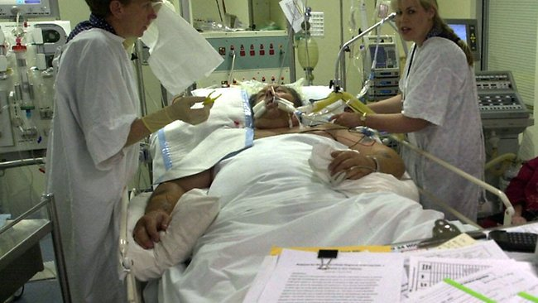
AGGRESSIVE TREATMENT
Notes:
With aggressive treatment All available medical care will be provided including resuscitation, life support machines to breath for you, dialysis if your kidney’s fail
Example: If you are just diagnosed with diabetes you many wish to mark aggressive treatment and then later if you experience kidney fail
This decision may be based on your current healthcare you may choose to change the form to limited or comfort care.
Recognize Testing can be painful or uncomfortable and depending on the course of your illness, you may or may not want to do this
Consider – if you have an x-ray, CT what do you want to happen with the results? Example: If more cancer is found on a CT do you want radiation? Chemo? Surgery?
If you know you DO NOT want those interventions, why get the test?

Slide 29
LIMITED TREATMENT
IV Fluids
Tube Feedings
Notes:
All artificial life support is not used except supplemental food and fluids. Good pain and symptom management are always provided.
Transfer to hospital is necessary, but usually not to ICU.
Examples of limited treatments:
Tube Feedings : Explain when Nutrition when might be used or not be used. Not useful for patients with dementia or end stage cancer
Chemotherapy
Radiation Treatments
Dialysis (cleaning out the waste from the blood when the kidneys fail)
Diagnostic Tests
Testing can be painful or uncomfortable – if you have an x-ray, CT what do you want to happen with the results? Example: If more cancer is found on a CT do you want radiation? Chemo? Surgery?

Slide 30
COMFORT CARE
Notes:
All artificial life support to prolong life is not used
Treatments focus on keeping the patient comfortable, with necessary oxygen, medications and treatments for pain, shortness of breath, constipation, nausea diarrhea.
Food and fluids are offered by mouth, but the person controls how much is taken in,

Slide 31
DURABLE POWER OF ATTORNEY FOR HEALTH CARE: Who will speak for you when you can’t?
Consider:
Who will be your proxy?
Can they speak FOR you, and not their own interests?
Does the proxy hold similar values as you do?
Name one primary & at least one alternate proxy.
Notes:
Someone with values similar to your
Who can respond to crisis logically

Slide 32
Question
How can you make sure your wishes
are known TODAY,
when you have a
SERIOUS/CHRONIC illness?

Slide 33
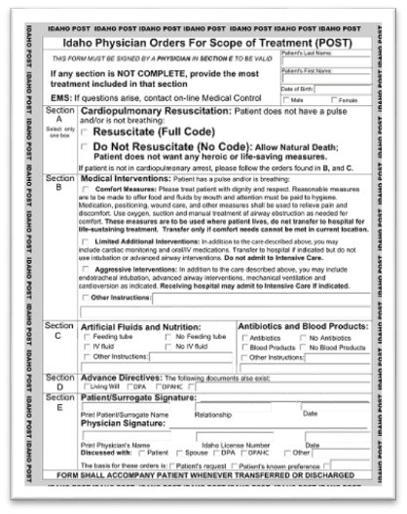
Get the Idaho “POST” form from your doctor
Express your wishes, if you have a serious or chronic
Illness
Notes:
This form should trigger a family discussion about your wishes.
After completing the form, the form should be signed by your physician, and shared with the hospital , family and a copy in a prominent place (like the front of your refrigerator at home for EMS).
EMS personnel are prohibited from attempting resuscitation if a patient has this DNR documentation signed by a doctor.
This form MUST be discussed and signed by your doctor to go into effect.

Slide 34
IF YOUR HEART STOPS, WHAT SHOULD BE DONE?
NO CPR = Do Not Resuscitate (DNR)
OR
FULL Code = Resuscitation with CPR, Defibrillation, Intubation
Notes:
DNR aka “Allow Natural Death”

Slide 35
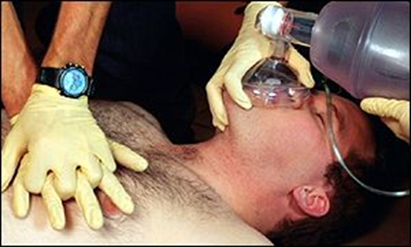
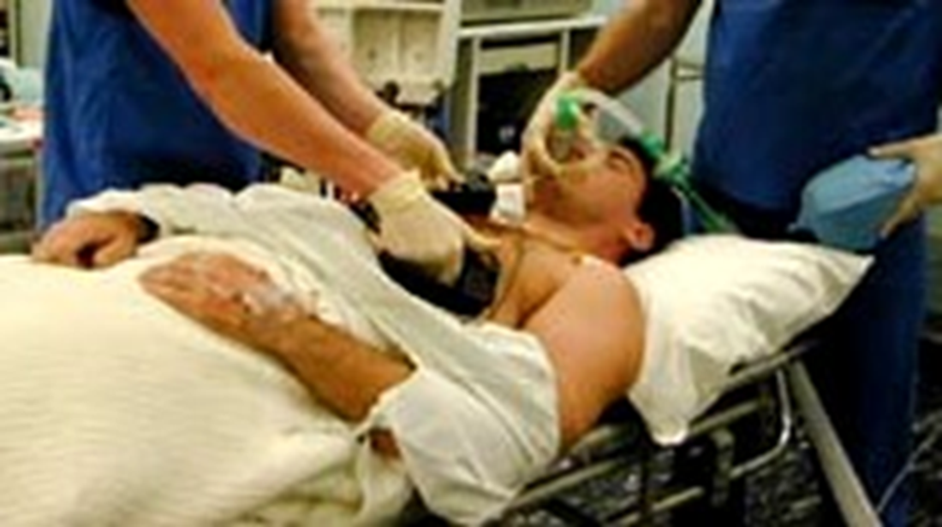
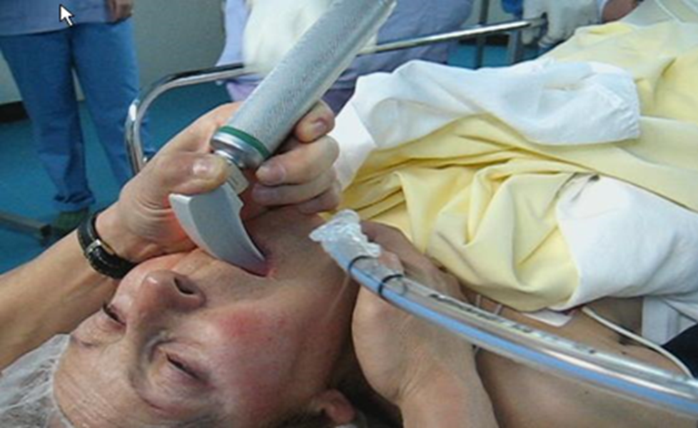
RESUSCITATION INCLUDES:
Chest Compressions
Defibrillation Shocking the heart
Intubation Breathing tube
Notes:
Resuscitation involves: Chest Compressions
If your heart stops, CPR may be done to restart your heart.
CPR forces blood to your heart and breath in to the body.
Compressions may be painful and ribs broken in the process.
Rate of “meaningful recovery” from CPR is 1-3 % of general population outside of the hospital
10-15% I if person is in the hospital

Slide 36
OTHER INTERVENTIONS
IV Fluids
Blood Products
Tube Feedings
Antibiotics
Notes:
The second area on the POST is what happens if you have pulse and are breathing – what interventions do you want?
Other life prolonging treatments:
Other Interventiosn
IV Fluids:
Tube Feedings : Explain when Nutrition when might be used or not be used. Not useful for patients with dementia or end stage cancer
Chemotherapy
Radiation Treatments
Dialysis
Diagnostic Tests
Testing can be painful or uncomfortable – if you have an x-ray, CT what do you want to happen with the results? Example: If more cancer is found on a CT do you want radiation? Chemo? Surgery?
Many people who have chronic illness do not die from the disease itself, but from infections such as pneumonia, UTI, sepsis. Do you want those infections treated?

Slide 37
POST vs Advance Directive
Advance Directive | POST
For anyone 18 and older | For the seriously ill or frail of any age
General instructions for future care | Specific orders for current treatment
Names a medical decision-maker | May be signed by the decision-maker

Slide 38
TAKE STEPS TODAY!
Discuss your treatment options with the important people in your life
Decide which option suits you best (You can always change your mind!)
Select the Health Care Power of Attorney – ASK first!
Complete the advance directive & give copies to family/proxies
Review the AD periodically, especially when your health status changes

Slide 39
For questions or to schedule a palliative medicine appointment Give us a call..
Palliative Medicine Clinic
Dan Preucil, MD
Lesley Goulding, NP
Jamie Kelley-Kinyon, LCSW 208-814-8740

Slide 40
RESOURCES
St. Luke’s “Advance Directives” info and forms: https://www.stlukesonline.org/resources/before-your-visit/advance-directives
St Luke’s “Choosing a Health Care Agent” https://www.stlukesonline.org/health-services/health-information/healthwise/2015/05/15/13/40/choosing-a-health-care-agent
Idaho Quality of Life Coalition: “Advance Care Planning” http://www.idqol.org/page/planning
American Bar Association – “Advance Care Planning Toolkit” http://www.americanbar.org/groups/law_aging/resources/health_care_decision_making/consumer_s_toolkit_for_health_care_advance_planning.html

Slide 41
About St. Luke’s
Why Volunteer?
Older adults who volunteer and engage in more hours of volunteering report higher levels of well-being. RetiredBrains.com

Slide 42
Why Volunteer at St. Luke’s Magic Valley?
This is an opportunity to interact with a large group of different people.
You are a member of the Auxiliary serving patients, staff and our own Volunteer core.
The Need is Great! Patient experience is enhanced with Volunteer involvement.

Slide 43
St. Luke’s Volunteer Positions
Front Information Desk
Surgery Waiting Room
MSTI Volunteer
Women’s Imaging Center
Shuttle
Patient Advocate
Gift Shop Volunteer
Special Projects Volunteer
Comfort Volunteer
Medical Plaza Volunteer

Slide 44
For More Information
Contact Kim Patterson
Volunteer Services
St. Luke’s Magic Valley
814-0861
kimpa@slhs.org

Slide 45
TIME FOR OUR FACULTY Q&A
Be sure to have your questions given to the support team
12:40-1:00 pm

Slide 46
We would love to have you at our next bootcamp! Thanks for coming! PFNF Advisory Board
2019 Boot Camps: March and Sept

