Slide 1
Social Security:
With You Through Life’s Journey…
1
Produced at U.S. taxpayer expense
Notes:
For more than 80 years, Social Security has helped secure today and tomorrow by providing benefits and financial protection for millions of people throughout their life’s journey.
Social Security touches the lives of every American, both directly and indirectly. As you consider the information that you are about to receive , I encourage you to think about all the ways Social Security has been linked to your life – and the lives of your loved ones.

Slide 2
66 Million Social Security Beneficiaries
November 2016
Notes:
This image illustrates the number of beneficiaries we pay. Currently, more than one in every six people in America is receiving a Social Security benefit. The majority of our beneficiaries are retired.
But Social Security is more than retirement...it is a family protection plan (almost 1/3 of the beneficiaries are disabled, dependents of disabled, or survivors).
Source: https://www.ssa.gov/policy/docs/quickfacts/stat_snapshot/

Slide 3

Who Pays for Social Security?
Notes:
Social Security is an intergenerational transfer system: today’s workers help pay for current retirees’ and other beneficiaries’ benefits, not their own future benefits.
There’s no account set aside with your name and contributions on it.

Slide 4
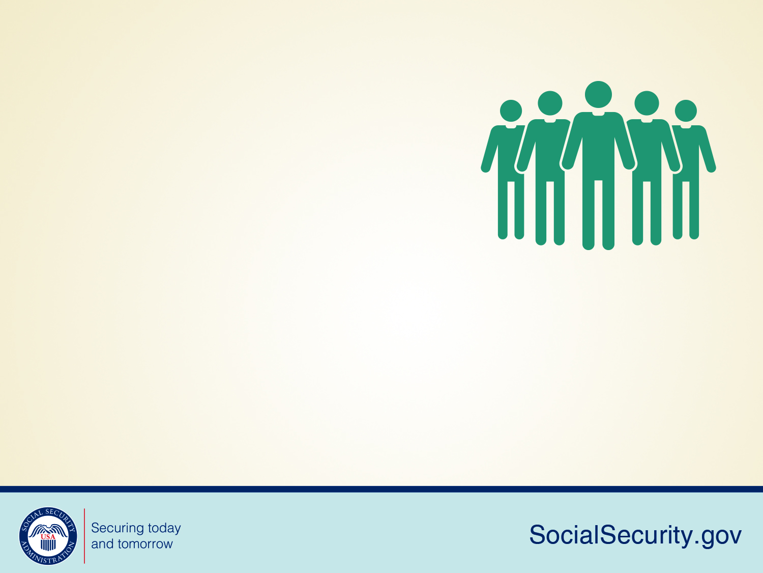
About 173 million workers will pay Social Security taxes in 2017.
About 94 percent of all workers are covered or eligible under Social Security.
Notes:
About 173 million workers will pay Social Security taxes in 2017. About 94 percent of all workers are covered under Social Security.

Slide 5
What’s FICA?
A U.S. federal payroll tax deducted from each paycheck
Stands for the Federal Insurance Contributions Act
Total deducted from your paycheck is 7.65% (6.2% to Social Security, 1.45% to Medicare)
Your employer matches this for a total of 15.3%
Helps fund both Social Security and Medicare programs, which provide benefits for:
  Retirees
  The Disabled
  Children
Notes:
Employers collect a U.S. federal payroll tax known as Federal Insurance Contributions Act withholdings or FICA and report your earnings electronically.
This is how Social Security tracks your earnings throughout your lifetime, and how you earn Social Security retirement, disability, and survivors coverage for you and your family.
This tax is collected from both employees and employers to fund Social Security and Medicare — federal programs that provide benefits for retirees, the disabled, spouses, widows, and children.
The total FICA tax is 15.3 percent of your gross wages. You and your employer both pay 7.65 percent. For Social Security tax, you pay 6.2 percent of your gross wages; for Medicare tax, you pay 1.45 percent of your gross wages.
The current Social Security system works like this: when you work, you pay taxes into Social Security. The amount of taxes is based on your earnings, up to a certain amount. In 2017, that amount is $127,200.
https://www.ssa.gov/pubs/EN-05-10003.pdf.
The money you pay in taxes is not held in a personal account for you to use when you get benefits. We use your taxes to pay people who are getting benefits right now.
Any unused money goes to the Social Security trust funds.

Slide 6

We’ll Be Here For Your Family In The Future
Notes:
Social Security has continuously revised and transformed over time to meet the changing needs of the public. The combined OASI and DI Trust Funds will be able to pay all benefits in full and on time until 2034.
In the next section, we will look at a few life expectancy statistics, dive a little deeper into Social Security in the Future.

Slide 7
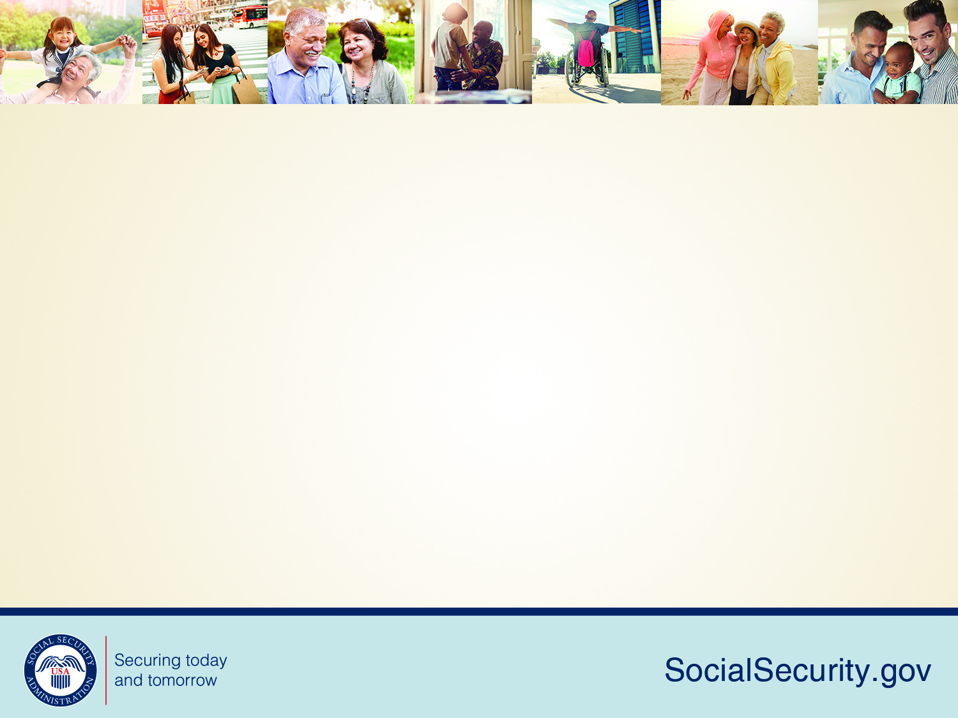
Birth Rates
Source: 2016 Trustees Report Table V.A1.
9
Notes:
The fertility rate in 1920 was about 3.2 children for all women of childbearing age. However, the rate declined dramatically during the depression.
Then, after World War II, a major increase in the fertility rate took place. We know the people born during that time of increase as the baby boomer generation.
But since 1960, there has been a major decline in the rate. This means there will be fewer future workers to support this large generation of baby boomer retirees.
Because of the changing demographics, over the years we have seen the ratio of workers to beneficiaries change.
In 1960 there were 5 people working for every 1 person drawing Social Security benefits, but today that radio is about 3 workers for each Social Security beneficiary. By 2035, when the baby boomer generation is in full retirement, there will be approximately 2 workers for each beneficiary.

Slide 8
Life Expectancy Statistics
A man reaching age 65 today can expect to live, on average, until age 84.3.
A woman turning age 65 today can expect to live, on average, until age 86.6.
And those are just averages. About one out of every four 65-year-olds today will live past age 90, and one out of 10 will live past age 95.
socialsecurity.gov/planners/lifeexpectancy.html
10
Notes:
The combined pressures of a massive baby boomer generation and increasing life expectancy will result in an American population with almost 20% of our projected population over the age of 65 by the year 2035.

Slide 9
Social Security in the Future
The two Social Security trust funds – Old-Age and Survivors Insurance (OASI)/85cents of every $1 and Disability Insurance (DI) /15cents will be able to pay all benefits in full and on time until 2034. SS spends less than 1 cent to manage the program.
The trust funds have reached the brink of depletion of asset reserves in the past, but Congress made substantial modifications to avoid this.
Even if legislative changes are not made before 2034, the trust funds will still be able to pay 79 percent of each benefit due.
11
Notes:
When you work, 85 cents of every Social Security tax dollar you pay goes to a trust fund that pays monthly benefits to current retirees and their families and to surviving spouses and children of workers who have died. The other 15 cents goes to a trust fund that pays benefits to people with disabilities and their families. From these trust funds, Social Security also pays the costs of managing the Social Security programs.
The Social Security Administration is one of the most efficient agencies in the federal government. For each dollar we receive, we spend less than one penny to manage the program.
There are two Social Security trust funds – Old-Age and Survivors Insurance (OASI) and Disability Insurance (DI).
Whether you’re just starting your career or are close to retirement, it’s important to understand these programs are directly dependent on the availability of asset reserves in their respective trust funds to pay benefits.
Social Security has evolved over time to meet the changing needs of the public.
Historically, the OASI and DI Trust Funds have reached times when dedicated tax revenue fell short of the cost of providing benefits and when the trust funds have reached the brink of asset reserve depletion. However, Congress approved the Social Security Amendments of 1977 and 1983, which reversed the cash flow of the program to positive levels and caused the substantial buildup of assets to the $2.8 trillion that exists today.
The 1983 amendments included an increase in the normal retirement age from 65 to 67 and introduced Social Security benefits income taxation with revenue credited to the trust funds.
The Social Security Trust Fund is fully funded until 2034.
Even if legislative changes are not made before 2034, Social Security will still be able to pay 79 percent of each benefit due.
The Social Security Administration’s Chief Actuary has a website with a wealth of data regarding the status of our Trust Funds. It includes online publications as well as a list of proposals to modify the Social Security program.
Here, you can also find online benefit calculators, information about Social Security Cost-of-Living Adjustments (COLA’s), and Congressional testimony and other communications by our Office of the Chief Actuary staff. Just visit SocialSecurity.gov/OACT.

Slide 10



Applying for Benefits
3 options available to apply:
Online –www.socialsecurity.gov
By phone 1-800-772-1213
At our office
You choose the most convenient option for you!
Note: Child and survivor claims can only be done by phone or in a field office (not online) at this time.
Notes:
You have three options, once you are ready to put in your application and start up your monthly benefits.
You can apply within 3 months of when you want your benefits to begin.
You have three options, when it comes time.
Your first option is to apply online at www.socialsecurity.gov. This is the most convenient way to apply.
Your second option is to call Social Security to schedule an appointment to apply over the telephone on a day and time that is convenient for you.
Your third option is to call Social Security to schedule an appointment to apply in-person at your local Social Security office with a face-to-face appointment.
Applying online is still the most convenient way to apply for benefits. You can apply for retirement benefits in as little as 15 minutes.

Slide 11
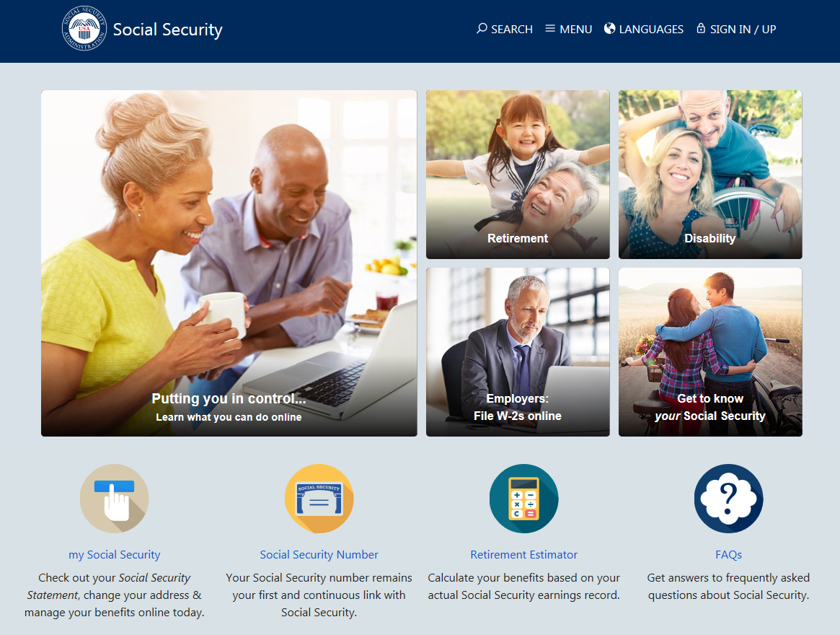
Notes:
The Social Security website is a valuable resource of information about all of Social Security’s programs and is accessible from a computer, tablet and smartphone. We encourage you to use our online retirement planning tools to plan for a secure financial future.

Slide 12

my Social Security
socialsecurity.gov/myaccount
Notes:
my Social Security is a convenient and secure suite of services designed to put you in control of your personal Social Security information, as well as help you manage your benefits when you are ready. Your account gives you the information you need whenever you want. All without calling or visiting a field office.
You can only open a my Social Security account for yourself. You cannot open an account for another person, even if you have his or her written consent.
You may be unable to open a my Social Security account if you:
• Blocked electronic access to your personal Social Security information;
• Recently moved or changed your name; or
• Placed a freeze on your credit report.
Your online my Social Security account provides a variety of information to help you and your family. If you need help setting up your account, we have a 4-minute walkthrough video on our YouTube page.

Slide 13
my Social Security Services
If you receive benefits or have Medicare, you can:
  Request a replacement Social Security card if you have a current Idaho Driver’s License and valid mailing address;
  Get a benefit verification letter as proof that you are getting benefits;
  Check your benefit and payment information and your earnings record;
  Change your address and phone number; *Think new Medicare Card*
  Start or change direct deposit of your benefit payment;
  Request a replacement Medicare card; and
  Get a replacement SSA-1099 or SSA-1042S for tax season.
Notes:
So what can you do with a my Social Security account?
Your online my Social Security account provides a wealth of information to help you and your family plan for your financial future.
If you receive benefits or have Medicare, you can…

Slide 14
my Social Security Services
If you do not receive benefits, you can:
  Request a replacement Social Security card if you have a current Idaho Driver’s License and valid mailing address;
  Check the status of your retirement, disability or Medicare application or appeal;
  Get a benefit verification letter as proof that you are not getting benefits;
  Get your Social Security Statement to review:
    Estimates of your future retirement, disability, and survivor benefits;
    Your earnings to verify the amounts that we posted are correct; and
    The estimated Social Security and Medicare taxes you’ve paid.
Notes:
If you do not receive benefits, you can…

Slide 15
How to open a my Social Security account
1
Visit socialsecurity.gov/myaccount
2
Select: Sign In or Create an Account
3
Provide some personal information to verify your identity.
4
Choose a “username” and “password” to create your account.
17
Notes:
To open a my Social Security account, you have to be at least 18 years of age, have a valid e-mail address, a Social Security number, and a U.S. mailing address.
To open your account, go to socialsecurity.gov/myaccount and select “Sign In or Create an Account.”
You will have to provide some personal Social Security information about yourself and give us answers to some questions only you are likely to know to verify your identity.
Next, you choose a “username” and an 8-character “password” to access your online account. This process protects you and keeps your personal Social Security information private.
You will also notice the option of adding an extra level of security to your account. By selecting “Yes, let’s start now” you are prompted to select an additional question to answer. With this feature, you will receive a temporary code via text message each time you attempt to log in. And you will use this code with your account password. Keep in mind that your cell phone provider’s message rates may apply.

Slide 16

Retirement!
Notes:
When most people think of Social Security, they think of retirement benefits —with good reason. Social Security is a lifeline for most retirees, keeping tens of millions out of poverty.
In the next section, we will talk about retirement, share some important details about retirement planning and discuss how Social Security is here to help secure today and tomorrow with financial benefits, information, and tools.

Slide 17
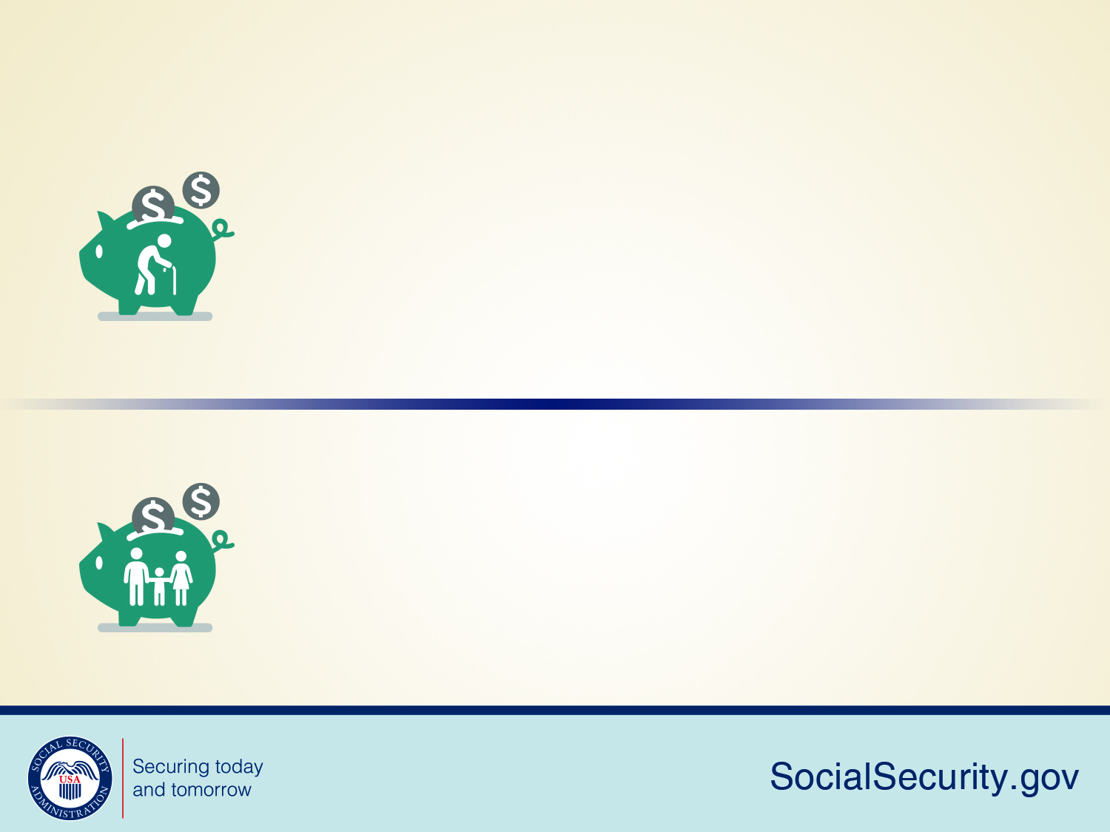
Retirement Benefit Statistics
As of December 2016, 41 million retired workers were receiving 56.1 billion dollars in Social Security benefits per month.
At the same time, 3 million dependents of retired workers were receiving 2.1 billion dollars in monthly Social Security benefits.
Notes:
As of December 2016, 41 million retired workers were receiving 56.1 billion dollars in Social Security benefits per month. At the same time, 3 million dependents of retired workers were receiving 2.1 billion dollars in monthly Social Security benefits

Slide 18
How Do You Qualify for Retirement Benefits?
By earning “credits” when you work and pay Social Security taxes
You need 40 credits (10 years of work) and you must be 62 or older
Each $1,300 in earnings gives you one credit
You can earn a maximum of 4 credits per year
Note: To earn 4 credits in 2017, you must earn at least $5,200.00.
20
Notes:
Credits are the "building blocks" Social Security uses to find out whether you have the minimum amount of covered work to qualify for each type of Social Security benefit.
If you stop working before you have enough credits to qualify for benefits, your credits will stay on your record. If you return to work later on, you can add more credits so you can qualify.
No benefits can be paid if you do not have enough credits.
In 2017, you must earn $1,300 in covered earnings to get one Social Security or Medicare work credit and $5,200 to get the maximum four credits for the year.
When you work and pay Social Security taxes, you earn up to a maximum of four "credits" for each year.
During your lifetime, you will probably earn more credits than the minimum number you need to be eligible for benefits; however, these extra credits do not increase your benefit amount.
Your average earnings during your working years determine how much your monthly payment will be.

Slide 19
How Social Security Determines Your Benefit?
Benefits are based on earnings
Step 1 -Your wages are adjusted for changes in wage levels over time
Step 2 -Find the monthly average of your 35 highest
earnings years
Step 3 -Result is “average indexed monthly earnings”
21
Notes:
Credits are based on your total wages and self-employment income during the year, no matter when you did the actual work. You might work all year to earn four credits, or you might earn enough for all four in a much shorter length of time.
We are looking for the highest 35 years during a worker's lifetime of earnings, regardless of when earned.
Using this formula means that a worker who qualifies for a retirement benefit with just 10 years of work would have a lower benefit payment than someone who worked longer. That’s because we are looking at the highest 35 years of earnings. In this example, there would be 25 years with zero earnings.

Slide 20
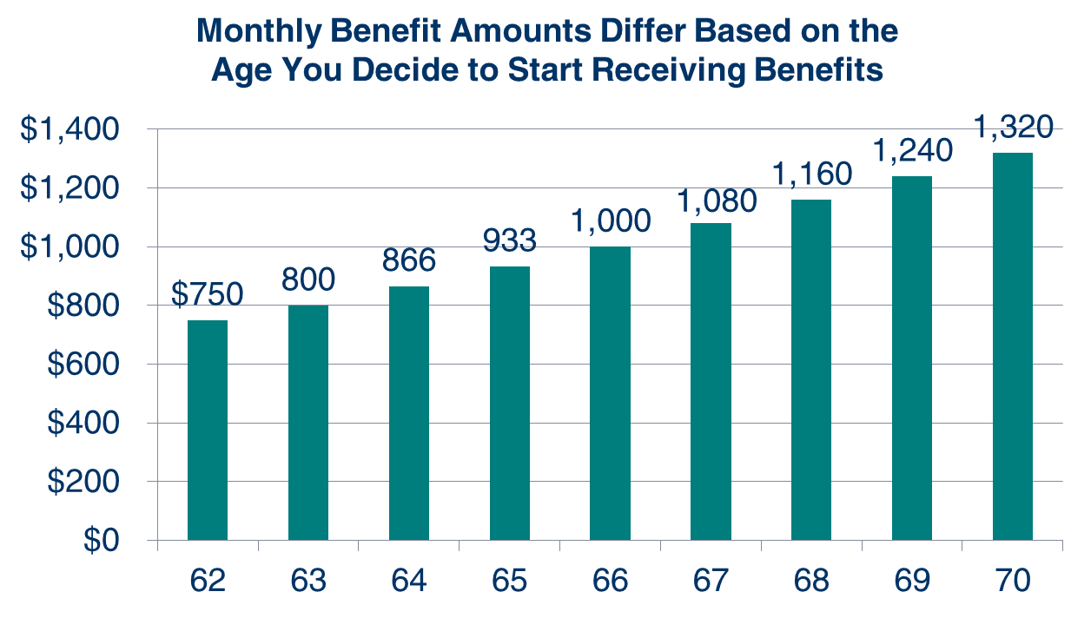
What Is the Best Age to Retire?
Age You Choose to Start Receiving Benefits
Note: This example assumes a benefit of $1,000 at a full retirement age of 66
Notes:
Choosing when to retire is an important and personal decision. Financial experts say you’ll need 70-80% of your preretirement income to have a comfortable retirement. You’ll want to choose a retirement age based on your circumstances so you’ll have enough income when you need it.
As you can see on this chart, your monthly retirement benefit will be higher if you delay starting it. We calculate your basic Social Security benefit — the amount you would receive at your full retirement age — based on your lifetime earnings.
However, the actual amount you receive each month depends on when you start receiving benefits. You can start your retirement benefit at any point from age 62 up until age 70, and your benefit will be higher the longer you delay starting it. This adjustment is usually permanent: it sets the base for the benefits you’ll get for the rest of your life.
You may receive an annual cost-of-living adjustments and, depending on your work history, may receive higher benefits if you continue to work.
Let’s say your full retirement age is 66 and your monthly benefit starting at that age is $1,000. If you choose to start getting benefits at age 62, we’ll reduce your monthly benefit 25 percent to $750 to account for the longer period of time you receive benefits. If you choose to delay getting benefits until age 70, you would increase your monthly benefit to $1,320. This increase is from delayed retirement credits you earn for your decision to postpone receiving benefits past your full retirement age. The benefit at age 70 in this example is 32 percent more than you would receive each month if you had chosen to start getting benefits at full retirement age.

Slide 21
Year of Birth | Full Retirement Age | A $1000 retirement benefit taken at age 62 would be reduced by | A $500 spouse benefit taken at age 62 would be reduced by
1943-1954 | 66 | 25% | 30%
1955 | 66 and 2 months | 25.83% | 30.83%
1956 | 66 and 4 months | 26.67% | 31.67%
1957 | 66 and 6 months | 27.5% | 32.5%
1958 | 66 and 8 months | 28.33% | 33.33%
1959 | 66 and 10 months | 29.17% | 34.17%
1960 + | 67 | 30% | 35%
Notes:
Remember that when to start receiving retirement benefits is a personal choice. There isn’t a one fits all answer.
You should make an informed decision about when to apply for benefits based on your individual and family circumstances.
Factors you should consider when deciding the best age to retire:
Your current cash needs;
Your health and family longevity;
Whether you plan to work in retirement;
Whether you have other retirement income sources;
Your anticipated future financial needs and obligations; and,
The amount of your future Social Security benefits.
This chart gives an example of how much a $1,000 retirement benefit and a $500 retirement benefit would be reduced if someone took the benefit at age 62.
The increase in full retirement age was the result of the 1983 Amendments to the Social Security Act. Full retirement age increases apply to both Retirement Benefits and Survivors Benefits. Although we at Social Security have always used the term “full” retirement age, you may find that some people now refer to “full retirement age” as the “Normal Retirement Age”. Regardless of your full retirement age, reduced benefits can still be paid as early as age 62.
In addition, the Medicare eligibility age of 65 has not changed. We recommend that you apply for Medicare 3 months before your 65th birthday (unless you are already receiving Social Security benefits when you turn 65, in which case you will be automatically enrolled in Medicare).
Source: https://www.ssa.gov/oact/quickcalc/earlyretire.html

Slide 22
Year of birth | Normal Retirement Age (NRA) | Increase for each year of delayed retirement (until age 70) | Benefit, as a percentage of PIA, beginning at age--
 |  |  | 62 | 63 | 64 | 65 | 66 | 67 | 70
1943-54 | 66 | 8% | 75 | 80 | 86 ²⁄₃ | 93 ¹⁄₃ | 100 | 108 | 132
1955 | 66, 2 mo. | 8% | 74 ¹⁄₆ | 79 ¹⁄₆ | 85 ⁵⁄₉ | 92 ²⁄₉ | 98 ⁸⁄₉ | 106 ²⁄₃ | 130 ²⁄₃
1956 | 66, 4 mo. | 8% | 73 ¹⁄₃ | 78 ¹⁄₃ | 84 ⁴⁄₉ | 91 ¹⁄₉ | 97 ⁷⁄₉ | 105 ¹⁄₃ | 129 ¹⁄₃
1957 | 66, 6 mo. | 8% | 72 ¹⁄₂ | 77 ¹⁄₂ | 83 ¹⁄₃ | 90 | 96 ²⁄₃ | 104 | 128
1958 | 66, 8 mo. | 8% | 71 ²⁄₃ | 76 ²⁄₃ | 82 ²⁄₉ | 88 ⁸⁄₉ | 95 ⁵⁄₉ | 102 ²⁄₃ | 126 ²⁄₃
1959 | 66, 10 mo. | 8% | 70 ⁵⁄₆ | 75 ⁵⁄₆ | 81 ¹⁄₉ | 87 ⁷⁄₉ | 94 ⁴⁄₉ | 101 ¹⁄₃ | 125 ¹⁄₃
1960 and later | 67 | 8% | 70 | 75 | 80 | 86 ²⁄₃ | 93 ¹⁄₃ | 100 | 124
Notes:
Remember that when to start receiving retirement benefits is a personal choice. There isn’t a one fits all answer.
You should make an informed decision about when to apply for benefits based on your individual and family circumstances.
Factors you should consider when deciding the best age to retire:
Your current cash needs;
Your health and family longevity;
Whether you plan to work in retirement;
Whether you have other retirement income sources;
Your anticipated future financial needs and obligations; and,
The amount of your future Social Security benefits.
This chart gives an example of how much a $1,000 retirement benefit and a $500 retirement benefit would be reduced if someone took the benefit at age 62.
The increase in full retirement age was the result of the 1983 Amendments to the Social Security Act. Full retirement age increases apply to both Retirement Benefits and Survivors Benefits. Although we at Social Security have always used the term “full” retirement age, you may find that some people now refer to “full retirement age” as the “Normal Retirement Age”. Regardless of your full retirement age, reduced benefits can still be paid as early as age 62.
In addition, the Medicare eligibility age of 65 has not changed. We recommend that you apply for Medicare 3 months before your 65th birthday (unless you are already receiving Social Security benefits when you turn 65, in which case you will be automatically enrolled in Medicare).
Source: https://www.ssa.gov/oact/quickcalc/earlyretire.html

Slide 23
Retirement Estimator
  Gives estimates based on your actual Social Security earnings record
  You can use the Retirement Estimator if:
    You have enough Social Security credits at this time to qualify for benefits and
    You are not:
      Currently receiving benefits on your own Social Security record;
      Waiting for a decision about your application for benefits or Medicare;
      Age 62 or older and receiving benefits on another Social Security record; or
      Eligible for a Pension Based on Work Not Covered By Social Security.
socialsecurity.gov/estimator
Notes:
You can use the online Retirement Estimator at www.socialsecurity.gov/estimator to get immediate and personalized benefit estimates to help you plan for your retirement.
It’s a convenient, secure and quick financial planning tool.
The Retirement Estimator, is an interactive tool that allows you to create “what if” scenarios.
You can, for example, change your “stop work” dates or “expected future earnings” to create and compare different retirement options.

Slide 24
Working While Receiving Benefits
If you are | You can make up to | If you earn more, some benefits will be withheld
Under Full Retirement Age | $16,920/yr. | $1 for every $2
The Year Full Retirement Age is Reached | $44,880/yr. before month of full retirement age | $1 for every $3
Month of Full Retirement Age and Above | No Limit | No Limit
Note: If some of your retirement benefits are withheld because of your earnings, your benefits will be increased starting at your full retirement age to take into account those months in which benefits were withheld.
Notes:
The first thing we recommend is that you visit SocialSecurity.gov/pubs and search for the publication entitled, How Work Affects Your Benefits. It explains the rules you must follow in order to avoid an overpayment, and it gives some great examples for different scenarios that could apply to your individual situation.
You can get Social Security retirement or survivors benefits and work at the same time. However, if you’re younger than full retirement age, and earn more than certain amounts, your monthly benefit remains the same but the total amount of benefits you receive for the year will be reduced. The amount that your annual benefits are reduced, however, isn’t truly lost. Your monthly benefit will be increased at your full retirement age to account for benefits withheld due to earlier earnings.
Note that spouses and survivors, who receive benefits because they have minor or disabled children in their care, don’t receive increased benefits at full retirement age if benefits were withheld because of work. I should also mention that different rules apply if you work outside the United States. Contact us if you’re working (or plan to work) outside the country.
But for most of you, here’s how this works. If you work, and are full retirement age or older, you may keep all of your benefits, no matter how much you earn.
If you’re younger than full retirement age, there is a limit to how much you can earn and still receive full Social Security benefits. If you’re younger than full retirement age, we must deduct $1 from your benefits for each $2 you earn above the annual limit. For 2017, that limit is $16,920.
If you reach full retirement age during 2017, we must deduct $1 from your benefits for each $3 you earn above $44,880 until the month you reach full retirement age.
Starting with the month you reach full retirement age, there is no limit on how much you can earn and still receive all of your Social Security benefits.

Slide 25
For People Younger Than Full Retirement Age During 2017
If your monthly Social Security Benefit is | And you earn | You’ll receive yearly benefits of
$700 | $16,920 or less | $8,400
$700 | $17,000 | $8,360
$700 | $20,000 | $6,860
Notes:
This table provides you with some quick examples to demonstrate how much someone could receive in Social Security benefits for the year 2017, based on his or her monthly benefits and estimated earnings.
In this example, we have a person whose monthly retirement, spousal, or survivor benefit is $700.
In the first row, you see that as long as the person doesn’t earn more than the 2017 limit of $16,920, all benefits are paid for the year ($700 x 12 = $8,400).
In the second row, the person earns a little more than the limit. We take the earned amount, the $17,000, and subtract the limit of $16,920, which leaves $80. Since the offset is $1 in withholdings for every $2 over the limit, we divide $80 in half, leaving $40 to be withheld before he or she is paid Social Security. $40 is the amount that Social Security must withhold up front before the person receives any Social Security payments in 2017. The yearly benefit amount would then be $8,360, or $8,400 minus $40.
In the third row, the person earns $20,000 in gross wages and/or net profit from self employment (which is all that we consider when applying the earnings limit). $20,000 minus the limit of $16,920 means the person went over by $3,080. Since the offset is $1 in withholdings for every $2 over the limit, we divide $3,080 in half, leaving $1,540 to be withheld before he or she is paid Social Security in 2016. $8,400 minus $1,540 equals $6,860 in yearly benefits for this individual, even though the person earned more than $3,000 over the Social Security earnings limit!
So, as you can see, you CAN work and still get some Social Security benefits prior to your full retirement age. And remember that once you reach full retirement age, all of this goes away. You can earn as much as you desire without any worries about a Social Security earnings limit, once you reach full retirement age. But keep in mind that, as we mentioned earlier, the IRS may still apply taxes to your Social Security benefits.
We do realize that sometimes people who retire in mid-year already have earned more than the annual earnings limit. That’s why there is a special rule that applies to earnings for one year, usually the first year of retirement. Under this rule, you can get a full Social Security check for any whole month you’re retired, regardless of your yearly earnings. In 2016, a person younger than full retirement age for the entire year is considered retired if monthly earnings are $1,310 or less.
NOTE: the $700 benefit seems a bit low for an average benefit but it is just an illustrative example. There are definitely people receiving benefits at that $700 level. According to https://www.ssa.gov/OACT/ProgData/benefits/ra_mbc201512.html , there were 1.7 million OABs receiving between $600 and $699 per month, and another 2.3 million between $700 and $799.

Slide 26
Spousal Benefits
Benefit is 35%-50% of worker’s unreduced benefit
Reduction for early retirement
If spouse’s own benefit is less than 50% of the worker’s, the benefits are combined
Does not reduce payment to the worker
Notes:
A spouse who has not worked or who has low earnings can be entitled to as much as one-half of the retired worker’s full benefit.
If you are eligible for both your own retirement benefits and for benefits as a spouse, we always pay your own benefits first. If your benefits as a spouse are higher than your retirement benefits, you will get a combination of benefits equaling the higher spouse benefit.
If spouses want to get Social Security retirement benefits before they reach full retirement age, the amount of the benefit is reduced. The amount of reduction depends on when the person reaches full retirement age.
However, if a spouse is caring for a child under age 16 or disabled, who gets Social Security benefits on the worker’s record, the spouse gets full benefits, regardless of age.

Slide 27
Year of Birth | Full Retirement Age | A $1000 retirement benefit taken at age 62 would be reduced by | A $500 spouse benefit taken at age 62 would be reduced by
1943-1954 | 66 | 25% | 30%
1955 | 66 and 2 months | 25.83% | 30.83%
1956 | 66 and 4 months | 26.67% | 31.67%
1957 | 66 and 6 months | 27.5% | 32.5%
1958 | 66 and 8 months | 28.33% | 33.33%
1959 | 66 and 10 months | 29.17% | 34.17%
1960 + | 67 | 30% | 35%
Notes:
This chart gives an example of how much a $1,000 retirement benefit and a $500 retirement benefit would be reduced if someone took the benefit at age 62.
The increase in full retirement age was the result of the 1983 Amendments to the Social Security Act. Full retirement age increases apply to both Retirement Benefits and Survivors Benefits. Although we at Social Security have always used the term “full” retirement age, you may find that some people now refer to “full retirement age” as the “Normal Retirement Age”. Regardless of your full retirement age, reduced benefits can still be paid as early as age 62.
In addition, the Medicare eligibility age of 65 has not changed. We recommend that you apply for Medicare 3 months before your 65th birthday (unless you are already receiving Social Security benefits when you turn 65, in which case you will be automatically enrolled in Medicare).
Source: https://www.ssa.gov/oact/quickcalc/earlyretire.html

Slide 28
Spousal Benefits Example 1
Husband turned 66 in 2015 and filed for SSA retirement (qualifies for 100% of his retirement)
His benefit is $2000 a month
Wife did not work. She turned 66 in 2017 and files for spousal benefits (50% of husband’s)
Her benefit is $1000 a month
Notes:
A spouse who has not worked or who has low earnings can be entitled to as much as one-half of the retired worker’s full benefit.
If you are eligible for both your own retirement benefits and for benefits as a spouse, we always pay your own benefits first. If your benefits as a spouse are higher than your retirement benefits, you will get a combination of benefits equaling the higher spouse benefit.
If spouses want to get Social Security retirement benefits before they reach full retirement age, the amount of the benefit is reduced. The amount of reduction depends on when the person reaches full retirement age.
However, if a spouse is caring for a child under age 16 or disabled, who gets Social Security benefits on the worker’s record, the spouse gets full benefits, regardless of age.

Slide 29
Spousal Benefits Example 2
Husband turned 66 in 2015 and filed for SSA retirement (qualifies for 100% of his retirement)
His benefit is $2000 a month
Wife did not work. She turned 62 in 2017 and files for spousal benefits ($1000 reduced by 30% = $300)
Her benefit is $700 a month (35% of his amount)
Notes:
A spouse who has not worked or who has low earnings can be entitled to as much as one-half of the retired worker’s full benefit.
If you are eligible for both your own retirement benefits and for benefits as a spouse, we always pay your own benefits first. If your benefits as a spouse are higher than your retirement benefits, you will get a combination of benefits equaling the higher spouse benefit.
If spouses want to get Social Security retirement benefits before they reach full retirement age, the amount of the benefit is reduced. The amount of reduction depends on when the person reaches full retirement age.
However, if a spouse is caring for a child under age 16 or disabled, who gets Social Security benefits on the worker’s record, the spouse gets full benefits, regardless of age.

Slide 30
Spousal Benefits Example 3
Wife is 66 and qualifies for $700 on her own record
Wife qualifies for a spousal benefit of $1000 on husband
She does NOT receive $1700
She receives her benefit of $700 and her spousal benefit of $300 to bring her total to $1000
Notes:
A spouse who has not worked or who has low earnings can be entitled to as much as one-half of the retired worker’s full benefit.
If you are eligible for both your own retirement benefits and for benefits as a spouse, we always pay your own benefits first. If your benefits as a spouse are higher than your retirement benefits, you will get a combination of benefits equaling the higher spouse benefit.
If spouses want to get Social Security retirement benefits before they reach full retirement age, the amount of the benefit is reduced. The amount of reduction depends on when the person reaches full retirement age.
However, if a spouse is caring for a child under age 16 or disabled, who gets Social Security benefits on the worker’s record, the spouse gets full benefits, regardless of age.

Slide 31
2015 Bi-Partisan Budget Act (BBA) Changes:
If you were born before January 2, 1954 and wait to reach your full retirement age, you can choose to receive only the spouse’s benefit and delay receiving your retirement benefit until a later date. If your birthday is January 2, 1954 or later, the option to take only one benefit at full retirement age no longer exists. When you file for one benefit, you will be filing for all retirement or spousal benefits.
socialsecurity.gov/planners/retire/deemedfaq.html
37
Notes:
You may have heard or read about the various filing strategies available to married couples, when it comes to Social Security retirement and spousal benefits. Due to a change in the law, some of those options are changing.
The first change in the law says that now, if you become eligible for Social Security benefits both as a retiree and as a spouse (or divorced spouse), and you want to go ahead and claim your benefits, you must file for both benefits.
This is called “deemed filing,” and it used to apply only prior to Full Retirement Age. Based on the law change, deemed filing now applies at any age for people who turned age 62 after January 1, 2016.
However, there are two exceptions to the deemed filing provision:
Child-in-Care Benefits: When a beneficiary is entitled to spousal benefits based on the child-in-care requirements and is eligible for retirement benefits, he or she may delay filing for the retirement benefit.
Receiving Both Disability And Spouse’s Benefits: When a beneficiary is entitled to disability and spouse’s benefits, he or she may delay filing for retirement benefits. If the disability benefits terminate before converting to retirement benefits, deemed filing applies in the month of termination of the disability benefit.

Slide 32
2015 BBA Example:
You were born on July 6, 1951 (age 66)
You qualify for $1000 on your own record at age 66 or you qualify for $1000 as a spouse
You can take the spousal benefit and let yours sit until age 70 when you would qualify for 132% of your own ($1000 x 132% = $1320) then switch.
socialsecurity.gov/planners/retire/deemedfaq.html
38
Notes:
You may have heard or read about the various filing strategies available to married couples, when it comes to Social Security retirement and spousal benefits. Due to a change in the law, some of those options are changing.
The first change in the law says that now, if you become eligible for Social Security benefits both as a retiree and as a spouse (or divorced spouse), and you want to go ahead and claim your benefits, you must file for both benefits.
This is called “deemed filing,” and it used to apply only prior to Full Retirement Age. Based on the law change, deemed filing now applies at any age for people who turned age 62 after January 1, 2016.
However, there are two exceptions to the deemed filing provision:
Child-in-Care Benefits: When a beneficiary is entitled to spousal benefits based on the child-in-care requirements and is eligible for retirement benefits, he or she may delay filing for the retirement benefit.
Receiving Both Disability And Spouse’s Benefits: When a beneficiary is entitled to disability and spouse’s benefits, he or she may delay filing for retirement benefits. If the disability benefits terminate before converting to retirement benefits, deemed filing applies in the month of termination of the disability benefit.

Slide 33
Voluntary Suspension
The 2015 BBA closed the loopholes on this retirement strategy. If you take your retirement benefit and then ask to suspend it to earn delayed retirement credits, your spouse or dependents (excluding divorced spouses) will not be able to receive benefits on your Social Security record while your own benefits are suspended.
socialsecurity.gov/planners/retire/suspendfaq.html
39
Notes:
The second change in the law involves what we call “voluntary suspension.”
If you take your retirement benefit and then ask to suspend it to earn delayed retirement credits, your spouse or dependents (excluding divorced spouses) generally will not be able to receive benefits on your Social Security record while your own benefits are suspended.
In addition, you will not be able to receive benefits on anyone else’s record during that time.
We know that some of these rules can be confusing, so we encourage you to visit our website for a comprehensive explanation and see some specific examples that illustrate how this plays out for married couples.

Slide 34
Benefits for Divorced Spouses
If you are divorced, and your marriage lasted 10 years or longer, you can receive benefits on your ex-spouse's record (even if he or she has remarried) if:
  You are unmarried;
  You are age 62 or older;
  Your ex-spouse is entitled to Social Security retirement or disability benefits; and
  The benefit you are entitled to receive based on your own work is less than the benefit you would receive based on your ex-spouse's work.
Notes:
If you are divorced, and your marriage lasted 10 years or longer, you can receive benefits on your ex-spouse's record (even if he or she has remarried) if:
You are unmarried;
You are age 62 or older;
Your ex-spouse is entitled to Social Security retirement or disability benefits; and
The benefit you are entitled to receive based on your own work is less than the benefit you would receive based on your ex-spouse's work.
Your benefit as a divorced spouse is equal to one-half of your ex-spouse's full retirement amount (or disability benefit) if you start receiving benefits at your full retirement age. The benefits do not include any delayed retirement credits your ex-spouse may receive.
If you remarry, you generally cannot collect benefits on your former spouse's record unless your later marriage ends (whether by death, divorce or annulment).
If your ex-spouse has not applied for retirement benefits, but can qualify for them, you can receive benefits on his or her record if you have been divorced for at least two years.
If you are eligible for retirement benefits on your own record and divorced spouse’s benefits, we will pay the retirement benefit first. If the benefit on your ex-spouse’s record is higher, you will get an additional amount on your ex-spouse’s record so that the combination of benefits equals that higher amount.
If you were born before January 2, 1954 and have already reached full retirement age, you can choose to receive only the divorced spouse’s benefit and delay receiving your retirement benefit until a later date. If your birthday is January 2, 1954 or later, the option to take only one benefit at full retirement age no longer exists. If you file for one benefit, you will be effectively filing for all retirement or spousal benefits.

Slide 35

Notes:
At Social Security, we’re securing today and tomorrow.
Thank you for your participation in today’s program.
We wish you a safe, happy, and successful tomorrow.

Slide 36


AABD Medicaid
(Aid for the Aged, Blind and Disabled)
Presented by Laela Wilmot, Benefits Program Manager Regions 5 and 6

Slide 37

Basic Eligibility Criteria
Resident of the State of Idaho
Meet citizenship criteria or meet the legal non resident status
Meet Age or Disability Criteria
Meet income and resource guidelines
Estate Recovery rules
Meet level of care for long term care services

Slide 38

Residency
Voluntarily living in Idaho and have no immediate intention of leaving.

Slide 39
Citizenship
Must be a US Citizen or a Qualified Non-Citizen.
  US Citizens must provide documentation supporting their Citizenship and Identity
  Qualified Non-Citizens are required to provide proof that they are in the US legally. Must have been in the US a minimum of 5 years with few exceptions.
  **If a customer is receiving SSI, SSD, or Medicare they are exempt from verifying citizenship.

Slide 40
Aged and Disabled
65 years of age or older
Under age 65 and meets the definition of blindness or disability used by SSA
  Does not require an application for SSA benefits.

Slide 41
Potential Income
Before Medicaid can be approved, you must apply for all benefits due to you.
  Social Security (Except Supplemental Security Income)
  Other retirement payments

Slide 42
SSI and Medicaid
SSI recipients are categorically eligible for Medicaid no matter the amount of the SSI payment.
Recipients of other SSA payments are not categorically eligible for Medicaid.
  Social Security Disability Insurance (SSDI)
  Retirement, Survivors, Disability Insurance (RSDI)
Note: There are separate applications for Medicaid and Social Security Payments.

Slide 43
Income and Resource Guidelines
Current income limit for 2017 (updates annually):
$2,225 for an individual per month
$4,430 for a couple per month
Current Resource limit:
Limit for an individual is $2000
Limit for a couple is $2000 each

Slide 44
Estate Recovery
If full Medicaid is received at the age of 55 or older, any resources in an estate at time of death may be subject to recovery of medical expenses.
  Lien is put on property by the State of Idaho
  Never recover more than medical costs paid by Medicaid.

Slide 45
Long Term Care Medicaid
Home and Community Based Services
  Own Home
  Community Setting
  Cost less than Nursing Home
Nursing Home Assistance
  Nursing Facility
    Eligibility based on ability to care for self determined by a nurse reviewer from the Division of Medicaid.
Notes:
Income limit $2,219 ($2,199)

Slide 46
Over Income/Resource for Long-term Care Medicaid
Can set up an Income Trust also known as a “Miller Trust”
  Contact Idaho Legal Aid
    Contact Information: www.idaholegalaid.org
    or
  Request assistance from an elder law attorney
Resource Assessment for Couples
  Determine Spousal Share (1/2 of countable resources verified on “snap shot” date)

Slide 47

Snap Shot Date
  First day of 30 continuous days of long-term care
    1st day as determined by a physician which the care was needed
    1st day of nursing home admission
    1st day of moving to assisted living
  Department reviewer determines the appropriate date if the individual still lives at home.
Notes:
Include Resource Assessment in the packet
Linda’s Part

Slide 48
Resource Spend-down
Pay for care privately
Settle personal debt
Prepay burial, for self and spouse
Disposal of excluded resources does not reduce countable assets
Do not transfer anything without receiving adequate consideration (fair market value)

Slide 49
Asset Transfers
Look-back 5 years to determine if an Asset Transfers occurred.
Assets transferred without fair consideration
  Penalty for Long-Term Care determined based on value vs. average cost = months of ineligibility
Notes:
$5813

Slide 50
Medicare Savings Programs
Qualified Medicare Beneficiary (QMB) – Income at or below 100% Federal Poverty Guidelines = currently $1025 for an individual and $1373 for a couple (updates annually)
Specified Low-Income Medicare Beneficiary (SLMB) Income above 100% to 120% = currently $1226 for an individual and $1644 for a couple (updates annually)
Qualified Individual (QI) Income above 120% up to 135% = currently $1377 for an individual and $1847 for a couple (updates annually)
  Resource Limit is $7,390 for an individual and $11,090 for a couple.
  Medicare Savings Programs are not subject to Estate Recovery.
Notes:
Currently QMB is $1010 ($990), slmb $1208 ($1188), QI $1357 ($1337)

Slide 51
QMB
Pays for Medicare:
  Part B premiums
  Part A in some circumstances
  Deductibles
  Co-Pays
  QMB benefits begin the month after approval

Slide 52
SLMB & QI
Pays for:
Medicare Part B premiums
  Coverage can begin up to 3 month prior to the Application month
  QI has limited funding

Slide 53

Eligibility Information
Refer to www.livebetteridaho.org to easily find information regarding eligibility for all welfare programs as well as many other resources available in the community.

Slide 54
Learn more about Medicaid and other assistance offered by the Department of Health and Welfare at:
http://www.healthandwelfare.idaho.gov
or call:
The Idaho Care Line by dialing 211

Slide 55
Dennis Brown, CPA
Twin Falls, Idaho
Tax Issues with Social Security Benefits

Slide 56
Computing the tax is a 18 step process
This formula does not include an inflationary factor adjusted base amount of income.
1984 single amt : $25,000 (in today’s income: $92,500)
1984 married filing jointly: $32,000 (today - $118,400)
Originally only the wealthy were impacted by this tax.
Now almost everyone is paying this tax.
The state of Idaho does not tax these benefits.
The formula was set in 1984 when Congress first put into law the ability of the federal government to tax Social Security Benefits

Slide 57




Taxation of Social Security Benefits
If you:
file a federal tax return as an "individual" and your combined income* is
  between $25,000 and $34,000, you may have to pay income tax on up to 50 percent of your benefits.
  more than $34,000, up to 85 percent of your benefits may be taxable.
file a joint return, and you and your spouse have a combined income* that is
  between $32,000 and $44,000, you may have to pay income tax on up to 50 percent of your benefits
  more than $44,000, up to 85 percent of your benefits may be taxable.
are married and file a separate tax return, you probably will pay taxes on your benefits.
Visit IRS.gov and search for Publication 554, Tax Guide for Seniors, and Publication 915,
Social Security And Equivalent Railroad Retirement Benefits
Notes:
No one pays federal income tax on more than 85 percent of his or her Social Security benefits based on Internal Revenue Service (IRS) rules.
If you:
file a federal tax return as an "individual" and your combined income* is
between $25,000 and $34,000, you may have to pay income tax on up to 50 percent of your benefits.
more than $34,000, up to 85 percent of your benefits may be taxable.
file a joint return, and you and your spouse have a combined income* that is
between $32,000 and $44,000, you may have to pay income tax on up to 50 percent of your benefits
more than $44,000, up to 85 percent of your benefits may be taxable.
are married and file a separate tax return, you probably will pay taxes on your benefits.
Every January you will receive a Social Security Benefit Statement (Form SSA-1099) showing the amount of benefits you received in the previous year. You can use this Benefit Statement when you complete your federal income tax return to find out if your benefits are subject to tax.
Note that if you currently live in the United States and you misplaced or didn’t receive a form SSA-1099 or SSA-1042S, you can now can get an instant replacement form by using your online my Social Security account. If you don’t already have an account, you can create one online. To get your replacement form SSA-1099 or SSA-1042S, click the link that says “Sign In or Create an Account.” Once you are logged in to your account, select the "Replacement Documents" tab to request the form.
If you do have to pay taxes on your Social Security benefits, you can make quarterly estimated tax payments to the IRS or choose to have federal taxes withheld from your benefits. For more information about taxation of Social Security benefits, read page 14 of our Retirement Benefits booklet or visit the IRS.gov website and search for Publication 915, Social Security and Equivalent Railroad Retirement Benefits. You can also find some basic information on our website, SocialSecurity.gov, by typing the word “taxes” in the search box.

Slide 58
Taxation of Social Security Benefits
  Your adjusted gross income
  + Nontaxable interest
  + ½ of your Social Security benefits
  = Your "combined income“
29

Slide 59
Your Benefits Can Be Taxable
About 40 percent of people who get Social Security pay income taxes on their benefits.
At the end of each year, you’ll receive a Social Security Benefit Statement (Form SSA-1099).
Use this statement to complete your Federal income tax return to find out if you have to pay taxes on your benefit.
To get a replacement SSA-1099, go to my Social Security at www.socialsecurity.gov/myaccount.

Slide 60
What are some of the questions I should ask my accountant if I am still having income when I become SS eligible?
Any advise to ensure I am well informed as I approach SS eligible age?

Slide 61
Let’s go to our first panel Q&A
Write questions; hand to team and we will read to the faculty.
11:05-11:20 am

Slide 62
Break Time in lobby
See you back at 11:35 am

