Slide 1
SHIBA
Free, Unbiased Medicare Information for Idaho

Slide 2
WHAT IS SHIBA?
SHIBA stands for “Senior Health Insurance Benefits Advisors”.
SHIBA is part of the Consumer Affairs Bureau of the Idaho Department of Insurance (DOI).
SHIBA is funded by the Idaho Department of Insurance and federally by the Administration for Community Living (ACL).

Slide 3
A NATIONWIDE ORGANIZATION
SHIBA is part of a nationwide program known as
SHIP - “State Health Insurance Assistance Program”.
There is a SHIP program in every State. In Idaho we are called SHIBA. In other states it may be known as SHINE, HICAP, SHIIP.
SHIPs are usually housed under various state agencies such as Department of Insurance, Agencies on Aging, or the Governor’s office.

Slide 4
WHAT DOES SHIBA DO?
Conducts Community Education about Medicare
Provides one-on-one Medicare counseling
Assists with complex Medicare issues
Conducts Outreach and Advocacy
Educates on Fraud and Abuse

Slide 5
SHIBA OFFERS INFORMATION ON
Getting started with Medicare –turning 65 or disabled
Comparing Medigap, Medicare Advantage, and Medicare Prescription Drug Plan choices
Getting help with Medicare costs
Understanding your medical bills
Filing appeals and grievances
Evaluating long-term care insurance

Slide 6
HOW DOES SHIBA WORK?
Idaho SHIBA has 11 paid staff members statewide.
There are counseling sites in nearly every county.
Regional Offices:
Coeur d’Alene
Pocatello
Boise

Slide 7
THE PROBLEM?
With over 300,000 people eligible for Medicare in Idaho, if SHIBA coordinators counseled each beneficiary, the beneficiaries would each get a 4 minute counseling session.
Most counseling sessions take between 1 to 1½ hours.
HOW
So, does SHIBA make it work?

Slide 8
THE ANSWER!
SHIBA RELIES ON WELL-TRAINED
VOLUNTEERS!

Slide 9
ABOUT VOLUNTEERS
SHIBA recruits, trains, certifies and supports a network of counselors who assist Medicare beneficiaries in their local communities.
SHIBA volunteer counselors are compassionate and responsible people dedicated to helping others. They receive expert, ongoing training.
SHIBA counselors deliver information that empowers their neighbors to make informed decisions about Medicare.

Slide 10
HOW DO VOLUNTEERS HELP?
Counsel Medicare beneficiaries and their caregivers
Research to solve problems
Conduct Outreach
Help with Administrative Tasks
Educate on Fraud and Abuse

Slide 11
COUNSELORS
Provide comprehensive Medicare education
Provide information on Medicare options and choices
Provide information on assistance programs

Slide 12
CASEWORKERS
Help resolve issues with:
Medicare appeals and grievances
Medicare enrollment
Medicare claims and billing
Medicare fraud and abuse
Medicare quality of care

Slide 13
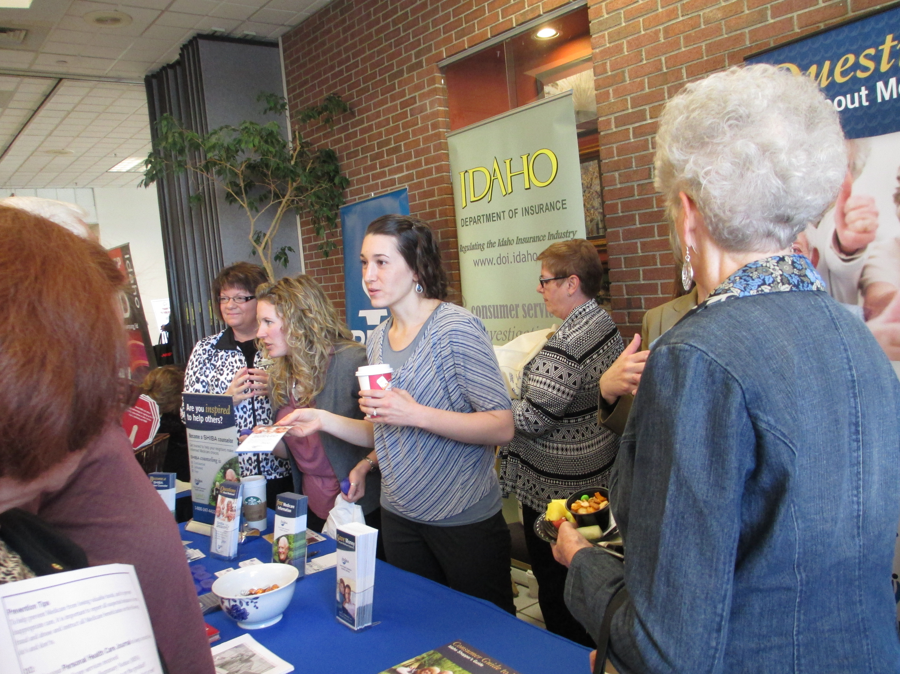
OUTREACH WORKERS
Oversee booths at health fairs and conferences
Distribute information throughout communities
Create and strengthen community relations
Make Medicare presentations
Conduct workshops

Slide 14
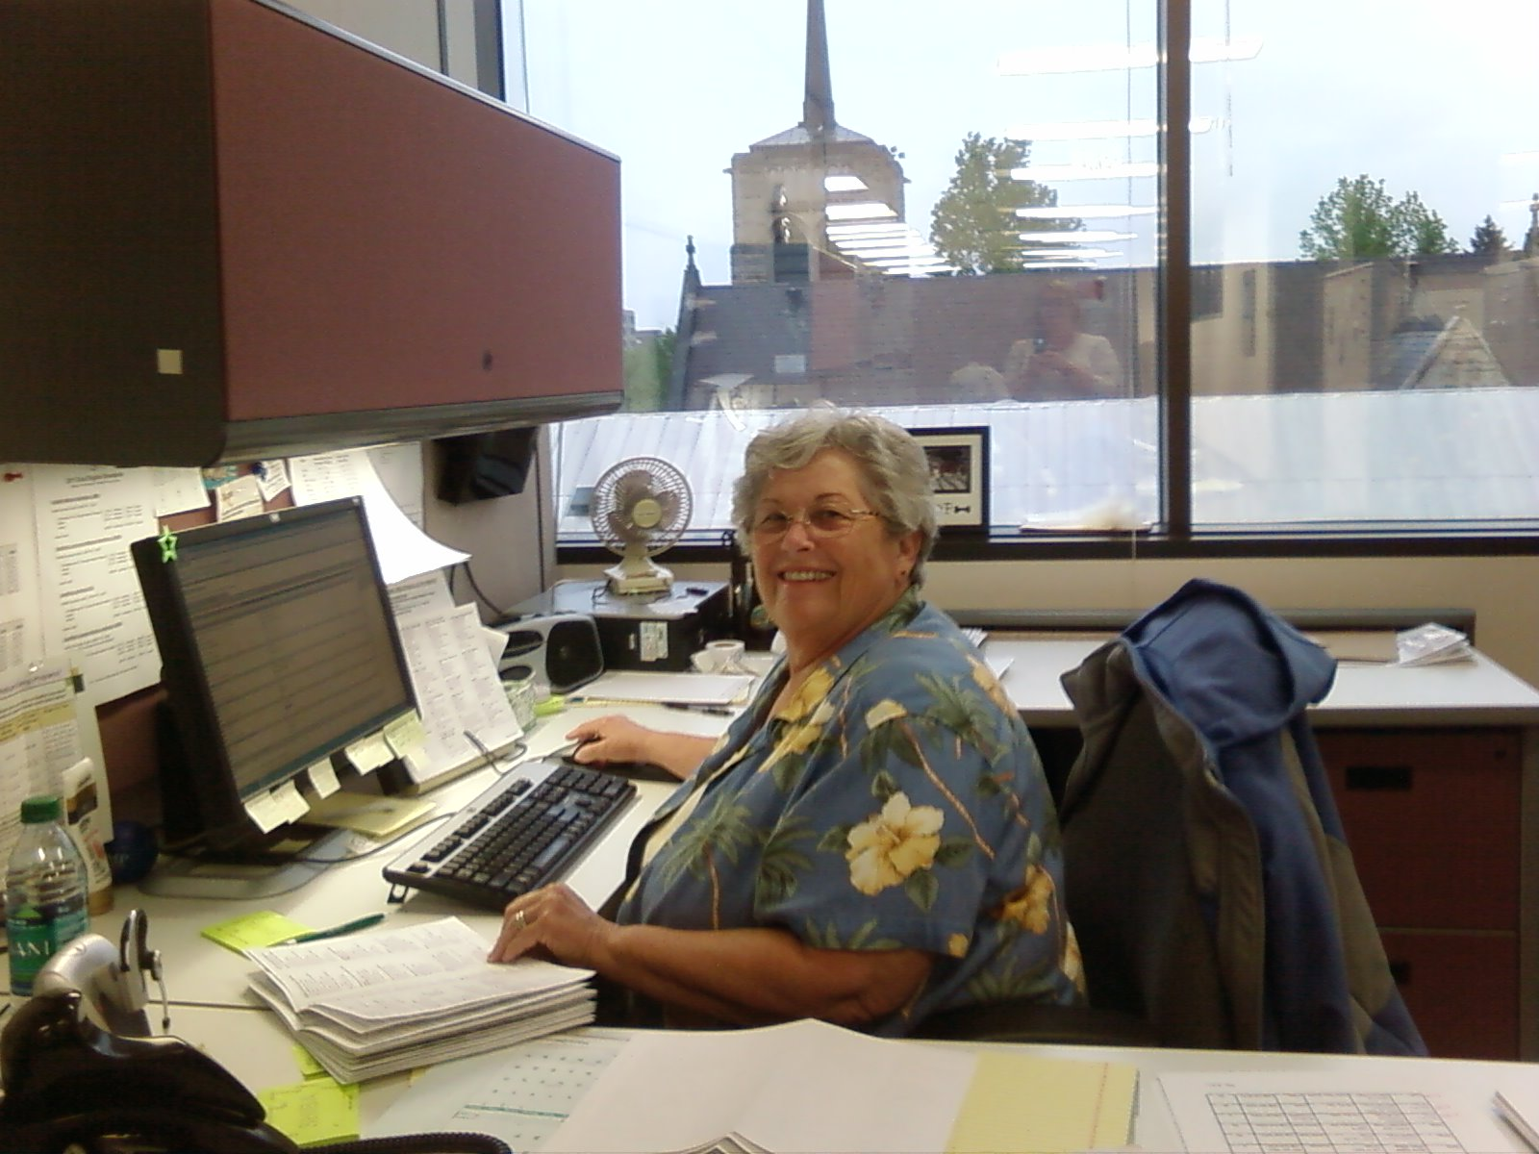
ADMINISTRATIVE VOLUNTEERS
Provide clerical assistance:
Assist with trainings and enrollment events
Assemble materials for distribution
Compile and report data
Answer phones

Slide 15
WHAT DOES SHIBA NOT DO?
We do not sell insurance.
We do not recommend companies or agents.
We do not recommend insurance plans.
We do not charge for service.

Slide 16
RESOURCES
Website: www.doi.idaho.gov/shiba/shibahealth.aspx
Email: idahoshiba@doi.idaho.gov
To Volunteer: www.doi.idaho.gov/shiba/Vol/login.aspx
800-247-4422
SHIBA toll-free number:

Slide 17
SHIBA
FREE, UNBIASED MEDICARE
INFORMATION FOR IDAHO

Slide 18
Scams: Are YOU At Risk?
Health
care
Scams
Lottery
Scams
IRS
Scams
Romance
Scams
Phone
Scams
Brought to you by Idaho Senior Medicare Patrol
Taenia Hudson, CSI Office on Aging
Notes:
Handouts to consider using with this presentation:
Senate Special Committee on Aging “Fighting Fraud” report
Maine SMP ”Be Scam Smart” flyer
“10 Things You Can Do to Avoid Fraud” brochure from the Federal Trade Commission
In 2015 the U.S. Senate Special Committee on Aging’s Fraud Hotline received more than 1,100 calls regarding a variety of fraud and scams. 189 of those calls came from Mainers, the largest percentage of calls from any state in the country. Since Maine ranks #1 as the oldest state in the nation, it’s important to educate seniors, their families, caregivers, friends and health care providers about the risks and how Mainers can be protected.
Some of the scams I’ll be talking about today have made the “Top 10 Scams List” according to a report issued by the Senate Committee on Aging: The IRS Impersonation Scam ranks #1; with Lottery Scams coming in at #2; Phone Scams are listed as #3, with Romance Scams listed as #9. We’ll also be discussing healthcare scams.

Slide 19
What the Scammer Does
Health
care
Scams
“Hello, Mrs. Smith…this is Ima Scammer from the Pills-a-Lot Medicare Plan. I’m calling to let you know that we have a one-time offer that could save you money on your prescription drug costs. If you can provide me with your Medicare number and your checking account number, you could start saving money today!”
Notes:
READ SLIDE
Although this scenario is a bit silly, the scam is not. Since 2006, when Medicare began providing prescription drug coverage, con artists have tried a variety of different scams to steal money from individuals, from Medicare and from other health insurance plans.

Slide 20
What the Scammer Does
Lottery
Scams
#2 Scam in U.S.
“Is this James Cohen? Mr. Cohen, I have great news…you’ve just won the Jamaican lottery! It’s worth $100,000,000 and to claim this prize, all you have to do is pay international taxes. If you can just provide your bank account information, we’ll deposit your winnings in your account today.”
Notes:
According to a report from the Senate Committee on Aging, Lottery Scams are the #2 scam in the United States.
READ SLIDE
In this context, it sounds “scammy”, doesn’t it? However, tens of thousands of seniors have fallen for this scam.

Slide 21
What the Scammer Does
IRS
Scams
#1 scam in U.S.
“Mrs. Jones, this is Special Agent Trustworthy from the Internal Revenue Service. Our records indicate that you currently owe $23,295 in back taxes and I have a warrant for your arrest. I’m calling today to inform you that unless you pay these taxes immediately, the police will be arresting you.”
Notes:
According to the report from the Senate Committee on Aging, the IRS Scam is ranked #1 scam in the United States today.
READ SLIDE

Slide 22
What the Scammer Does
Romance
Scams
#9 Scam in U.S.
“Hello, Henry – this is Rose. I saw your profile on the Date-a-Con-Artist website and you sound like the kind of man I’ve been looking for. I understand you’re widowed – me too. I’m so lonely, I can’t believe I found someone like you so quickly! I’d love to meet you in person, but since I live on a fixed income, I can’t afford to travel out-of- state.”
Notes:
READ SLIDE
Typically, scammers first connect with individuals online, either through a chatroom, dating site, social media site, or email. Con artists often call and chat on the phone to prove that they are real. These conversations can take place over weeks and even months as the con artists build trust with their victims. In some instances, con artists have even promised to marry their victims.

Slide 23
What the Scammer Does
Phone
Scams
#3 Scam in U.S.
“Hello, Mrs. White…I’m calling today with a one-time only offer for a great new product. You’ve been selected from thousands of Mainers to receive this special offer for our new and improved Best Water Filter Evah. This product is not yet in stores, which is why we can offer it to you today at a reduced price. You want your family to be drinking safe water, don’t you Mrs. White? Of course you do. It will just take a few minutes for me to get your information and your Best Water Filter Evah system will be on its way to you.”
Notes:
READ SLIDE
According to the Senate Committee on Aging report, phone scams rank #3 scam in the United States.
Scam artists prey on people’s vulnerabilities – who wouldn’t want their families drinking safe water?
These calls often include “spoofed” phone numbers, so Caller ID shows an in-state number or the name of a legitimate company.

Slide 24
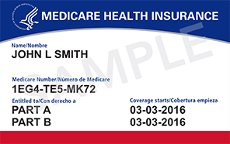
Update on New Medicare Cards
Why the new cards?
Your new Medicare card will NOT have your Social Security number. This will help protect your identity.
You will not see your new cards before April 2018.
You do not need to do anything! CMS will send you your new Medicare Card in the mail.
Your benefits will stay the same.
There is no charge for the new card. The card is free.

Slide 25
Be a savvy consumer…
Lottery
Scams
Hang up!
Contact Bank
IRS
Scams
Hang up!
Contact IRS
Romance
Scams
Run!
Contact
FTC
Phone
Scams
Hang Up! Don’t Answer!
Health Care
Scams
Hang up!
Check Statements
Notes:
Wrapping up: Be a savvy consumer to avoid becoming a victim of these scams.
Healthcare scams: Protect your Medicare and other health insurance numbers – just like your credit card number!
Lottery scams: Entering lotteries outside the U.S. is illegal. If you didn’t enter, you can’t win!
IRS scams: IRS Agents don’t call and threaten arrest!
Romance scams: Be careful about the personal information you share – and NEVER give money to someone you met online!
Phone scams: Use Caller ID to screen your calls. If in doubt, contact the legitimate company and ask if they called you!
HANDOUT: “Reporting 101” flyer, which provides contact info for reporting a variety of scams.

Slide 26
Office on Aging
Located on the csi twin falls campus
PO Box 1238
Twin Falls, Idaho 83303
208.736.2122

Slide 27
Office on Aging
Shawna Wasko, M.OLP
Public Information/Contracts Manager/Group Facilitator
Widowed Wellness Programs of Idaho, Inc. Caregiver Support Group Grandparents as Parents support group

Slide 28
Office on Aging
Our Goal:
Is to enable people to live in their own homes:
As long as they can
As comfortably as they can
As safely as they can.

Slide 29
Office on Aging
The csi office on aging provides
a wide range of services to
seniors aged 60 and older
and to family members of a senior citizen.

Slide 30
Office on Aging
The csi office on aging serves the eight
Counties of the magic valley:
Blaine, camas, cassia, gooding, Jerome,
Lincoln, minidoka, and twin falls

Slide 31
Office on Aging
Aging & Disability Resource Center
Helps people with questions about long term care. It helps identify needs; educate as to options & resources; empower them to make informed choices; & assist them to access desired resources

Slide 32
Office on Aging
Adult Protection Services
Are mandated by Law to investigate allegations of abuse, neglect, or exploitation of a vulnerable adult (18 or older, who is unable to make, implement, or communicate decisions due to mental/physical impairment).

Slide 33
Office on Aging
Adult Protection Services
What to report to adult protection (can be anonymous):
Physical/Mental Abuse: unexplained bruises, falls, scratches, lacerations, contusions, etc.
Neglect: Malnourishment, no food, no clothing, failure to obtain needed medical care, no heat, no running water.

Slide 34
Office on Aging
Adult Protection Services
What to report to adult protection:
Self-Neglect: Social isolation, no food, no heat, no running water, malnourishment, failure to obtain needed medical care
Exploitation: Unusual account activity, unpaid bills, inappropriate legal documents

Slide 35
Office on Aging
Information & Assistance
Is the gateway to senior services in the Magic Valley. They can help identify needs, & make referrals to resources and services to meet those needs.

Slide 36
Office on Aging
Ombudsman Program
Works to assist residents of long-term care facilities to protect their health, rights, safety, and welfare.

Slide 37
Office on Aging
Ombudsman Program
They investigate complaints in 55+ facilities, for seniors that involve accessing care, resident rights, facility or home-based care issues, Medicaid, Medicare, social security and other agencies

Slide 38
Office on Aging
Support Groups
Meet regularly for education, discussion & peer support.
Caregiver support group Grandparents as parents support groups widowed wellness programs of Idaho, Inc.

Slide 39
Office on Aging
Senior Corps programs
Retired & senior Volunteer program
Provides volunteer opportunities to people 55 years of age & older

Slide 40
Office on Aging
Senior Corps programs
Foster Grandparent program
Provides volunteer opportunities in educational and care oriented settings. They assist children to overcome learning challenges.

Slide 41
Office on Aging
Senior Corps programs
Senior Companion program
Offers one-on-one companionship between frail, elderly, & homebound individuals and senior volunteers. They help complete everyday tasks such as grocery shopping, bill paying, & transportation.

Slide 42
Office on Aging
Contracted services
Homemaker: assist with light housekeeping & general chores
Respite Care: offers caregivers a break with companionship, supervision, & assistance, with such tasks as bathing, dressing, & other care receiver needs.

Slide 43
Office on Aging
Contracted services
Transportation: services provide rides for seniors to senior centers, medical appointments, shopping and other locations.

Slide 44
Office on Aging
Contracted services
Senior Dining & Activities: are offered at 16 senior centers and 2 meal sites throughout the Magic Valley.

Slide 45
Office on Aging
Senior Centers
1 in 6 seniors in idaho struggle with Hunger
Congregate Meals: On track to serve 98,280 Meals in 2017
Home Delivered Meals: on track to serve 73,692 Meals in 2017
Live longer with less dementia

Slide 46
Office on Aging
Biggest Risk to Seniors:
Loneliness

