Slide 1
St. Luke’s Strategy 2020
Notes:
Mike

Slide 2
Rising Premiums Outpace Incomes
17% of Income
Premiums Growth
Per Capita Income
Notes:
Mike

Slide 3
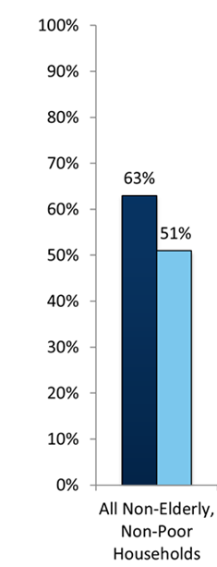
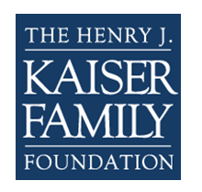
…and Deductibles are Unaffordable
For 40% - 50% of Idaho households, standard annual deductibles represent more than all of their liquid assets.
% Households Where
Total Liquid Financial Assets >
Health Insurance Deductibles
Notes:
Mike

Slide 4
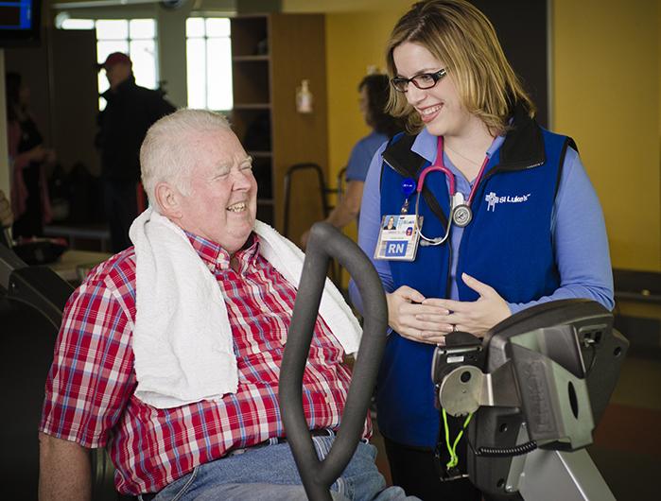
Population Health
Population Health
We are accountable for …
The healthcare outcomes and costs of caring for a defined population of people.
Notes:
Mike

Slide 5
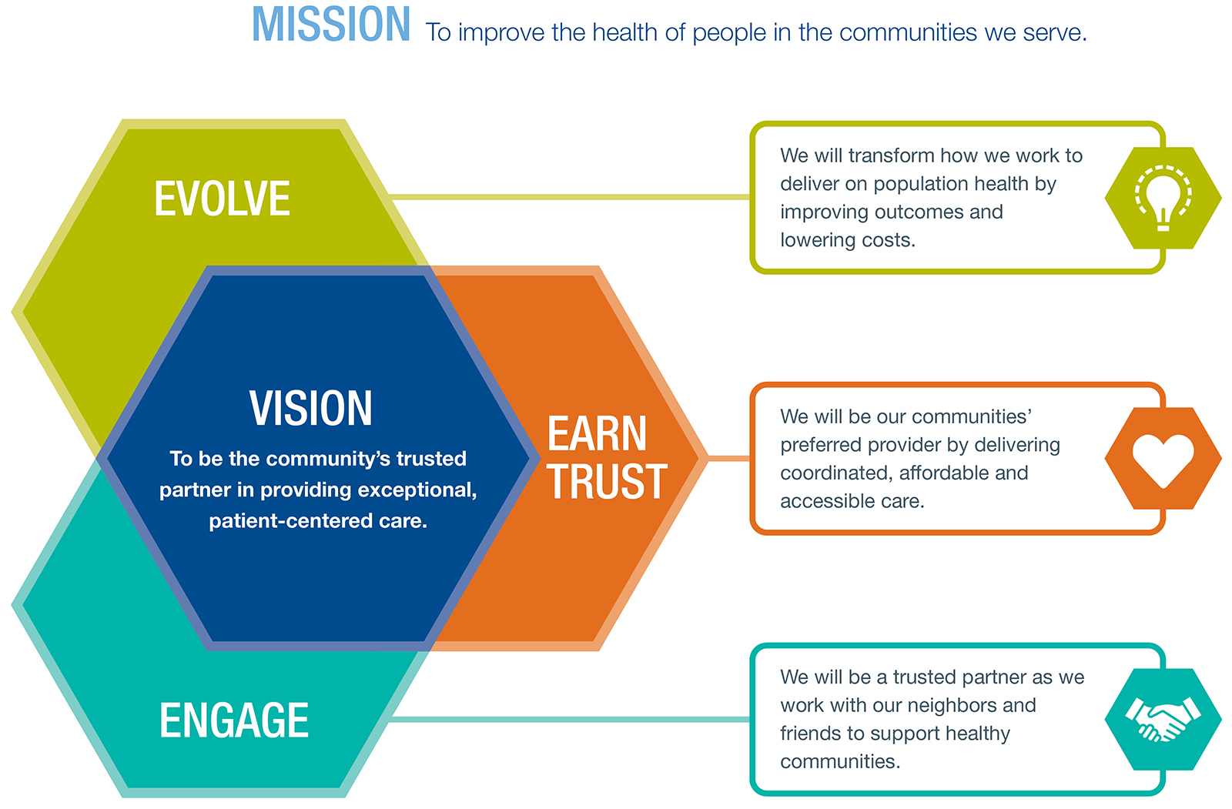
Strategy 2020
Notes:
Mike

Slide 6
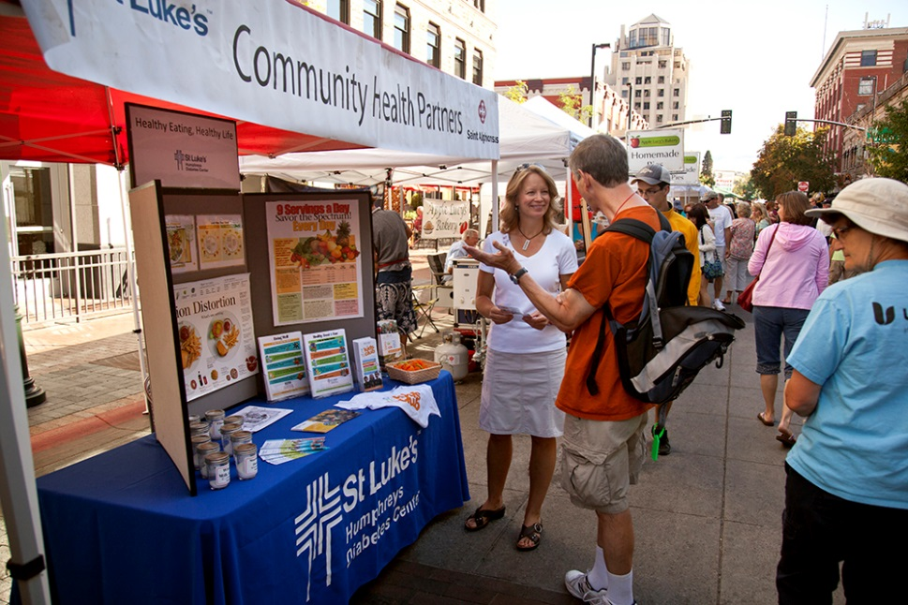
Community Health
Community Health
We are responsible ...
To contribute to the health of the communities we serve, in partnership with many others.
St. Luke’s does not ...
Have the resources or expertise to take accountability for a community’s health.
Notes:
Kyli

Slide 7
Community Health Mission
To be a trusted community partner in identifying, convening, promoting and/or deploying efficient and effective community health initiatives within the Magic Valley and surrounding communities.
Notes:
Kyli

Slide 8
Our Collaborative Framework
Foundation
Building
Prioritizing & Deploying
Assessment & Monitoring
Gap Analysis
Partner
Collective Impact
Evidence Based & Evidence Informed
Notes:
Kyli

Slide 9
Community Health Needs Assessment
Improve the Prevention & Management of Obesity & Diabetes
Improve Mental Health & Reduce Suicide
Improve Access to Affordable Health Insurance
Notes:
Kyli

Slide 10

Questions

Slide 11
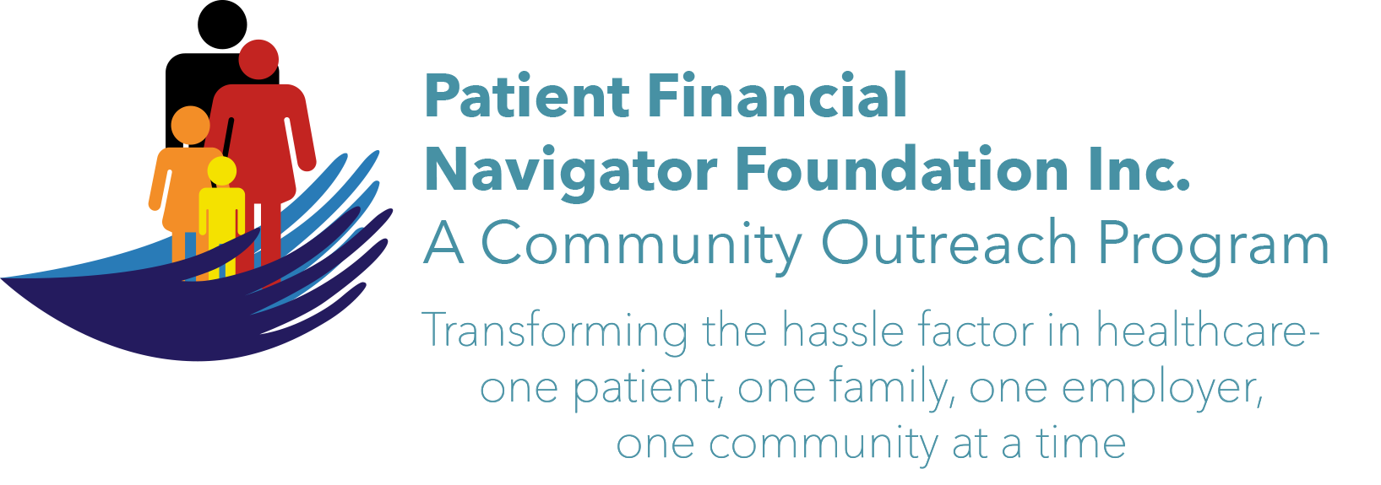
Welcome to the
Patient Financial
Navigator Foundation, Inc.

Slide 12
A Community Outreach Program
The Patient Financial Navigator Foundation, Inc with its home base in Twin Falls, Idaho, is thrilled to present free educational programs for patients to attack the hassle factor in healthcare…thru education.
Day Egusquiza, President, with over 37 years’ experience in healthcare including 20 years at an Idaho hospital, will guide the Patient Financial Navigator Foundation which will create a pathway for patients with multiple educational efforts – thru employers, payers, boot camps– while developing networks including a Resource Library with local hospitals to help navigate thru the maze called healthcare. Transforming healthcare one patient at a time. An advocate for all!
NO cost to the Employer for any employer programs.
NO cost to the community for any community programs.
NO cost to the community for the Boot camps

Slide 13
The Patient Challenges with HealthCare
No one ‘asks’ to come to a hospital.
Patient’s lives are impacted – they are scared, they feel out of control, they are lost with the overwhelming factors of cost/unknown, multiple providers, and continuing frustration with ‘who knows all of this?”
Patients are unaware of the many changes with their insurance, government programs, employer’s coverage and all the ‘rules’ associated with getting services paid.
Patients historically access hospitals once a year or less. Healthcare is very personal!

Slide 14
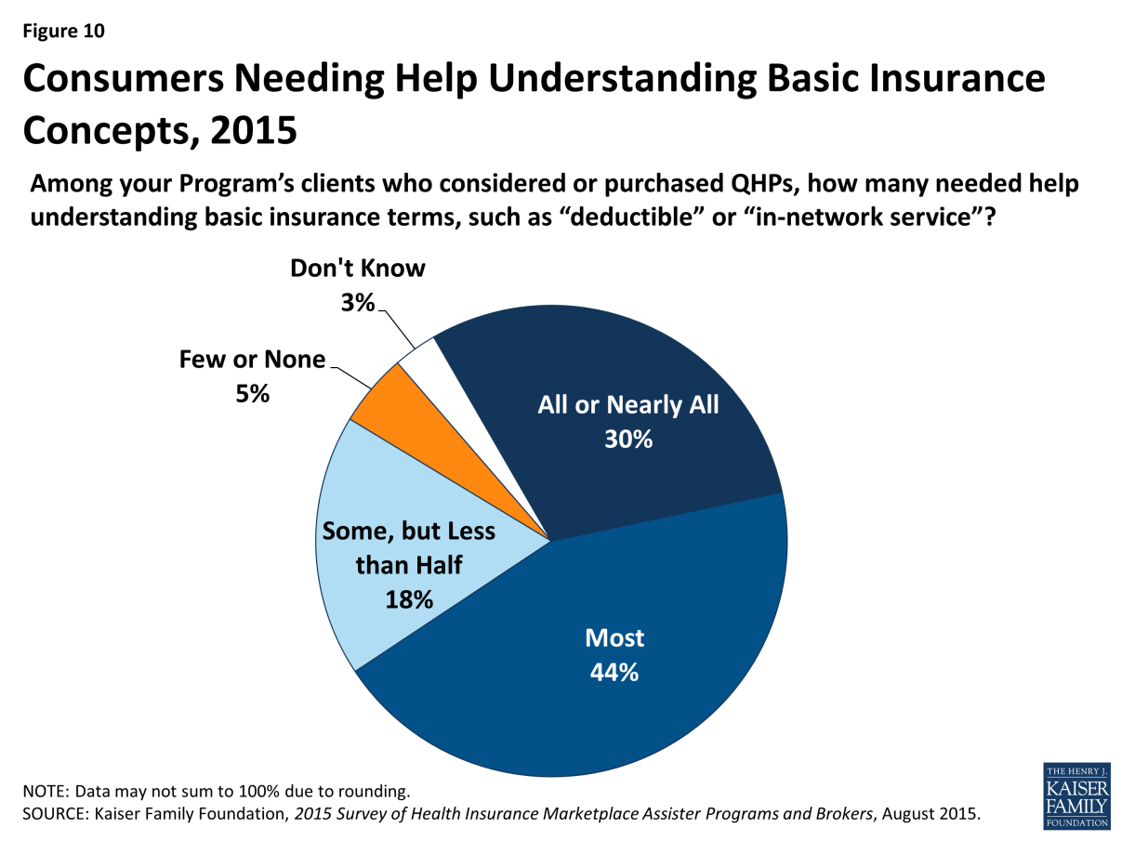
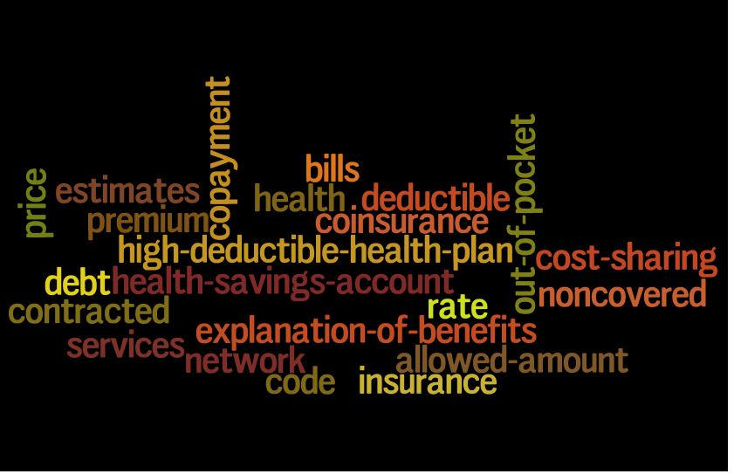
But Patients Don’t Speak the Language of Health Insurance Today…

Slide 15
…and They May Not Identify with the Language of Value-Based Care Tomorrow
We say… | Consumers said…
Medical home | “It sounds just like a nursing home.” “First you go to the medical home, then you go to the funeral home.”
Integrated care | “It sounds like a sales pitch in a cheap brochure.”
Accountable | “It’s kind of scary. I am going to go there and something bad is going to happen and someone has to be held accountable for it.”
Value | “It means things are cost effective. They are going to keep the value down. You aren’t getting the best care.”
Source: M. Ross, T. Igus, and S. Gomez, “From Our Lips to Whose Ears? Consumer
Reaction to Our Current Health Care Dialect.” The Permanente Journal.
Winter 2009, Vol. 13, No. 1. http://www.thepermanentejournal.org/files/Winter2009/dialect.pdf

Slide 16
Additional ‘factors’ influencing the patient experience= confused=hassle factor
Electronic medical record /EHR – incentive and penalties
Integrated systems between providers/doctors and hospitals but safety with data sharing a concern. *Ransomware*
Quality reporting systems –with rewards and penalties
Insurance plans who ‘control approval’ for physician-directed care.
Alternative payment systems for hospitals, doctors, long term care, DME , home health – all in the midst of rolling out with the goal of increased quality, reduced costs and more engaged patients.
New terms from the healthcare providers:
  Population health Patient Centered Care Quest for Quality
  Quality over quantity

Slide 17
Take the Hassle Out of the Experience
Improve the experience
Hassle Map: Elective Surgery for an Insured Patients- who knows to do this?
Get a referral to a surgeon
Find out if the surgeon, anesthesiologist, pathologist, and radiologist are in your network
Find out if the hospital is in your network
Find out how much the operation will cost you out-of-pocket (or hold your breath until the bill comes)
Figure out where your out-of-pocket costs for pre-op tests will be lowest (or don’t think about this until you get the bill)
Call to get a preauthorization from your health plan (or realize later that you forgot)
Worry about whether you will have to pay anything in advance, and if so, how much
Have the surgery
Spend a month dreading getting the final bill in the mail
Source: Based on the hassle-map construct developed by Slywotzky (2011).

Slide 18
Healthcare is personal.
Healthcare is local… but…
Healthcare can be complex and too complicated
WHY? Every insurance has their own rules for coverage.
WHY? Physician directed care may not be insurance approved.
WHY? Frustration in ‘thinking there is coverage in my plan’ only to be denied as ‘not medically necessary.’
WHY? Charges and actual payment do not align.
WHY? Itemized statements from providers are confusing
WHY? Changing employer plans are adding new items – like Health Savings Accounts –with limited understanding by the employers. +++++++

Slide 19
Why create the Patient Financial Navigator Foundation, Inc?
No one really understands their healthcare insurance until they need it.
No one realizes the ‘next steps’ once the medical incident has occurred/been ordered.
When a family is in a healthcare crisis, their life is disrupted, scared and vulnerable - coordination/communication is required to reduce the hassle factor.
THE FOUNDATION IS AN INNOVATION LAB – finding new ways to transform today’s chaos.

Slide 20
What is the PFNF, Inc
A not-for-profit Foundation with the focus on transforming the hassle factor …thru Education. Answers: What happens now—beyond the clinical care?
Three legs of the Foundation’s Outreach Mission:
  Community Outreach – Boot Camps
  Employer Outreach – Lunch and Learn for employees
  Navigator Resource Library- personal pt/family
  As significant healthcare changes occur along with ongoing ‘Healthcare buzz’ updates in local newspaper.

Slide 21
Three components of this dynamic program- A community outreach program
Employer program
Navigator Resource library * located at local hospital
Lunch & Learn-onsite education with employers
HealthCare Buzz
Q&A –as requested by the site
EOB – how to read
New healthcare changes-national and local
Medicare & ME
Traditional vs Mgd
Translating ‘ease’
What to expect when??
General Education
Networking with existing services
Employer specific guides
How to appeal?
Build historical info
Community programs
Networking with existing services
Creating unique trainings
Identify community healthcare legislative changes -educate
Turning 65 Bootcamp
National ‘new terms:- HSA, ACO, Quality based, Managed, Medicare, etc.
HealthCare Buzz

Slide 22

1st) Example of Community Outreach Education – Boot Camps
Identify community leaders to participate in the boot camp trainings
Identify thru existing community services, additional healthcare related ‘hassle factor’ training.
Provide education to high schools, colleges, regional and others as requested.
Join with existing educational groups to add the financial ‘translation’ for ease of understanding ‘what happens now.”
Innovation lab – creating community specific ed.

Slide 23
2018 Projected Community Outreach Education
BEGIN OUTREACH TO HIGH SCHOOL SENIORS AND COLLEGE STUDENTS/MEDICAL FIELD
Dec-ish/2017 Begin outreach to area High Schools & College
“Insurance 101” - taught to seniors & college students to prepare them to become young, informed adults
May 19, 2018 Community Boot camp – “The Language of Insurance” Tying to the Sr education, national focus, local /state changes
CONTINUE 2X A YEAR MEDICARE FOCUSED BOOT CAMPS
Feb 2, 2018 Community Boot Camp- “Medicare 101, Social Security Administration, and Assistance for Seniors.” ++ “Turning 65”

Slide 24
Trusted HealthCare Educator
Participate:
Office on Aging events
Wellness Fairs **Oct 7th, CSI**
Population Health dialogue/changes = ‘translator’
New transformations in healthcare
Employer work place insurance initiatives
Next generation of healthcare –with partners
School outreach – high school, colleges
Professional associations
As requested

Slide 25

2nd) Example of Employer-Specific “Lunch & Learn”
Meet with the HR staff to learn about the employer’s insurance plan.
Outline the key elements for education to be covered during the 30 min employee ‘Lunch and Learn.’
Hot spots for education (usually): EOB education, out of network, what happens when you are scheduled for a surgery and ‘HealthCare Buzz’ ++ Q&A.
Innovation lab – taking the education to the employer.

Slide 26
So now you need healthcare – Outpt surgery (Sample) – in network
Surgeon’s office will contact your insurance carrier to get the surgery pre-authorized. Insurance carrier has their own criteria for medically necessary services. Many times requires ‘negotiation’ with provider and payer.
Routine bills for an outpt surgery- usually each sent separately:
Surgeon Anesthesiologist
Pre-op testing Procedure location (Hospital, free standing ctr)
IMPORTANT: Validate all of the above are within the network that is part of Cigna’s plan. IN NETWORK

Slide 30
Think like a pt – out of network
(means what to the pt or family?)
40 year old has had emergency foot /ankle surgery approx 8 years ago and taken to a Boise hospital. The surgeon specialized in this type of foot surgery. Both in network at that time.
3 surgeries later –still problems with rebuilding the foot to allow the pt to walk.
July 2013, employer changes plans and now the doctor and hospital who employees the doctor is out of network.
The pt continues to go to the surgeon who does another surgery Oct 2014 and a follow up minor surgery in 2015. Pt was aware of the change but did not know to do anything different as he was in continuing care.
Insurance pays significantly lower – no adjustment from charges as out of network/no contract. Pt pays all charges except actual payment to doctors, hospitals, tests. Huge financial hit.
What does the employee or pt know of the a) ramifications of out of network, b) prior notice to get approved and c) appeal rights?

Slide 31
Let’s look at out of network- Surgery done at out of network hospital
Surgery done at an out of network hospital.
Billed charges: $8000
Out of network deductible applied: $2000 individual
Hospital bills Cigna; Cigna pays ‘reasonable amt’ that would be paid to IN network providers.
Amt eligible for payment from Cigna: $4400
LESS $2000 out of network deductible
LESS 50% out of network coinsurance after deductible: $2400 x 50% = $1200
TOTAL AMT PD BY CIGNA:
$4400-$2000 ded- $1200 coins = $1200paid to out of network provider/hospital.
But the hospital is NOT contracted. Therefore, the hospital accepted the $4400 but left due on the account for the pt to pay:
$8000 – $1200 = $6800 from pt.
**Out of network deductible: $2000 (Separate from any in network deductible)
**PLUS 50% copayment: $1200
**PLUS balance billing due to no contract: $8000 - $4400 =$3600
TOTAL DUE FROM PT: $6800

Slide 32
Examples from actual employer “Lunch and Learn”
Denials
EX) Colonoscopy is part of the wellness package from the insurance.
However, if anesthesia was used-which is very common- there is inconsistency with coverage.
Denied conscious sedation for 1 employee, approved it for another.
Employee handbook does not speak to ‘anesthesia.’
Family member situations
EX) Mother is in CA and part of Medicare Gold. (A Part C/Medicare Advantage program= separate from traditional Medicare.)
She had an unfortunate health situation, made worse by mis-information from the Medicare Advantage plan.
Readmitted with deteriorating health.
EX) College students

Slide 33
Employer Insurance Costs/Changes
Healthcare spending 2015-16
Spending averaged $5141 per individual.
Out of pocket rose 3% to aver $813 per capita
Prescription drugs increased 3.5-9%
Women of all ages spent $236 more out of pocket than men.
$649 per capita was spent on brand prescriptions.
The price of an ER visit jumped 10.5% to an aver of $1,863
Employers contribute about 73% toward the monthly premium for individuals. 38% for dependents. *MCOL 3-17
Average Health Savings Account balance for 2015 = $1844 (Can have up to $3400/single; $6750/family)
Average contribution by individuals = $1864
Average employer contributions =$948
Average high deductible plan: $2600-13,100 /family; $1300-6550 /single
Benefit: Amt deferred for tax impact.
Con: Family would have to pay premiums, deductible $, co-insurance $ AND have enough left to put money in the HSA.

Slide 34
Ongoing Education – thru “HealthCare Buzz” articles
Times News /local bi-monthly educational articles
All articles are available on our webpage:
  What does out of network look like?
  What is a portal and why do I care?
  Turning 65: Initial wellness visit
  Turning 65: How does a Medicare inpt actually pay?
  Turning 65: What is a Medicare Supplemental Insurance plan?
  Turning 65: What are the Medicare options? **
  Turning 65: When is Medicare a 2nd payer? **
  Leading to : Oct 28th - “Turning 65 Boot Camp”

Slide 35
More updates – Healthcare Buzz
‘Roughly 95M working Americans under age 65, along with 5.2M of their family members gained health insurance coverage from 2010-2015 under the ACA. They represent 77% of all of these who gained coverage in first 6 yrs.”
Robert Wood Johnson/8-17
9.2% of adults were covered by Medicaid.
43.8% of adults were insured thru an employer.
3.5M more Hispanic adults had health insurance in 2015 vs 2013.
2M more black adults had health insurance 2015vs 2013.
The uninsured rate for 2nd Q 2017 was 14.2%.
Well Being Index.

Slide 36
Health Care Buzz (Ex)
55% of Americans are paying more than last year for insurance.
1 of 4 Americans health worsened after delaying care because of cost concerns
30% said their health insurance coverage has gotten worse in the past year.
1 in 4 lost access to their doctors last year due to insurance networks. (out of network huge costs!!)
3 in 10 delayed emergency care in the last year out of fear of costs
DailyFactoid / MCOL 10-16
Morning consult
Biggest changes Doctor’s expect to result from Millennial patient habits in coming years.
Increased use of telemedicine (28%)
Proliferation of walk-in clinic settings (27%)
Growth in online scheduling and extended hrs (24%)
Greater transparency for out of pocket costs (11%)
Easily portable electronic health records (10%)
Sprocket Rocket 12-6-16
“Millennial patients challenging status quo, over 2900 US doctors say.”

Slide 37
Included in Every Event/Training- “HealthCare Buzz”
Factoid: Health Exec Mobile Mon, March 27, 2017
“Although only 4% of all doctors are emergency physicians, they provide care for:
28% of all acute care visits
50% of all Medicaid and CHIP (children) visits
67% of all acute care to the uninsured patients.
Healthcare Bulletin. The Slate Group. March 30, 2017
“An annual health survey conducted by states and Medicare/CMS found that the full ACA reduced the uninsured rate by 44% while also reducing the number of people without a primary care doctor by 12% and those not having an annual check up by 10%.”

Slide 38
Humana’s – Bold Goals program
Major % of market is Seniors- Part C Medicare* (HEALTHCARE BUZZ EX)
65% of Seniors have multiple chronic conditions
1/3 have diabetes
1/4 have mental health
10% live below the poverty level
6 doctor visits yearly
27 prescriptions yearly
High cost to the healthcare system for ‘navigating thru’ alone. Social-economic issues.
EX) Depressed? Not taking chronic meds.
EX) Can’t afford meds = ED is next. (Medicaid?)
*Population Health Colloquium. March 27, 2017 Philadelphia

Slide 39
Employment “Norms” in Huge Flux
AARP & MIT Agelab (Population Health 3/17)
By 2020: 1 in 5 students will be 35 yrs or older.
By 2020: 10,000 will be turning 65 every day
By 2020: 1 out of every 5 adults will be over 65; more than under 5 yrs.
57 year old's are the primary owner of IPad.
50% of over 60 year old's use the internet
Over 50 years of age = 1/3 of the work force.
Family Care Giver: 42 M adults , age 45-64, providing care for older family/parents. 17%/ 24 M are providing in addition to their ‘day job.’
Multi-generations in the work force.
Norm: 3-4 generations. (BB and Millennials = both approach ‘work’ differently.)
HealthExecMobile -Multiples
18.4% of US adults had a mental illness in the past year.
8.6% reported substance abuse/dependence in the past year
Almost 40% had at least one chronic medical condition during their lifetimes
1.2% had all three conditions: mental illness, substance abuse/dependence and at least one chronic medical condition.
AND more than 50% of Americans now have at least ONE chronic health condition, mental disorder or substance use issue. (Taylor & Francis group news – “Psychology, Health, and Medicine” Oct 2016.)
Employees/Pts look different – ages (3-17)
Baby Boomers 51-69 74.9 M
Generation X 35-50 74.2 M – to Surpass BB by2028
Millennials 18-24 75.4 M – HAVE surpassed BB

Slide 40
Plus more working past 65…
“More Americans age 65 & over are still punching the clock and the last time the percentage was this high was when John F Kennedy was in the White House, 1962. “
“Last month, 19% of Americans age 65 and over were still working, according to government data released Fri. That’s the highest rate since, 1962 and it caps a long trend higher since the figure bottomed out at 10% in 1985.”
Why? Some work to feel engaged. Others do not have enough money to retire. Employee Benefit Institute survey: Nearly 1/3 of all workers with less then $10,000 in savings will work until 70. *Associated Press 5-7-17
Medicare Secondary Payer
Older workers care giving for other adults
PS By 2020 – 10,000 people will be turning 65 daily! WOW!

Slide 41

3rd) Examples from the Hospital Navigator Resource Library
Thru employer specific meetings, build data base of insurance plans, how to read the EOB, deductibles, etc.
1 on 1 intervention with the patient/family – complete work paper
Create glossary of terms
Create reference guide for additional community resources
Create networking ‘handoffs’ with existing hospital team - payment options, social work, estimates, patient experience, physician offices, others
Innovation Lab: After Hours Q&A – Weds 5:00 -6:00 p.m.; using patient portal; tracking and trending improvements/feedback; integration with medical community; face to face and automation.

Slide 42
Think like the family who is scared with a new ER visit w/insurance, employer specific—WHAT HAPPENS NEXT!
Daughter has just been admitted thru the ER. (Inpt vs obs means what to the pt?)
Parents are scared and distraught about the health of their daughter with the unplanned ‘admit.’
As comforting as the care givers are, the financial questions loom large. What happens now?
Who has insurance? What was done with the insurance? What is my coverage? “I have never had to use it before, so I don’t know anything! “
Think Pt Financial Navigator Program referral

Slide 43
Think like a patient – Medicare Part C/Managed Care – comes to the ER
WHAT HAPPENS NEXT?
86 year old with Humana. What is done in the ER to inform the pt this is not traditional Medicare?
If the pt is ‘admitting/obs or inpt” – what happens so the pt understands the difference between Traditional Medicare and Part C/Mgd Medicare?
Now they are in a bed, what happens so the 86 year old understands their out of pocket, what coverage there is with Humana that may be different than Traditional, is this obs or inpt? Who has this information for our sick, confused Sr who does not have anyone to ask?
Care givers/family – who do they ask about the above?
Think Pt Financial Navigator Program referral

Slide 44
And now we have Ongoing Healthcare Discussions
Sept 2017
“Medicare for all” – Bernie Sanders
Elements:
  All citizens are covered thru tax program
  No premiums
  Healthcare is a right, not a privilege
  Repeal and Replace ACA – Still unresolved in DC

Slide 45

Healthcare Buzz – NATIONAL FOCUS
17 million Americans have at least 1 chronic disease. 86% of healthcare spending in the US goes to treat chronic diseases.
Outpt depression cases rose from 3,578,847 in 2013 to 4,045,879
Managed Care Digest June 2017
6.3 million with Pre-Existing Conditions could face higher premiums.
25% of adult enrollees in the 2015 individual market had a pre-existing condition.
Kaiser Family Foundation
***Essential benefits *** part of the ACA require all plans to offer essential benefits – mental health, maternity, and protect against pre-existing exclusions or massive rate increases.
***Senate proposed plan**** No required coverage for employers or individuals…no essential benefit requirements

Slide 46
A Kaiser Family Foundation analysis of insurer rate filings and news report found that, in 2017 – 8.7 million people (84% of all marketplace enrollees) received tax credits to cover a share of their premiums and 5.9 m (57% of all enrollees) received cost sharing reductions. It also shows that 38 counties and 25,133 enrollees risk having NO insurer in the marketplace in 2018.
Exchange premiums increased 105% from 2013-17. The average 2013 monthly premium in 39 states was $232. 62% of those same states saw premiums double in 2017. Lowest premium: NJ $12%. Highest : AL at 222%
All states have at least 1 insurance carrier offering coverage thru the
Exchange/Open Market. 2017
CLARIFICATION: Currently, market place is used for individual coverage, small employers’ employees/less 50 employees, early retirees/prior to 65 /Medicare..

Slide 47
Medicaid
Medicaid covered 45% of children in Rural areas 2015. 38% in metropolitan areas.
Uninsured children declined in rural areas in 43 of 46 states. National rate fell 3%. 30 states expanded Medicaid.
Medicaid provides coverage to more than 4.6M low-income SENIORS, nearly all of whom are also enrolled in Medicare. (MM)
Provides 3.7M people with disabilities who are enrolled in Medicare. (MM)
Different programs for low income Srs – but it is income based. EX) Qualified Medicare Beneficary/QMB $1025/individual $1374 couple.
Medicaid.gov

Slide 48
Highlights of Changes from ACA **Mandates impacted employers with more than 50 employees**
Allows children to stay on plan until 26
State and Federal share costs of providing healthcare to low income children & adults ; disabled children and adults; with expansion – income based
Protection from massive rate increase for pre-existing or no coverage.
Older Americans – 3x higher premiums than younger
Tax set up to pay the insurance companies for their reduction in premiums/subsidizing
No change
Complex formula for funding with focus moving to States to fund and oversee.- MEDICAID
Break in service or change of jobs = risk for pre-existing exclusion or premiums
5x higher premiums
No mechanism to pay for these
ACA/Obamacare
American Healthcare Act/Trumpcare

Slide 49
More Comparisons.. ACA VS AHC
Tax penalty for no health insurance.
Essential benefits have to be offered in ALL plans
No lifetime or annual limits on coverage
Cannot charge women more than men for same health plan.
Planned Parenthood federal funding for family planning, cancer screening, STD testing, contraception. NO federal funds for abortion.
Tax medical devices & insurance companies = new customers.
No penalty; no requirement to have insurance. But if no continuous coverage, have to wait 6 mons before purchasing.
Scale back on conditions that insurance has to cover. Insurers could now reimpose annual and lifetime limits on some coverage.
Same – but insurers can waive maternity and contraceptives
Nearly 80% of PP patients have incomes at or below 150% of poverty level. **TOTALLY DEFUND PP.**
Medical device makers, insurance companies and wealthy Americans would receive a BIG tax-cut as no taxes on Insurance companies or Medical devices…

Slide 50
Comments from BCBS & America’s Health Insurance Plans 7-17
Sent a strongly worded letter expressing opposition to a GOP controversial conservative repeal plan to ACA.
Warned that the provision by Sen Cruz would mean ‘premiums would sky rock for people with pre-existing conditions’ and ‘millions of more individuals will become uninsured.’
Conservatives argue this move will allow younger, healthier people to buy cheaper plans.
Warns that sicker people would remain in the more expensive, more generous ACA plans – leading to premium SPIKES for pre-existing conditions.
SKINNY PLANS = only cover wellness. No doctor visits, hospital care, etc. with very low premiums accompanied by a five-figure deductible. Thus, junk insurance.
The Hill & NY Times

Slide 51
Small employers – under 50 employees up to 200 …
Census Bureau’s statistics of US Business 2012
Employer firms with fewer than 500 workers employed 48.5% of private sector payrolls in 2011
And Employer firms with fewer than 100 workers employed 34.4% of private sector payrolls
And Employer firms with less than 20 workers employed 17.5% of private sector payrolls.
“American Business is Overwhelming Small Business” 2012 Census Bureau
5.73M employer firms in the US firms with fewer than 500 workers accounted for 99.7% of those businesses
And businesses with less than 20 workers made up 89%.
Add in the number of non-employer businesses – there are 23M in 2013 – then the share of businesses with less than 20 workers increase to 97.9%

Slide 52
Making it real – Small Employer Premium “Hits”
Small employer in Idaho
Premiums have had 23-25% increase each year/3 years.
Currently for 2 employees: *Exchange was not cheaper/similar*
  $1200 monthly premiums
  High deductible per person: $7000
  70/30 coinsurance
  “Age “ rated … 60 year old
  Annual $14,400 in premiums !! UNSUSTAINABLE
  This was before the new GOP plan for up to 5x higher than younger premiums. It is capped at 3x under ACA.

Slide 53
Moving Forward…
Create a work group to aggressive address small employer insurance challenges in Idaho
  Ask Insurance plans to present methodology for determining rates. Actuary and risk
  Invite Mountain Health Co-Op – present how they created a co-op. Current status in Idaho
  Explore Nebraska’s Concierge concepts –another option
  Discuss current options and challenges with small employers in Idaho
  What is available now? What could be done working with local insurance plans? If anything..
  Report in 6 months at the next “Healthcare Education Day”

Slide 54
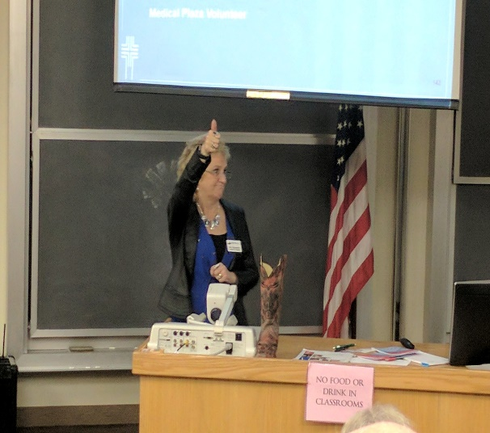
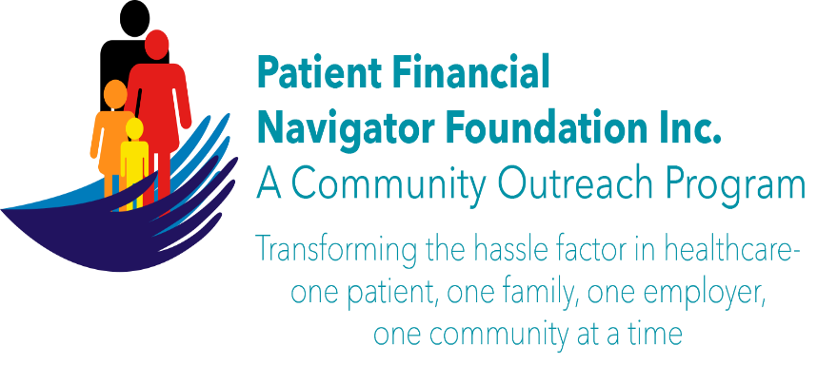
It is all doable..
Have the vision and the passion to make a difference in the hassle factor in healthcare
Remember – all the automation does not replace the human touch.
Remember – our families are the core of healthcare.
It is very personal!
Thanks, Day Egusquiza
Founder/President
Webpage: Http://PFNFInc.com
Like us on Facebook.com/PFNFInc

